Slide 1
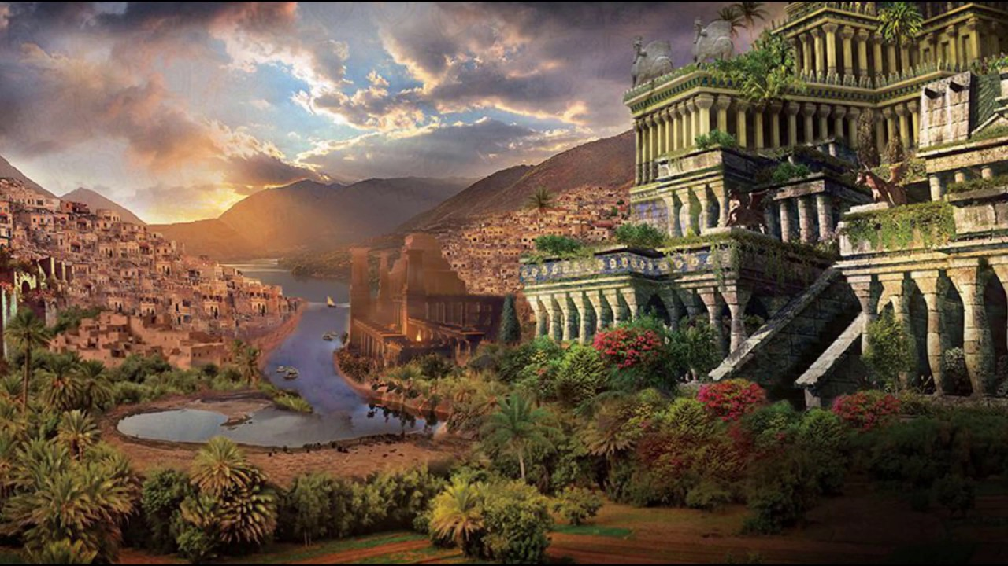
The Richest Man in Babylon

Slide 2
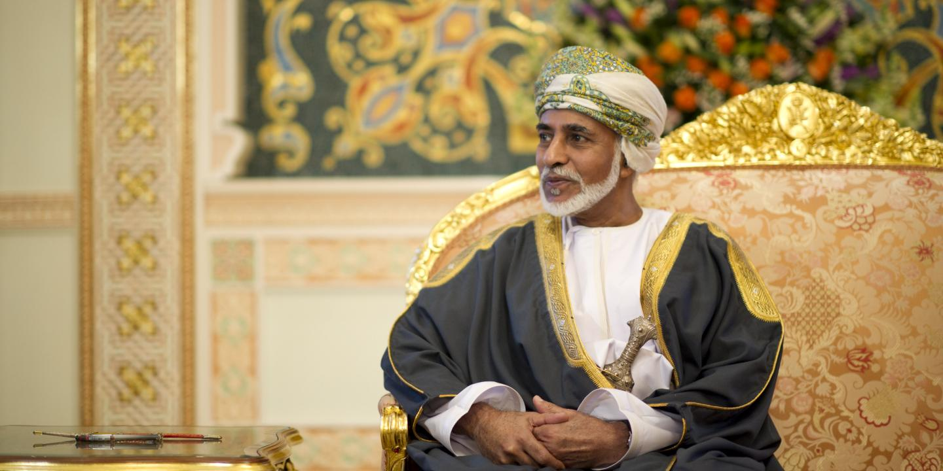
The Richest Man in Babylon
In old Babylon there once lived a certain very rich man named Arkad. Far and wide he was famed for his great wealth. Also was be famed for his liberality. He was generous in his charities. He was generous with his family. He was liberal in his own expenses. But nevertheless each year his wealth increased more rapidly than he spent it.

Slide 3
The Richest Man in Babylon
And there were certain friends of younger days who came to him and said:
"You, Arkad, are more fortunate than we. You have become the richest man in all Babylon while we struggle for existence. You can wear the finest garments and you can enjoy the rarest foods, while we must be content if we can clothe our families in raiment that is presentable and feed them as best we can.
"Yet, once we were equal. We studied under the same master. We played in the same games. And in neither the studies nor the games did you outshine us. And in the years since, you have been no more an honorable citizen than we.

Slide 4
The Richest Man in Babylon
"Nor have you worked harder or more faithfully, insofar as we can judge. Why, then, should a fickle fate single you out to enjoy all the good things of life and ignore us who are equally deserving?“
Thereupon Arkad remonstrated with them, saying, "If you have not acquired more than a bare existence in the years since we were youths, it is because you either have failed to learn the laws that govern the building of wealth, or else you do not observe them.

Slide 5
The Richest Man in Babylon
“Fickle Fate' is a vicious goddess who brings no permanent good to anyone. On the contrary, she brings ruin to almost every man upon whom she showers unearned gold. She makes wanton spenders, who soon dissipate all they receive and are left beset by overwhelming appetites and desires they have not the ability to gratify. Yet others whom she favors become misers and hoard their wealth, fearing to spend what they have, knowing they do not possess the ability to replace it. They further are beset by fear of robbers and doom themselves to lives of emptiness and secret misery. "Others there probably are, who can take unearned gold and add to it and continue to be happy and contented citizens. But so few are they, I know of them but by hearsay. Think you of the men who have inherited sudden wealth, and see if these things are not so.

Slide 6
The Richest Man in Babylon
"His friends admitted that of the men they knew who had inherited wealth these words were true, and they besought him to explain to them how he had become possessed of so much prosperity, so he continued: "In my youth I looked about me and saw all the good things there were to bring happiness and contentment.
And I realized that wealth increased the potency of all these.
"Wealth is a power. With wealth many things are possible.
"One may ornament the home with the richest of furnishings.
"One may sail the distant seas.”

Slide 7
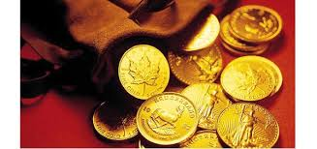
The Richest Man in Babylon
"One may feast on the delicacies of far lands.
"One may buy the ornaments of the gold worker and the stone polisher.
"One may even build mighty temples for the Gods.
"One may do all these things and many others in which there is delight for the senses and gratification for the soul.

Slide 8
The Richest Man in Babylon
"And, when I realized all this, I decided to myself that I would claim my share of the good things of life. I would not be one of those who stand afar off, enviously watching others enjoy. I would not be content to clothe myself in the cheapest raiment that looked respectable. I would not be satisfied with the lot of a poor man. On the contrary, I would make myself a guest at this banquet of good things.
"Being, as you know, the son of a humble merchant, one of a large family with no hope of an inheritance, and not being endowed, as you have so frankly said, with superior powers or wisdom, I decided that if I was to achieve what I desired, time and study would be required.

Slide 9
The Richest Man in Babylon
"As for time, all men have it in abundance. You, each of you, have let slip by sufficient time to have made yourselves wealthy.
Yet, you admit; you have nothing to show except your good families, of which you can be justly proud.
"As for study, did not our wise teacher teach us that learning was of two kinds: the one kind being the things we learned and knew, and the other being the training that taught us how to find out what we did not know?

Slide 10
The Richest Man in Babylon
"Therefore did I decide to find out how one might accumulate wealth, and when I had found out, to make this my task and do it well. For, is it not wise that we should enjoy while we dwell in the brightness of the sunshine, for sorrows enough shall descend upon us when we depart for the darkness of the world of spirit?
"I found employment as a scribe in the hall of records, and long hours each day I labored upon the clay tablets. Week after week, and month after month, I labored, yet for my 24earnings I had naught to show. Food and clothing and penance to the gods, and other things of which I could remember not what, absorbed all my earnings. But my determination did not leave me.

Slide 11
The Richest Man in Babylon
"And one day Algamish, the money lender, came to the house of the city master and ordered a copy of the Ninth Law, and he said to me, I must have this in two days, and if the task is done by that time, two coppers will I give to thee.“
"So I labored hard, but the law was long, and when Algamish returned the task was unfinished. He was angry, and had I been his slave, he would have beaten me. But knowing the city master would not permit him to injure me, I was unafraid, so I said to him, 'Algamish, you are a very rich man. Tell me how I may also
become rich, and all night I will carve upon the clay, and when the sun rises it shall be completed.'

Slide 12
The Richest Man in Babylon
"He smiled at me and replied, 'You are a forward knave, but we will call it a bargain.‘
"All that night I carved, though my back pained and the smell of the wick made my head ache until my eyes could hardly see. But when he returned at sunup, the tablets were complete.
“Now,' I said, 'tell me what you promised.'

Slide 13
The Richest Man in Babylon
“You have fulfilled your part of our bargain, my son,' he said to me kindly, 'and I am ready to fulfill mine. I will tell you these things you wish to know because I am becoming an old man, and an old tongue loves to wag. And when youth comes to age for advice he receives the wisdom of years. But too often does youth think that age knows only the wisdom of days that are gone, and therefore profits not. But remember this, the sun that shines today is the
sun that shone when thy father was born, and will still be shining when thy last grandchild shall pass into the darkness.

Slide 14
The Richest Man in Babylon
“The thoughts of youth,' he continued, 'are bright lights that shine forth like the meteors that oft make brilliant the sky, but the wisdom of age is like the fixed stars that shine so unchanged that the sailor may depend upon them to steer his course.
“Mark you well my words, for if you do not you will fail to grasp the truth that I will tell you, and you will think that your night's work has been in vain.'

Slide 15
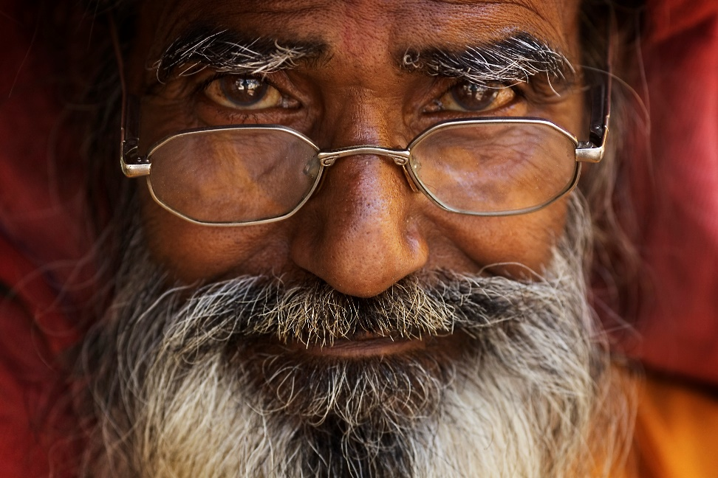
The Richest Man in Babylon
"Then he looked at me shrewdly from under his shaggy brows and said in a low, forceful tone:
“I found the road to wealth when I decided that a part of all I earned was mine to keep. And so will you.”

Slide 16
The Richest Man in Babylon
"Then he continued to look at me with a glance that I could feel pierce me but said no more. “Is that all?' I asked.
“That was sufficient to change the heart of a sheep herder into the heart of a money lender,' he replied.
“But all I earn is mine to keep, is it not?' I demanded.
“Far from it,' he replied. 'Do you not pay the garment- maker? Do you not pay the sandal-maker? Do you not pay for the things you eat? Can you live in Babylon without spending? What have you to show for your earnings of the past mouth? What for the past year? Fool! You pay to everyone but yourself. Dullard, you labor for others. As well be a slave and work for what your master gives you to eat and wear.

Slide 17
The Richest Man in Babylon
If you did keep for yourself one-tenth of all you earn, how much would you have in ten years?‘
"My knowledge of the numbers did not forsake me, and I answered, 'As much as I earn in one year.‘
“You speak but half the truth,' he retorted. 'Every gold piece you save is a slave to work for you. Every copper it earns is its child that also can earn for you. If you would become wealthy, then what you save must earn, and its children must earn, that all may help to give to you the abundance you crave.

Slide 18
The Richest Man in Babylon
“You think I cheat you for your long night's work,' he continued, 'but I am paying you a thousand times over if you have the intelligence to grasp the truth I offer you.”
“A part of all you earn is yours to keep. It should be not less than a tenth no matter how little you earn. It can be as much more as you can afford. Pay yourself first. Do not buy from the clothes-maker and the sandal-maker more than you can pay out of the rest and still have enough for food and charity and penance to the gods.”

Slide 19
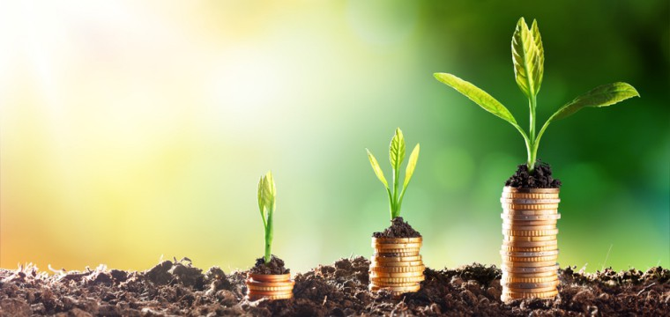
The Richest Man in Babylon
“Wealth, like a tree, grows from a tiny seed. The first copper you save is the
seed from which your tree of wealth shall grow. The sooner you plant that
seed the sooner shall the tree grow. And the more faithfully you nourish and
water that tree with consistent savings, the sooner may you bask in
contentment beneath its shade.'
"So saying, he took his tablets and went away.
"I thought much about what he had said to me, and it seemed reasonable. So I
decided that I would try it. Each time I was paid I took one from each ten
pieces of copper and hid it away. And strange as it may seem, I was no
shorter of funds, than before. I noticed little difference as I managed to get
along without it. But often I was tempted, as my hoard began to grow, to
spend it for some of the good things the merchants displayed, brought by
camels and ships from the land of the Phoenicians. But I wisely refrained.

Slide 20
The Richest Man in Babylon
"A twelfth month after Algamish had gone he again returned and said to me, 'Son, have you paid to yourself not less than one-tenth of all you have earned for the past year?‘
"I answered proudly, 'Yes, master, I have.'
'That is good,' he answered beaming upon me, 'and what have you done with it?”
"I have given it to Azmur, the brick maker, who told me he was traveling over the far seas and in Tyre he would buy for me the rare jewels of the Phoenicians. When he returns we shall sell these at high prices and divide the earnings.”

Slide 21
The Richest Man in Babylon
"Every fool must learn,” he growled, 'but why trust the knowledge of a brick maker about jewels? Would you go to the bread maker to inquire about the stars? No, by my tunic, you would go to the astrologer, if you had power to think. Your savings are gone, youth, you have jerked your wealth-tree up by the roots. But plant another. Try again. And next time if you would have advice about jewels, go to the jewel merchant. If you would know the truth
about sheep, go to the herdsman. Advice is one thing that is freely given away, but watch that you take only what is worth having. He who takes advice about his savings from one who is inexperienced in such matters, shall pay with his savings for proving the falsity of their opinions.” Saying this, he went away.

Slide 22
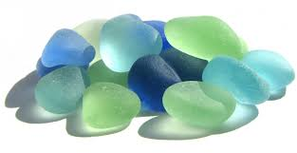
The Richest Man in Babylon
"And it was as he said. For the Phoenicians are scoundrels and sold to Azmur worthless bits of glass that looked like gems. But as Algamish had bid me, I again saved each tenth copper, for I now had formed the habit and it was no longer difficult.
"Again, twelve months later, Algamish came to the room of the scribes and addressed me. ”What progress have you made since last I saw you?”

Slide 23
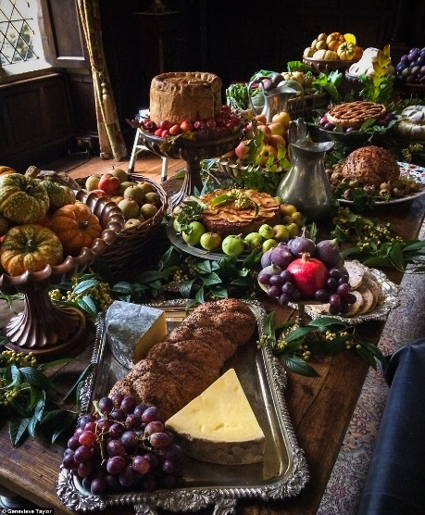
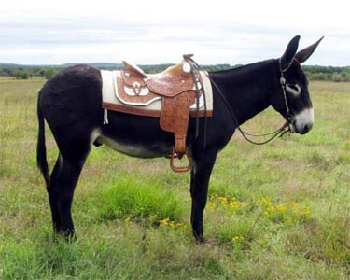
The Richest Man in Babylon
"I have paid myself faithfully,' I replied, 'and my savings I have entrusted to Agger the shield maker, to buy bronze, and each fourth month he does pay me the rental.”
"That is good. And what do you do with the rental?”
"I do have a great feast with honey and fine wine and spiced cake. Also I have bought me a scarlet tunic. And some day I shall buy me a young ass upon which to ride.”

Slide 24
The Richest Man in Babylon
To which Algamish laughed, “You do eat the children of your savings. Then how do you expect them to work for you?
And how can they have children that will also work for you?
First get thee an army of golden slaves and then many a rich banquet may you enjoy without regret.” So saying he again went away.

Slide 25
The Richest Man in Babylon
"Nor did I again see him for two years, when he once more returned and his face was full of deep lines and his eyes drooped, for he was becoming a very old man. And he said to me, “Arkad, hast thou yet achieved the wealth thou dreamed of?”
And I answered, “Not yet all that I desire, but some I have and it earns more, and its earnings earn more.”
"And do you still take the advice of brick makers?”
"About brick making they give good advice,” I retorted.

Slide 26
The Richest Man in Babylon
"Arkad,” he continued, “you have learned your lessons well. You first learned to live upon less than you could earn. Next you learned to seek advice from those who were competent through their own experiences to give it. And, lastly, you have learned to make gold work for you.”
"You have taught yourself how to acquire money, how to keep it, and how to use it. Therefore, you are competent for a responsible position. I am becoming an old man. My sons think only of spending and give no thought to earning. My interests are great and I fear too much for me to look after. If you will go to Nippur and look after my lands there, I shall make you my partner and you shall share in my estate.”

Slide 27
The Richest Man in Babylon
"So I went to Nippur and took charge of his holdings, which were large. And because I was full of ambition and because I had mastered the three laws of successfully handling wealth, I was enabled to increase greatly the value of his properties.
So I prospered much, and when the spirit of Algamish departed for the sphere of darkness, I did share in his estate as he had arranged under the law.“
So spoke Arkad, and when he had finished his tale, one of his friends said
"You were indeed fortunate that Algamish made of you an heir."

Slide 28
The Richest Man in Babylon
"Fortunate only in that I had the desire to prosper before I first met him. For four years did I not prove my definiteness of purpose by keeping one-tenth of all earned? Would you call a fisherman lucky who for years so studied the habits of the fish that with each changing wind he could cast his nets about them? Opportunity is a haughty goddess who wastes no time with those who are unprepared."

Slide 29
The Richest Man in Babylon
"You had strong will power to keep on after you lost your first year's savings. You are unusual in that way," spoke up another.
"Will power!" retorted Arkad. "What nonsense. Do you think will power gives a man the strength to lift a burden the camel cannot carry, or to draw a load the oxen cannot budge? Will power is but the unflinching purpose to carry a task you set for yourself to fulfillment.

Slide 30
The Richest Man in Babylon
If I set for myself a task, be it ever so trifling, I shall see it through. How else shall I have confidence in myself to do
important things? Should I say to myself, 'For a hundred days as I walk across the bridge into the city, I will pick from the road a pebble and cast it into the stream,' I would do it.
If on the seventh day I passed by without remembering, I would not say to myself, Tomorrow I will cast two pebbles which will do as well.' Instead, I would retrace my steps and cast the pebble. Nor on the twentieth day would I say to myself, 'Arkad, this is useless. What does it avail you to cast a pebble every day? Throw in a handful and be done with it.' No, I would not say that nor do it. When I set a task for myself, I complete it.
Therefore, I am careful not to start difficult and impractical tasks, because I love leisure."

Slide 31
The Richest Man in Babylon
And then another friend spoke up and said, "If what you tell is true, and it
does seem as you have said, reasonable, then being so simple, if all men did
it, there would not be enough wealth to go around.“
Wealth grows wherever men exert energy," Arkad replied. "If a rich man
builds him a new palace, is the gold he pays out gone? No, the brickmaker has
part of it and the laborer has part of it, and the artist has part of it. And
everyone who labors upon the house has part of it Yet when the palace is
completed, is it not worth all it cost? And is the ground upon which it stands
not worth more because it is there? And is the ground that adjoins it not
worth more because it is there?
Wealth grows in magic ways. No man can prophesy the limit of it. Have not the Phoenicians built great cities on barren coasts with the wealth that comes from their ships of commerce on the seas?"

Slide 32
The Richest Man in Babylon
"What then do you advise us to do that we also may become rich?" asked still another of his friends. "The years have passed and we are no longer young men and we have nothing put by.“
"I advise that you take the wisdom of Algamish and say to yourselves, 'A part of all I earn is mine to keep.' Say it in the morning when you first arise. Say it at noon. Say it at night. Say it each hour of every day. Say it to yourself until the words stand out like letters of fire across the sky.

Slide 33
The Richest Man in Babylon
"Impress yourself with the idea. Fill yourself with the thought. Then take whatever portion seems wise. Let it be not less than one-tenth and lay it by.
Arrange your other expenditures to do this if necessary. But lay by that portion first. Soon you will realize what a rich feeling it is to own a treasure upon which you alone have claim. As it grows it will stimulate you. A new joy of life will thrill you.
Greater efforts will come to you to earn more. For of your increased earnings, will not the same percentage be also yours to keep?

Slide 34
The Richest Man in Babylon
"Then learn to make your treasure work for you. Make it your slave. Make its children and its children's children work for you.
"Insure an income for thy future. Look thou at the aged and forget not that in the days to come thou also will be numbered among them. Therefore invest thy treasure with greatest caution that it be not lost. Usurious rates of return are deceitful sirens that sing but to lure the unwary upon the rocks of loss and remorse.

Slide 35
The Richest Man in Babylon
"Provide also that thy family may not want should the Gods call thee to their realms. For such protection it is always possible to make provision with small payments at regular intervals. Therefore the provident man delays not in expectation of a large sum becoming available for such a wise purpose.
"Counsel with wise men. Seek the advice of men whose daily work is handling money. Let them save you from such an error as I myself made in entrusting my money to the judgment of Azmur, the brickmaker. A small return and a safe one is far more desirable than risk.

Slide 36
The Richest Man in Babylon
"Enjoy life while you are here. Do not overstrain or try to save too much. If one-tenth of all you earn is as much as you can comfortably keep, be content to keep this portion. Live otherwise according to your income and let not yourself get niggardly and afraid to spend. Life is good and life is rich with things worthwhile and things to enjoy."

Slide 37
The Richest Man in Babylon
His friends thanked him and went away. Some were silent because they had no imagination and could not understand. Some were sarcastic because they thought that one so rich should divide with old friends not so fortunate. But some had in their eyes a new light. They realized that Algamish had come back each time to the room of the scribes because he was watching a man work his way out of darkness into light. When that man had found the light, a
place awaited him. No one could fill that place until he had for himself worked out his own understanding, until he was ready for opportunity.

Slide 38
The Richest Man in Babylon
These latter were the ones, who, in the following years, frequently revisited Arkad, who received them gladly. He counseled with them and gave them freely of his wisdom as men of broad experience are always glad to do. And he assisted them in so investing their savings that it would bring in a good interest with safety and would neither be lost nor entangled in investments
that paid no dividends.
The turning point in these men's lives came upon that day when they realized the truth that had come from Algamish to Arkad and from Arkad to them.
A PART OF ALL YOU EARN IS YOURS TO KEEP.

