Slide 1
19 Women Presbyters

Slide 2
What was a presbyter and what did presbyters do?
Bishops, presbyters, and deacons/deaconesses
Not a direct line from bishop to presbyter, but from bishop to deacon
Presbyters as council of the bishop, then to churches in the countryside

Slide 3
Ambiguity in the word presbyter: elder or leader?
Mrs. Presbyter?

Slide 4
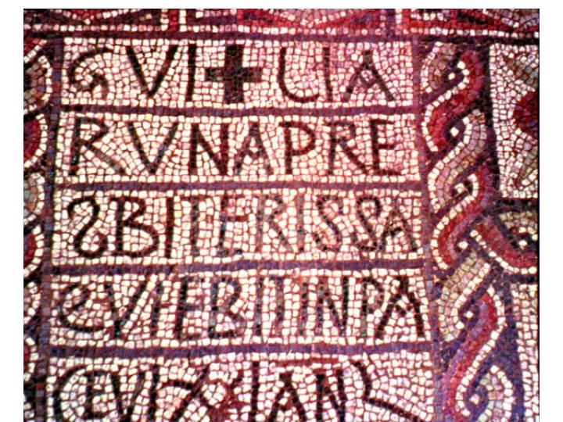
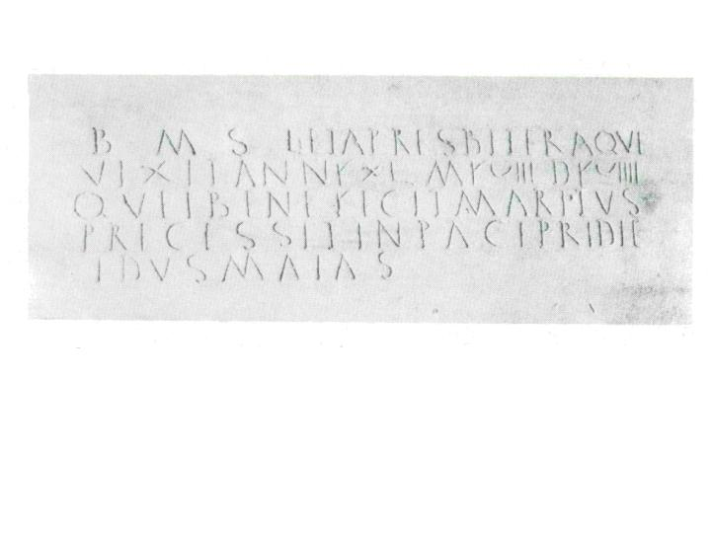
4th-5th c. epitaphs of women presbyters
Flavia Vitalia, Leta, Guilia Runa
Photo Giorgio Otranto
Photo David Brecht

