Slide 1
World History 101 Section 2 500 B.C.-1000 A.D.
Persia
India
China
Peru
Mesoamerica
Mediterranean Basin

Slide 2
Persia
Cyrus the Great
Darius
Persian/Greek Wars

Slide 3
Cyrus the Great: READING ASSIGNMENT: Achaemenid Empire
http://www.ancient.eu/Achaemenid_Empire/
Atlas of Empires by Peter Davidson (New Holland Publishers Ltd, 2016).

Slide 4
Cyrus the Great
570(?) B.C.-529B.C.
United by conquest, disjointed parts of Neo-Babylonia Empire: esp. Persia (Iran), Media, and Babylon… by 559, ruler of Mesopotamia
Lydia: Captured capital and King Croesus—beginnings of long conflict with Greek city States
Controlled by conquest, from Indus Valley to East shores of Mediterranean Sea.

Slide 5
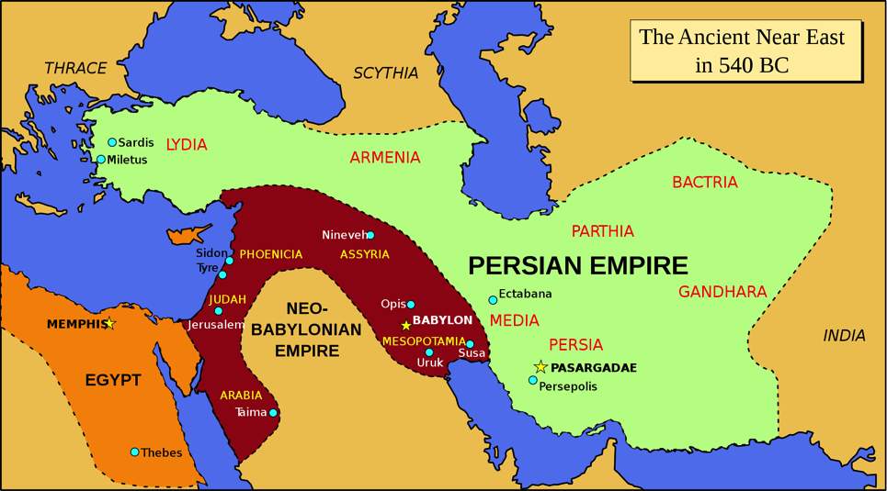
Cyrus the Great
https://upload.wikimedia.org/wikipedia/commons/thumb/d/dc/Ancient_near_east_540_bc.svg/800px-Ancient_near_east_540_bc.svg.png

Slide 6
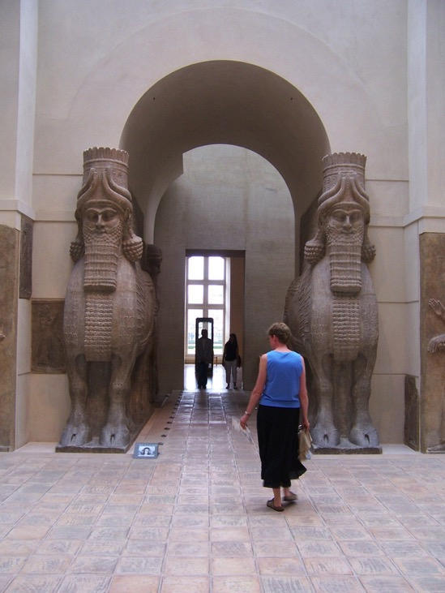

Slide 7
Cyrus the Great allows local cultures and religious to be practiced
Cyrus, claims he rules Babylonia by the will of Marduk.
Within his empire he encourages the repatriation of captured peoples to their homeland and helps them rebuild their cultures and religions.

Slide 8
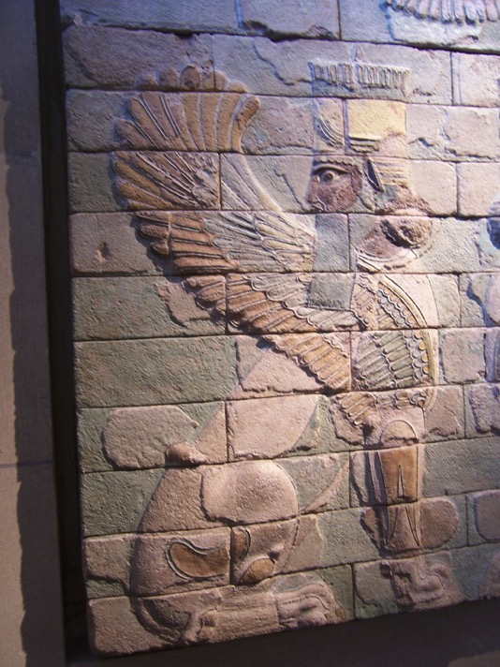

Slide 9
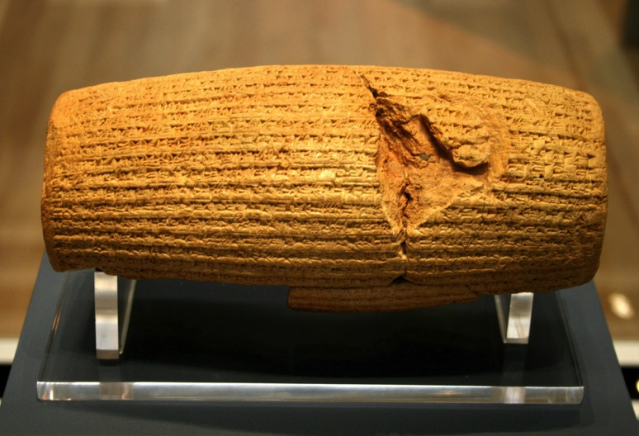
Cyrus Cylinder
https://upload.wikimedia.org/wikipedia/commons/3/35/Cyrus_Cylinder.jpg

Slide 10
Cyrus and the Jews
Ezra 1: 1-4
In the first year of Cyrus king of Persia, in order to fulfill the word of the Lord spoken by Jeremiah, the Lord moved the heart of Cyrus king of Persia to make a proclamation throughout his realm and also to put it in writing:
² “This is what Cyrus king of Persia says:
“‘The Lord, the God of heaven, has given me all the kingdoms of the earth and he has appointed me to build a temple for him at Jerusalem in Judah. ³ Any of his people among you may go up to Jerusalem in Judah and build the temple of the Lord, the God of Israel, the God who is in Jerusalem, and may their God be with them. ⁴ And in any locality where survivors may now be living, the people are to provide them with silver and gold, with goods and livestock, and with freewill offerings for the temple of God in Jerusalem.’”

Slide 11
Cyrus and the Jews cont.
Isaiah 45:1-3
“This is what the Lord says to his anointed, to Cyrus, whose right hand I take hold of to subdue nations before him and to strip kings of their armor, to open doors before him so that gates will not be shut: ² I will go before you and will level the mountains; I will break down gates of bronze and cut through bars of iron. ³ I will give you hidden treasures, riches stored in secret places, so that you may know that I am the Lord, the God of Israel, who summons you by name.

Slide 12
Persia Expands
READING ASSIGNMENT: Darius I, by Steven Fife
http://www.ancient.eu/Darius_I/

Slide 13
Darius I 549-486 B.C.
Expands Persian Empire greatest extent
Heyday of cultural, institutional, economic, military, and artistic culture: builds Persepolis.
Begins direct military conflict with Greeks over Ionia…
Contrasting views of kings—Persia and Greece
“To grovel like a dog”

Slide 14
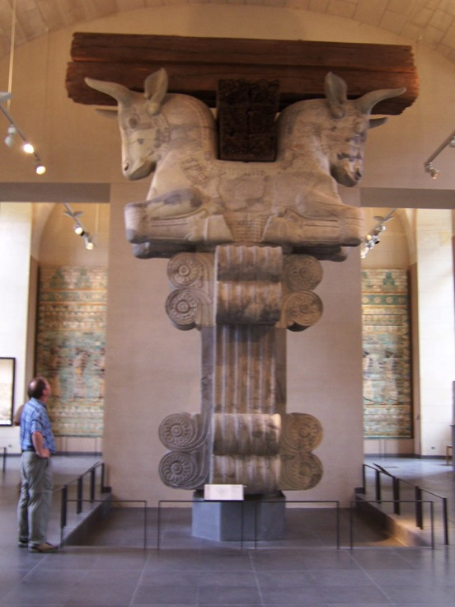

Slide 15
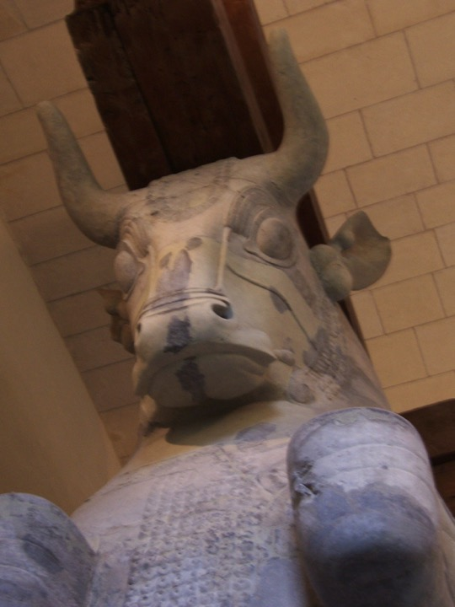

Slide 16
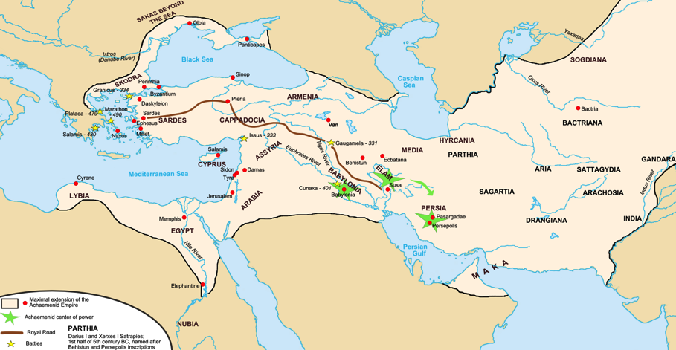
Darius I’s Persia
https://upload.wikimedia.org/wikipedia/commons/b/b3/Map_achaemenid_empire_en.png

Slide 17
Zoroastrianism
Eastern Iranian religion founded by Zoroaster around 1000 B.C. Darius I makes official religion of Persian Empire.
“Monotheism” with Ahura Mazda as god.

Slide 18
Struggle between good and evil, with “angels and demons” on each side. Humans are called to be on the side of the good. Ethical religion, with freedom of choice emphasized.
Ultimate victory of the good, with a glorious age to follow….with eternal rewards of “heaven and hell”.

Slide 19
Some conflict between official religion, Zoroastrianism, and traditional Median religious authorities known as the “Magi”---the priestly group centered in Babylon.
Magi, astrologers and priests---sometimes called Chaldeans. “Wise men”

Slide 20
Greek/Persian Wars Reading Assignment
Article: Persian Wars by Mark Cartwright
http://www.ancient.eu/Persian_Wars/

Slide 21
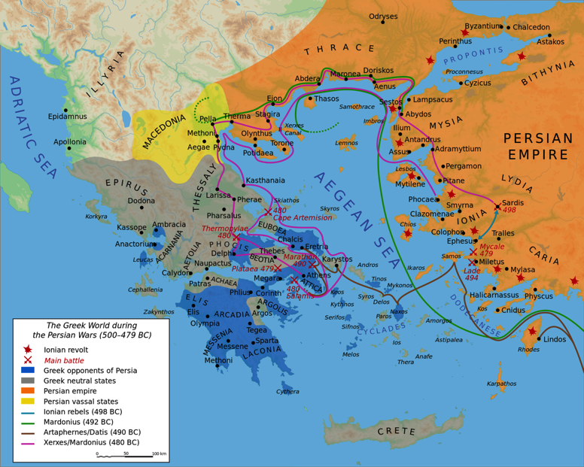
https://upload.wikimedia.org/wikipedia/commons/thumb/3/3a/Map_Greco-Persian_Wars-en.svg/2000px-Map_Greco-Persian_Wars-en.svg.png

Slide 22
Greek Persian Wars
499-490 B.C.---Darius ends tax revolt in Ionia, overwhelms Macedonia and Thrace. Pushes to conquer all of Greece: Athens and Sparta---but at Battle of Marathon, 490 B.C., defeated by smaller Greek armies.

Slide 23
Xerxes 480 B.C.
Thermopylae--- 300 Spartans, hold off Persians, but ultimately defeated…gains time for other Greeks to gather. Athens sacked by Persians

Slide 24
Salamis, fall of 480 B.C.
Navel battle at which smaller Greek warships outmaneuvered Persian fleet. Xerxes returns to Persia, leaves his standing army in Greece.

Slide 25
Plataea
Equally matched Greek and Persian armies, but Greeks won due to superior armament. Persians give up invasion of Greece and retreated to Asia Minor.
449 B.C. Treaty signed between Greece and Persia

Slide 26
https://upload.wikimedia.org/wikipedia/commons/thumb/3/3a/Map_Greco-Persian_Wars-en.svg/2000px-Map_Greco-Persian_Wars-en.svg.png

Slide 27
Achaemenid Empire
Lasted another 200 years, still a great empire, but with diminishing power in region until finally overcome by Alexander the Great in 334 B.C.

Slide 28
Ancient India
About 500 B.C.-1000 A.D.
Shift in cultural dominance from the Indus to the Ganges (west to east).

Slide 29
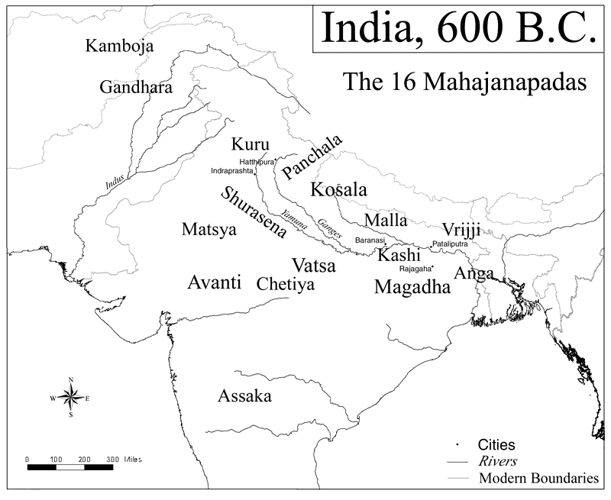
https://upload.wikimedia.org/wikipedia/commons/f/ff/Ancient_india.png

