Slide 1
Preacher, Preparation,
Presentation
A class on making and preaching sermons
Session 21
Developing
A Sermon
Organizing
The Message

Slide 2
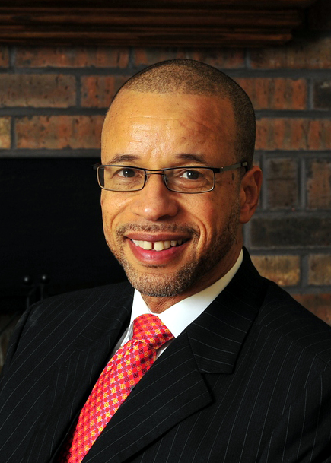

Slide 3
https://youtu.be/hghA7EQepuE

Slide 4
Situation
Complication of the situation
Resolution of the complication
Celebration of the resolution

Slide 5
Topical Organization

Slide 6
Topical Organization
Psalm 82:2-4
How long will you defend the unjust and show partiality to the wicked? Defend the weak and the fatherless; uphold the cause of the poor and the oppressed. Rescue the weak and the needy; deliver them from the hand of the wicked.

Slide 7
I The History of the church caring for the poor
II The history in our nation
III The necessity of caring for the poor today

Slide 8
Notes:
The topic is derived from the text
But the main points are not
Nor are the sub points

Slide 10
Textual Organization
Topic comes from the text
Main points come from the text
Sub points come from outside the text

Slide 11
Textual Organization
I John 2:15
Do not love the world or anything in the world. If anyone loves the world, love for the Father is not in them. For everything in the world-the lust of the flesh, the lust of the eyes, and the pride of life—comes not from the Father, but from the world.

Slide 12
Textual Organization
I We should resist the lust of the flesh
- Materialism
- David’s erosion of faith
II We should resist the lust of the eyes
- Sensuality
- Damaged David’s purity
III We should resist the pride of life
- Arrogance
- Destroyed David’s humility

Slide 15
Expository Outline

Slide 16
Expository Outline
Main topic taken from the text
Points taken from the text
Sub points taken from the text

Slide 17
gotquestions.org
579,179 Bible Questions Answered!
Do you have a question about God, Jesus, the Bible, or theology? Do you need help understanding a Bible verse or passage? Are there any spiritual issues in your life for which you need advice or counsel?

Slide 18
Romans 8:31-39
I God’s love is greater than sin
A. Past sin (vv. 31-33)
B. Present sin (v. 34)
II God’s love is greater than circumstances
A. Challenge God’s love (vv. 35-36)
B. Cannot undo God’s love (vv. 32, 37)
III God’s love is greater than Satan
A. Than spiritual powers (v. 38)
B. Than Satan’s strength (v. 39)

