Slide 1
Early Christianity
1. First generations: Jewish sect---Paul, gentile world.
2. Popular among lower classes, and a few wealthier women
3. Under suspicion as a “mystery cult”---not patriotic: Pliny Book 10, letters 96-97
4. More common in East than West

Slide 2
Nicaea, 325 A.D.
Constantine needed to unify Empire; unified religion: doctrinal decisions: Council of Nicaea: Athanasius (?) vs. Arius Christological doctrines—nature of Christ and relationship with Father; Trinitarian doctrines, next cent.
Political purpose. Latin and Orthodox branches, same official doctrine---variations abounded: Coptic

Slide 3
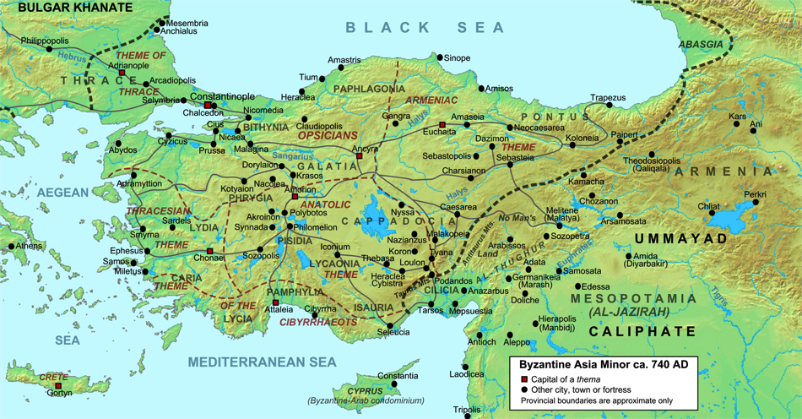
https://upload.wikimedia.org/wikipedia/commons/thumb/9/9c/Asia_Minor_ca_740_AD.svg/2000px-Asia_Minor_ca_740_AD.svg.png

Slide 4
Eastern Roman Empire--Byzantium
Article by Livius entitled Byzantine Empire at ://www.ancient.eu/Byzantine_Empire/

Slide 5
Byzantine 330-1453 A.D.
Roman Empire in East
Christian empire—center of Christianity
Egypt, Asia Minor, Balkans, Russia
Highly cultured—passed on Hellenistic culture—Greek
Conflicts with West and with Islam
Wealthy: trade over Silk Road

Slide 6
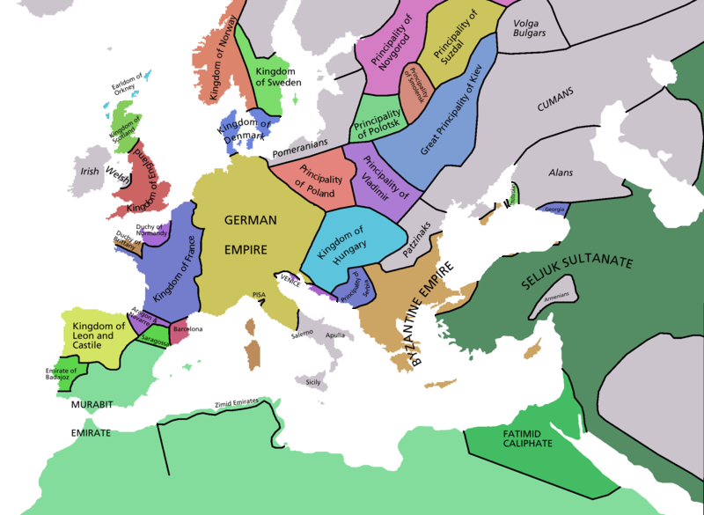

Slide 7
Conversion of the Slavs
8th-9th Cent.; Slavic peoples controlled from Baltic to Balkans---Russia, Poland, Hungary—
In 863, Byzantium sends missionaries (Cyril and Methodius) to convert Slavs… Eastern Slavs, become “Orthodox” (Greek), while western Slavs become “Latin”. In 988, Prince Vladimir of Kiev is baptized and marries Byzantine Princess Anna. Christianity in Russia.

Slide 8
Fall of Rome
376 A.D.—Rome constant battle with invasion of Eastern tribes: Goths, Visigoths, Huns..
Rome and western empire, overwhelmed by 476 A.D. by Germanic tribes…end of Western Roman Empire

Slide 9
Saint Augustine
354-430; Hippo in North Africa
Became Christian at age 31; early life pursuit of worldly pleasures; philosopher: Neo-Platonism
Confessions: soul searching; personalized faith

Slide 10
St. Augustine
Sovereignty of God: election
Human Sin
Trinitarian Doctrine
Political—City of God
“Church Father” Western Christian Doctrine 800 years; Reformation

Slide 11
Early Medieval Europe
“Ruled” as western part of Empire from Byzantium, but little support from East
Constant invasions by “Barbarians”;
Local Kingdoms; no centralized authority
Decline of culture-Dark Ages; little literacy
Disease abundant—esp. the Plague and smallpox

Slide 12
https://upload.wikimedia.org/wikipedia/commons/f/f1/Europe_map_1092.PNG

Slide 13
Church/Rome
Under jurisdiction of Patriarch of Constantinople: gradually Rome asserts independent authority over Church in Europe:
Pope Gregory I (Pope from 590-604): monastic life; emphasized sacramental worship; missionaries to Europe, esp. England; secular and military power, esp. in warring and later making peace with the Lombard tribes
Medieval Papacy—church/state powers combine

Slide 14
Holy Roman Empire
Christmas Day 800 A.D. Charlemagne crowned august emperor by Pope Leo III; Papacy needed military support, Charlemagne, King of Franks, best candidate. Wedded Church and State in Europe spiritual/temporal affairs. Not consistent partnership: rivals…control Europe until French Revolution/Napoleon in early 19th Cent.
Break with Byzantium nearly complete

