Slide 1
Preacher, Preparation,
Presentation
A class on making and preaching sermons
Session 30
Presenting
Your Sermon
Use
Meaningful
Gestures

Slide 2
Importance of Gestures
- Support
- Distraction

Slide 3
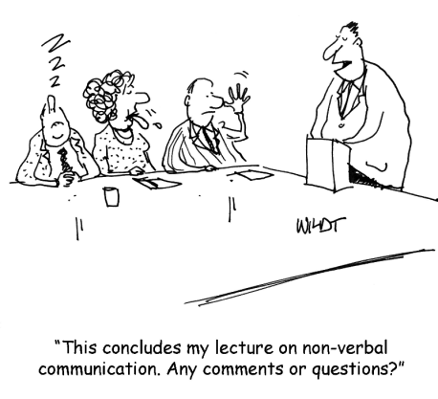

Slide 4
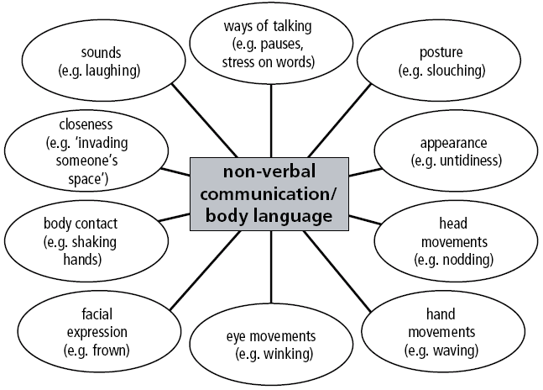

Slide 5
Communication is:
7% Verbal
38% Paraverbal
55% Non-verbal

Slide 6
Kinds of Gestures
publicspeakingpower.com
Descriptive Gestures
- Comparisons
- Depict size or shape
- Movement
- Placement

Slide 7
Kinds of Gestures
publicspeakingpower.com
Descriptive Gestures
Emphatic or Emotional
- sadness
- anger
- happiness

Slide 8
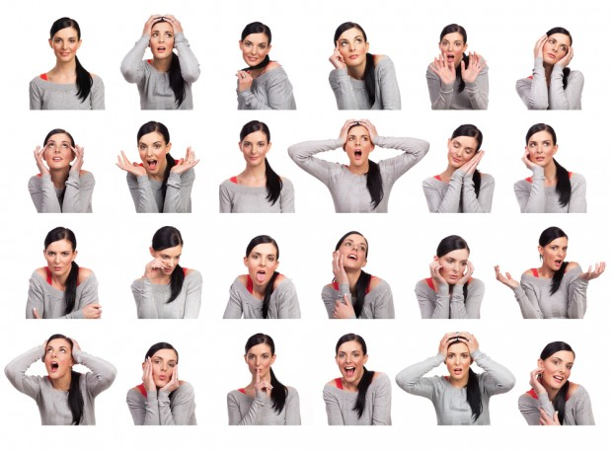

Slide 9
Kinds of Gestures
publicspeakingpower.com
Descriptive Gestures
Emphatic or Emotional
Suggestive
- Open/crossed arms
- Shrug
- Turning

Slide 10
Kinds of Gestures
publicspeakingpower.com
Descriptive Gestures
Emphatic or Emotional
Suggestive
Prompting
- raise your hand
- clapping

