Slide 1
UNIT 11

Slide 2
Beginning ESL Unit 13

Slide 3
Daily Routine for Month, Day, Weekday, and Year Journal Work
Month:
Day of the Week
Day:
Year:
Wednesday, January 10, 2018
January
Wednesday
10
2018

Slide 4
Dialogue, Greetings and Date

Slide 5
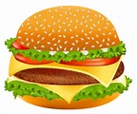
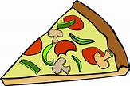
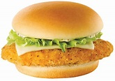
Different Types of Food
steak spaghetti tacos
hamburgers pizza chicken

Slide 6
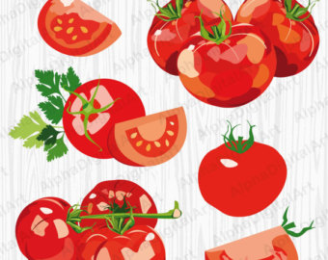
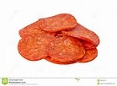
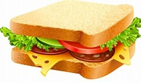
Different Types of Food
lettuce tomato cheese
pepperoni sandwiches

Slide 7
Different Types of Food Sentences
steak
spaghetti
tacos
hamburger
pizza
chicken
1. Tom likes to eat steak with a knife.
2. You can pour tomato sauce on your spaghetti.
3. People eat tacos with lettuce, tomato, and cheese.
4. I like to eat hamburgers with cheese.
5. My favorite pizza is made with pepperoni.
6. Many people eat chicken sandwiches.

Slide 8
Dialogue and Food
What type of food do you like to eat?
I like to eat hamburgers.
What is your favorite food?
I like to eat______________.
Do you like to eat pepperoni pizza?
No, I don’t like pepperoni pizza.
Do you like to eat steak dinners?
Yes, I like to eat steak dinners with lettuce and tomato.

Slide 9
Sight Words Repetition Level 6 Practice saying these words three times for 1 minute each
easy listen second can’t answer 5
enough make sense usually sometimes 10
usually don’t found after sure 15
favorite our won’t those being 20
off that’s hear talk walk 25
easy listen second can’t answer 30
enough make sense usually sometimes 35
usually don’t found after sure 40
favorite our won’t those being 45
off that’s hear talk walk 50

