Slide 1
Leadership 10
Learning the Culture

Slide 2
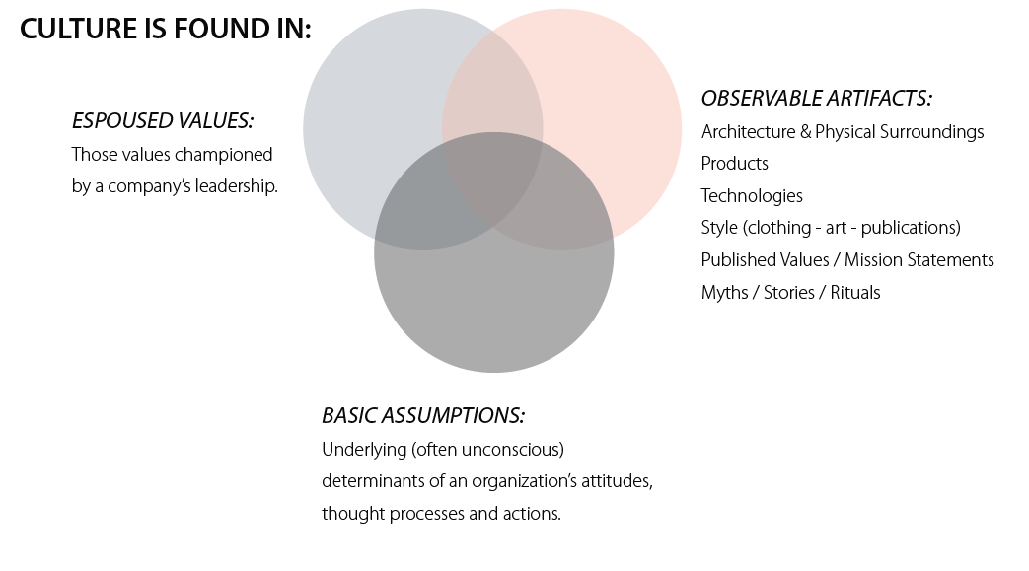

Slide 3
Learning a Culture
1. Listen
2. Do a values exercise
- Gather key leaders
- ideal behaviors?
- skills?
- What are we about?
- What are greatest strengths?

Slide 4
Group similar values
Define the central themes
What’s essential?
What’s unique?

Slide 5
- Create a list and check back with
the group.
Word them well
“Deliver “Wow” through service”
Evoke emotion

Slide 6
Put them to the test.

Slide 7
Learning a Culture
1. Listen
2. Do a values exercise
3. Do a “Culture Walk”
How is space allocated?
What is assumed?

Slide 8
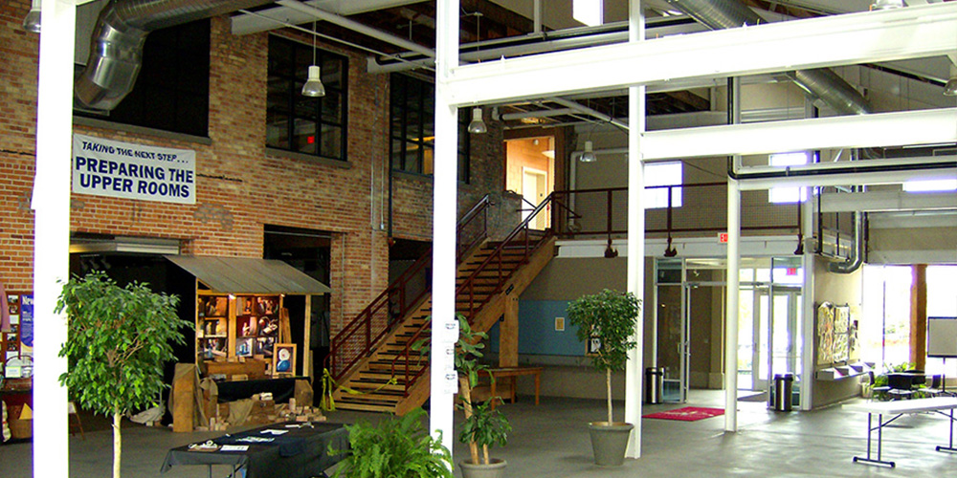

Slide 9
Learning a Culture
1. Listen
2. Do a values exercise
3. Do a “Culture Walk”
4. Culture Interviews
History
What would you say?
What would you change?
What kind of people fail?

