Slide 1
Preacher, Preparation,
Presentation
A class on making and preaching sermons
Session 11
Preparing
To
Preach
Kinds of Sermons

Slide 2
Euanglizo
Didasko
Laleo

Slide 3
Euanglizo
Didasko
Laleo – Speak of Important things

Slide 4
Laleo can refer to common speech.

Slide 5
“But I tell you that everyone will have to give account for every empty word they have spoken.” Matthew 12:36
“Therefore, each of you must put off falsehood and speak truthfully to your neighbor, for we are all members of one body.” Ephesians 4:25

Slide 6
“My dear brothers and sisters, take note of this: Everyone should be quick to listen, slow to speak, and slow to become angry….” Ephesians 425

Slide 7
Laleo can refer to common speech.
But sometimes refers to preaching.
- Jesus

Slide 8
While Jesus was still talking to the crowd, his mother and brothers stood outside, wanting to speak to him.” Matthew 12:46
“The disciples came to him and asked, “Why do you speak to the people in parables?” Matthew 13:10

Slide 9
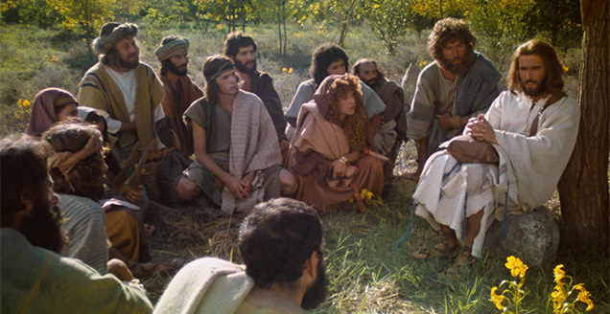

Slide 10
Laleo can refer to common speech.
But sometimes refers to preaching.
- Jesus
- Paul

Slide 11
“Have you been thinking all along that we have been defending ourselves to you? We have been speaking in the sight of God as those in Christ; and everything we do, dear friends, is for your strengthening.”
2 Corinthians 12:19

Slide 12
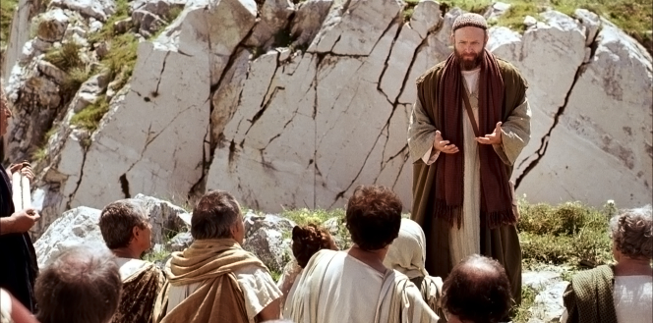

Slide 13
Laleo can refer to common speech.
But sometimes refers to preaching.
- Jesus
- Paul
- Peter

Slide 14
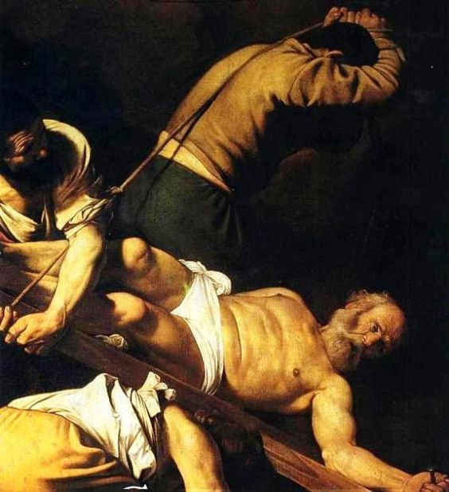

Slide 15
“Each of you should use whatever gift you have received to serve others. If anyone speaks, they should do so as one who speaks the very words of God. If anyone serves, they should do so with the strength God provides, so that in all things God may be praised through Jesus Christ. To him be the glory and the power for ever and ever. Amen.”
I Peter 4:10, 11

Slide 16
Speaking About Important Things
Therapeutic Preaching

Slide 17
Speaking About Important Things
- Preaching practical sermons
Marriage/Family
Being a better employee
How to act politically
Being a good citizen
Spiritual Warfare

Slide 18
Depression
How to handle anger
Facing death
How to evangelize
Sex and dating

Slide 19
“Living as a member of God’s kingdom has relevance to our life down here.”
- Sherman Haywood Cox II

Slide 20
Dangers
- Preaching to the crowd
need vs need
- Neglecting the “Big” themes
- Interpreting the Bible
God’s word vs. your opinion
Are you the person?

