Slide 1
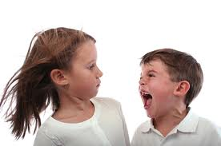
Mood Disorders
Psychological disorders in which the person’s mood negatively influences his or her physical, perceptual, social, and cognitive processes.
This Photo by Unknown Author is licensed under CC BY

Slide 2
Types of Mood Disorders
Dysthymia:
A condition characterized by mild, but chronic, depressive symptoms that last for at least two years.
This Photo by Unknown Author is licensed under CC BY-NC-ND

Slide 3
Major Depressive Disorder
This Photo by Unknown Author is licensed under CC BY-NC
A mental disorder characterized by an all-encompassing low mood accompanied by low self-esteem and loss of interest or pleasure in normally enjoyable activities.

Slide 4
Bipolar
A psychological disorder characterized by swings in mood from overly “high” to sad and hopeless, and back again, with periods of near-normal mood in between.
This Photo by Unknown Author is licensed under CC BY-NC-ND

Slide 5
Cycle of Depression

Slide 6
Schizophrenia
This Photo by Unknown Author is licensed under CC BY-NC-ND
A serious psychological disorder marked by delusions, hallucinations, loss of contact with reality, inappropriate affect, disorganized speech, social withdrawal, and deterioration of adaptive behavior.

Slide 7
Psychosis A psychological condition characterized by a loss of contact with reality.
This Photo by Unknown Author is licensed under CC BY-NC-ND

Slide 8
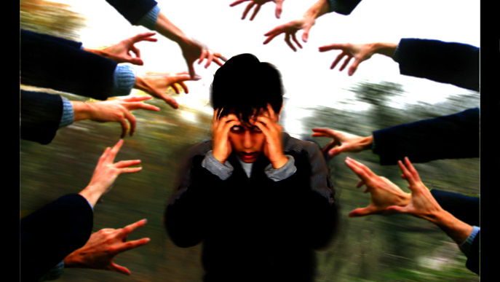
Hallucinations
Imaginary sensations that occur in the absence of a real stimulus or which are gross distortions of a real stimulus.
This Photo by Unknown Author is licensed under CC BY

Slide 9
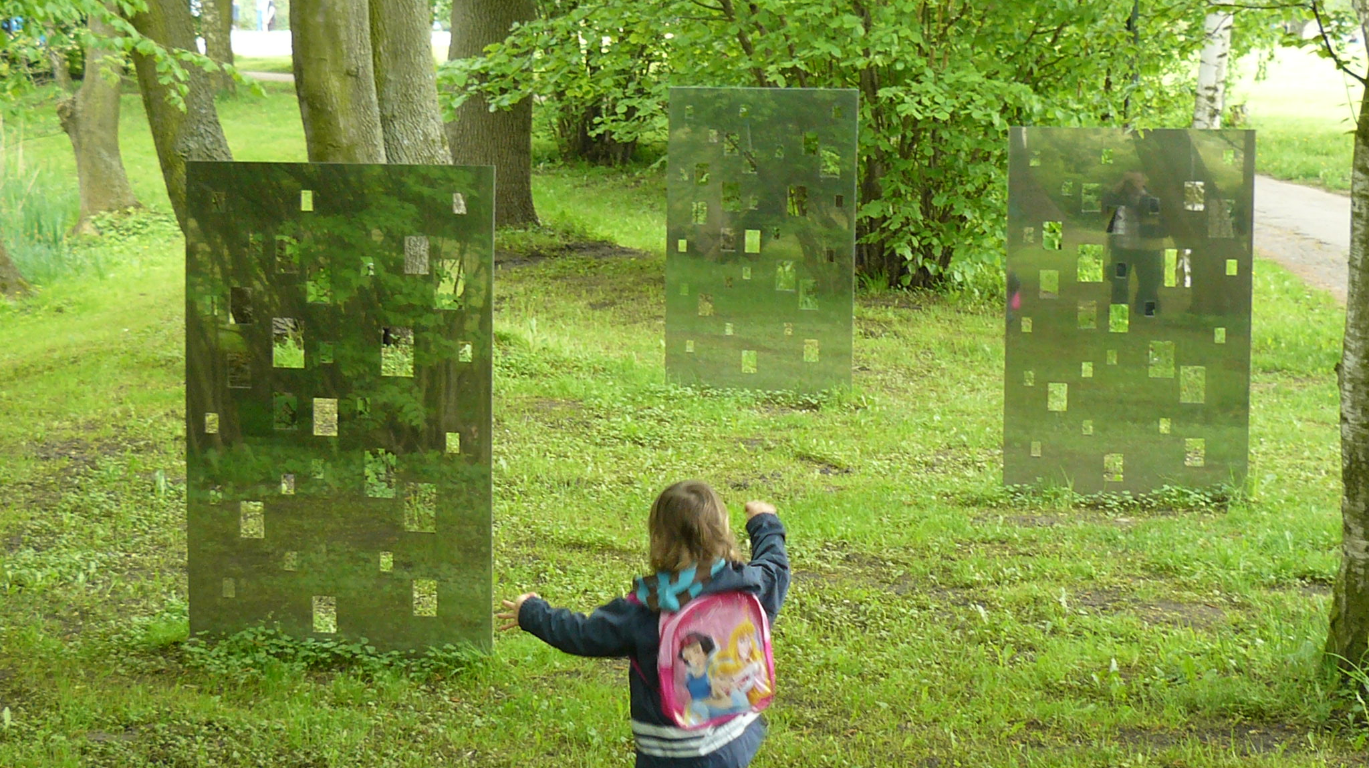
Delusions
False beliefs not commonly shared by others within one’s culture, and maintained even though they are obviously out of touch with reality
This Photo by Unknown Author is licensed under CC BY-SA

Slide 10
Personality Disorder
A disorder characterized by inflexible patterns of thinking, feeling, or relating to others that cause problems in personal, social, and work situations.
This Photo by Unknown Author is licensed under CC BY

Slide 11
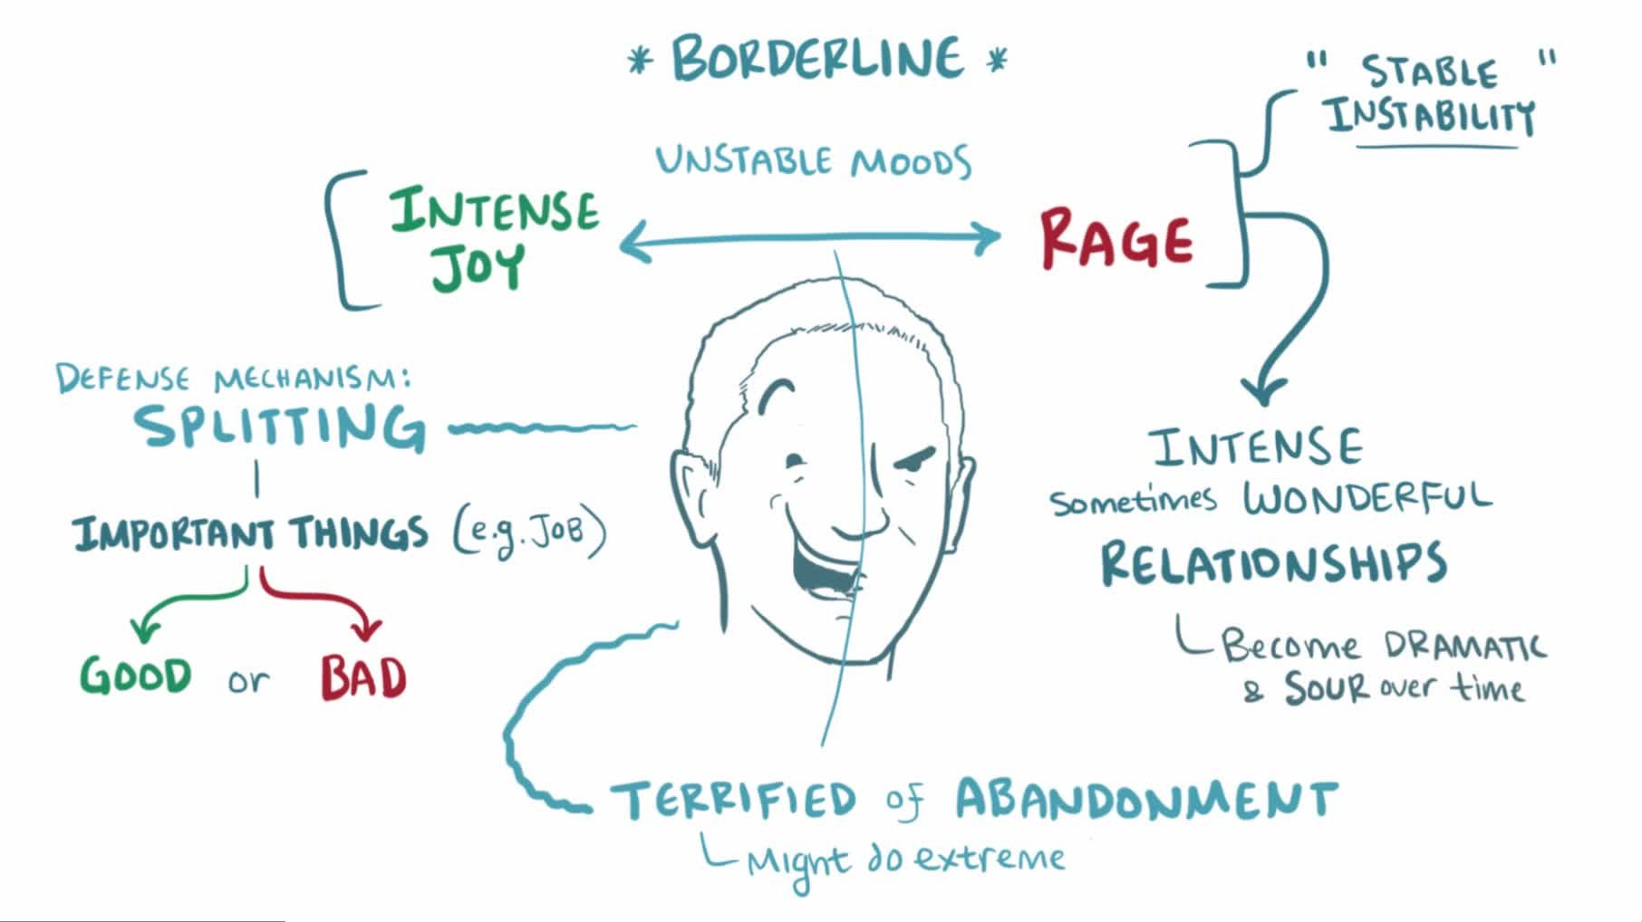
Borderline Personality Disorder
A psychological disorder characterized by a prolonged disturbance of personality accompanied by mood swings, unstable personal relationships, identity problems, threats of self-destructive behaviour, fears of abandonment, and impulsivity.
This Photo by Unknown Author is licensed under CC BY-SA

Slide 12
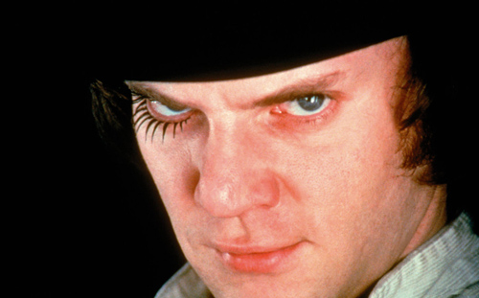
Anti-Social Disorder
A pervasive pattern of violation of the rights of others that begins in childhood or early adolescence and continues into adulthood.
This Photo by Unknown Author is licensed under CC BY-NC-ND

