Slide 1
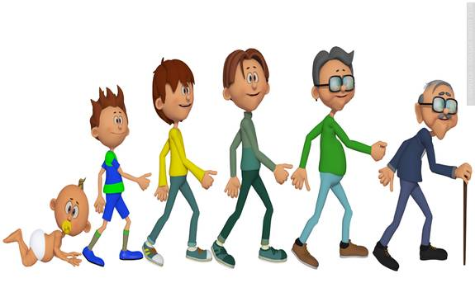
Growing & Developing:
Human Development,
The Mind & Behavior

Slide 2
Development
The physiological, behavioural, cognitive, and social changes
that occur throughout human life, which are guided by both genetic predispositions (nature) and
by environmental influences (nurture).

Slide 3
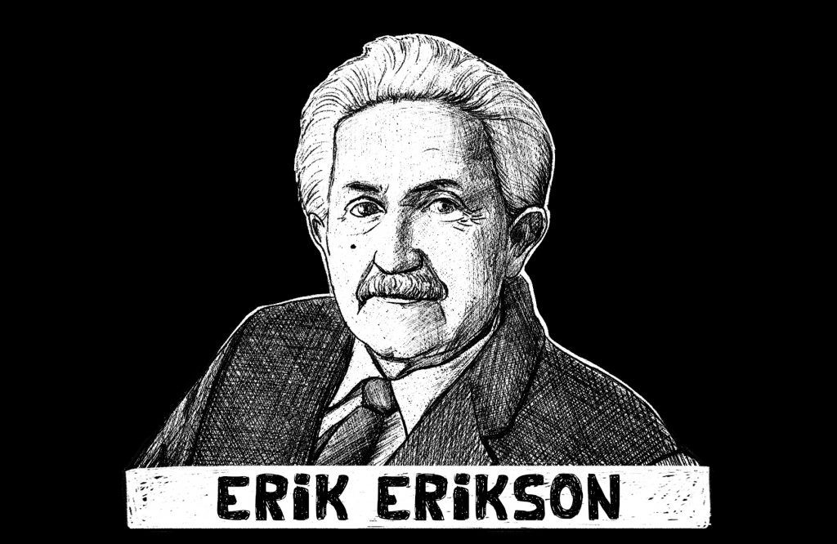

Slide 4
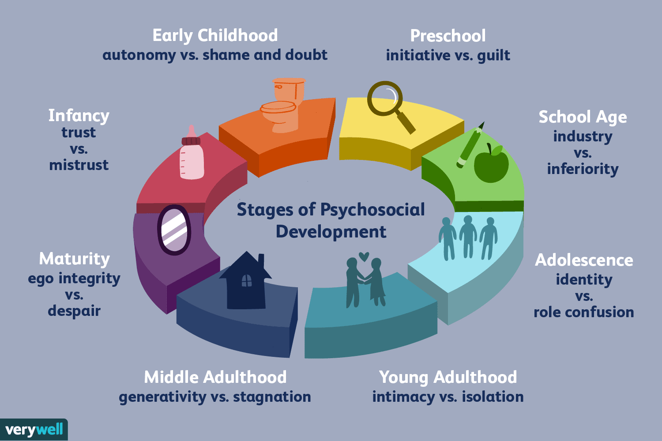

Slide 5
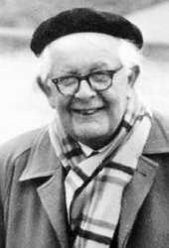
Jean Piaget

Slide 6
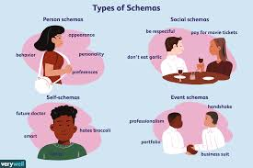
Schemas
Patterns of knowledge in long term memory — that help them remember, organize, and respond to information.

Slide 7
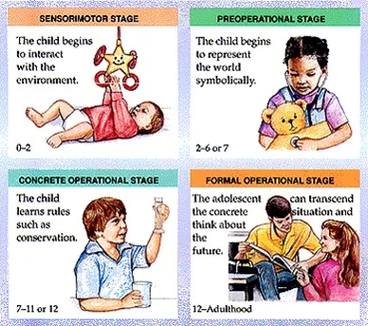
Assimilation
Use already developed schemas to understand new information
Accommodation
Learning new information and thus changing the schema.

Slide 8
