Slide 1
Title Layout
Subtitle

Slide 2
Middle and High School
Powerpoint

Slide 3
18

Slide 4
Dialogue for Church

Slide 5
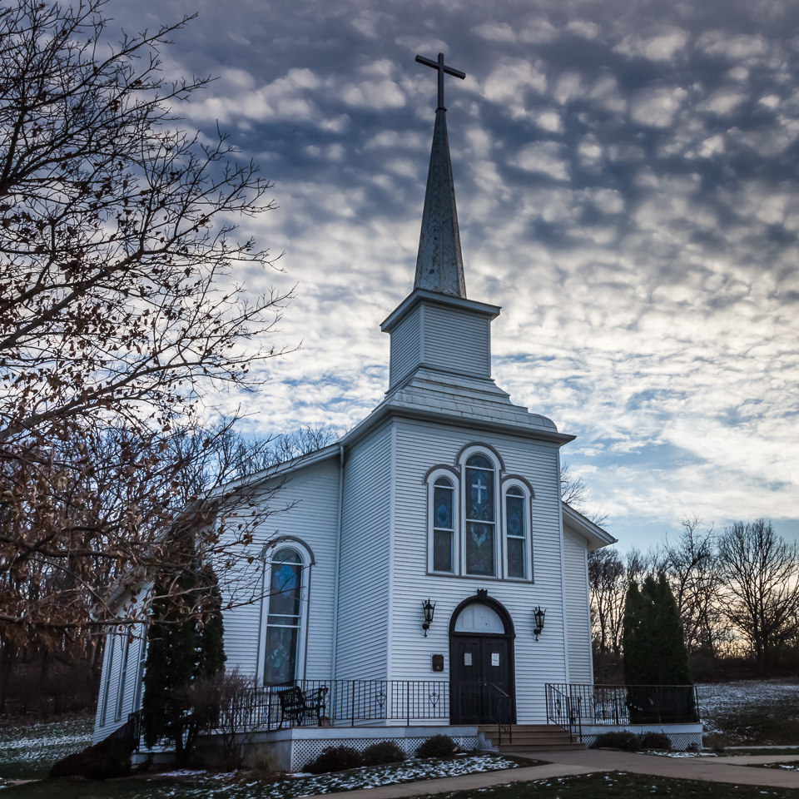
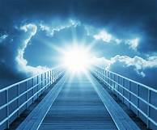
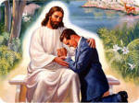
Dialogue Pictures for Church
Church God Jesus

Slide 6
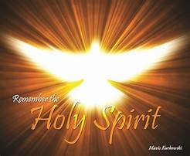
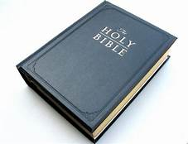
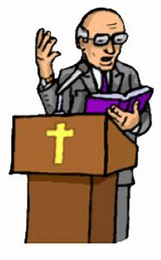
Dialogue Pictures for Church
Holy Spirit Bible Pastor

Slide 7
What the words mean.
1. church- a building where people gather to worship.
2. God- the creator, the supreme being, ruler of all life.
3. Jesus- Son of God who died for us.
4. Holy Spirit- The third person of the Trinity, God the Father, God the Son, and Holy Spirit, each person itself being God.
5. bible- The Christian scriptures, consisting of the 66 books of the Old and New Testaments.
6. pastor- a person in charge of Christian (church or congregation)

Slide 8
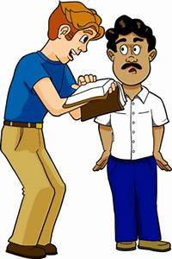
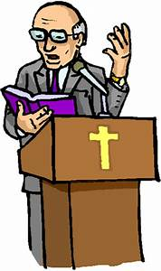
Dialogue Pictures for Church
Gospel People

Slide 9
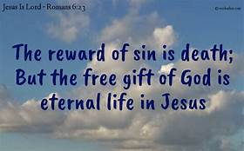
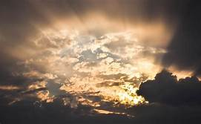
Dialogue Pictures for Church
eternal life perish believes

Slide 10
What the words mean.
7. congregation- A group of people gather together to worship.
8. people- human beings, persons (men, women, children).
9. gosbel - The record of Jesus life and teaching in the first four books of the New testament.
10. eternal life- refers to continued life after death, resurrection of the body, and life everlasting.
11. believes- To accept the truth of what is said, to accept something to be true.
12. perish- lost in hell

Slide 11
Practice 6: Dialogue for Church
Pastor: I want to welcome all of you to church today. In today’s gosbel the bible verse we will be reading is John 3:16.
For God so loved the world that he gave his one and only Son, Jesus Christ, that whoever believes in him shall not perish but have eternal life.
People: Amen
Pastor: Let us begin our sermon.

Slide 12
The meaning of John 3:16 from the Bible
For God so loved the world that he gave his one and only Son, Jesus Christ, that whoever believes in him shall not perish, but have eternal life.
Sermon:
In the beginning, God created man and woman. They sinned against God when they ate the fruit from the Tree of Life. This separated them from God. But He had a plan. He sent His Son, Jesus Christ, to live on this earth as we do. He did not sin but died for all the sins of the world. On the third day He rose again. If we believe in our hearts that Jesus died and rose again, and confess with our mouths that He is our Lord, the bible says we will not go to hell (perish in our sins) but have everlasting life (eternal life) and live with Him in Heaven forever.

Slide 13
The meaning of John 3:16 from the Bible Copy and write the sermon to John 3:16
For God so loved the world that he gave his one and only Son, Jesus Christ, that whoever believes in him shall not perish, but have eternal life.
Sermon:
______________________________________________
______________________________________________
______________________________________________
______________________________________________
______________________________________________
______________________________________________
______________________________________________

