Slide 1
Taking control of your parenting Part 4 Steve Elzinga
Giving your kids the "I am needed" attitude

Slide 2
Proverbs 4:23 (GN) Be careful how you think because your life is shaped by your thoughts.
"Why important? Human beings are the only species motivated to commit suicide by the perception "I am not needed.”

Slide 3
I. Believe that you are needed
Problem: Parents have a huge need to be needed that is not met.
Result: Parents often steal their children's significance.

Slide 4
Solution: Parents need to ...
Discover their purpose
Ephesians 2:10 For we are God's workmanship, created in Christ Jesus to do good works, which God prepared in advance for us to do.

Slide 5
Solution: Parents need to ...
Discover their gifts and use them
1 Corinthians 12:12 The spirit's presence is shown in some way in each person for the good of all .... He gives a different gift to each person.
1 Corinthians 12:27 Now here is what I am trying to say: All of you together are the one body of Christ, and each one of you is a separate and necessary part of it.

Slide 6
II. Believe that your child is needed
Matthew 19:14 Jesus said, Let the little children come to me, and do not hinder them, for the kingdom of heaven belongs to such as these.

Slide 7
III. Help your child believe he/she is needed.
Problem:
Kids today often feel like liabilities, not assets.
Kids today often feel like they do not belong.
note: If our children do not find a positive place to belong to where they feel needed, they will find a negative place.

Slide 8
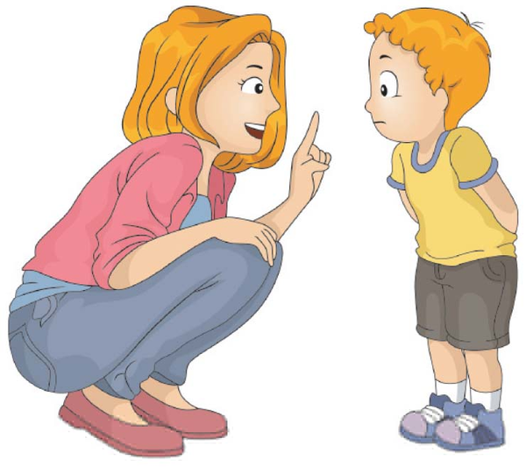
Solution:
Instead of giving, let them give.
2 Corinthians 12:27 If you give little, you will get little.
Instead of lecturing, listen to them.
Proverbs 18:13 He who answers before listening‑‑ that is his folly and his shame.

Slide 9
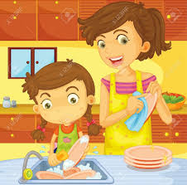
Instead of chores, give them challenges.
2 Thessalonians 3:10 For even when we were with you, we gave you this rule: “If a man will not work, he shall not eat.”

Slide 10
1 Corinthians 9:26,27 So I run straight to the goal with purpose in every step. I fight to win. I'm not just shadow‑boxing or playing around. Like an athlete I punish my body, treating it roughly, training it to do what it should, not what it wants to. Otherwise I fear that after enlisting others for the race, I myself might be declared unfit and ordered to stand aside.
.

Slide 11
Instead of directing, ask for their advice.
Proverbs 15:22 Plans go wrong with too few counselors; many counselors bring success.

Slide 12
Instead of pokes, give them strokes.
Ephesians 6:4 Fathers, don't exasperate your children by coming down hard on them. Take them by the hand and lead them in the way of the Master.

Slide 13
IV. Introduce your child to the God who wants both you on the team
Ephesians 1:11 It's in Christ that we find out who we are and what we are living for. Long before we first heard of Christ and got our hopes up, he had his eye on us, had designs on us for glorious living, part of the overall purpose he is working out in everything and everyone.

