Slide 1
Preacher, Preparation,
Presentation
A class on making and preaching sermons
Session 25
Presenting
Your Sermon
Make Your
Message
Memorable
Word
Pictures

Slide 2
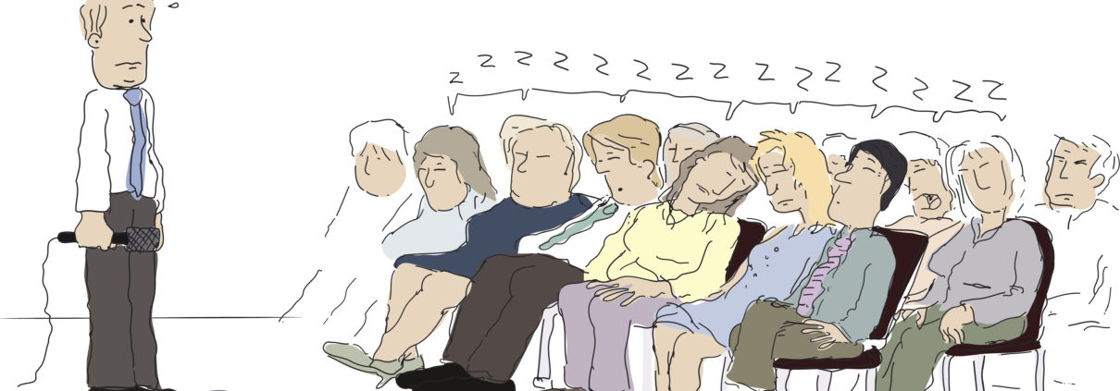

Slide 3
What Do People Remember?
10% of what we read
20% of what we hear
30% of what we see
50% of what we see and hear
70% of what we discuss
80% of what we experience
90% of what we teach

Slide 4
Presentation
Trumps
Information

Slide 5
How do you make a sermon
memorable?

Slide 6
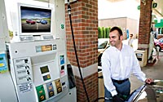
How do you make a sermon
memorable?
1. Use picture-language

Slide 7
https://youtu.be/nx7q5KruXTw

Slide 8
How do you make a sermon
memorable?
1. Use picture-language

Slide 9
Where do you find pictures?

Slide 10
Where do you find pictures?
In the passage.
Acts 17
“babbler”
“What is this babbler trying to say?” vs 18

Slide 11
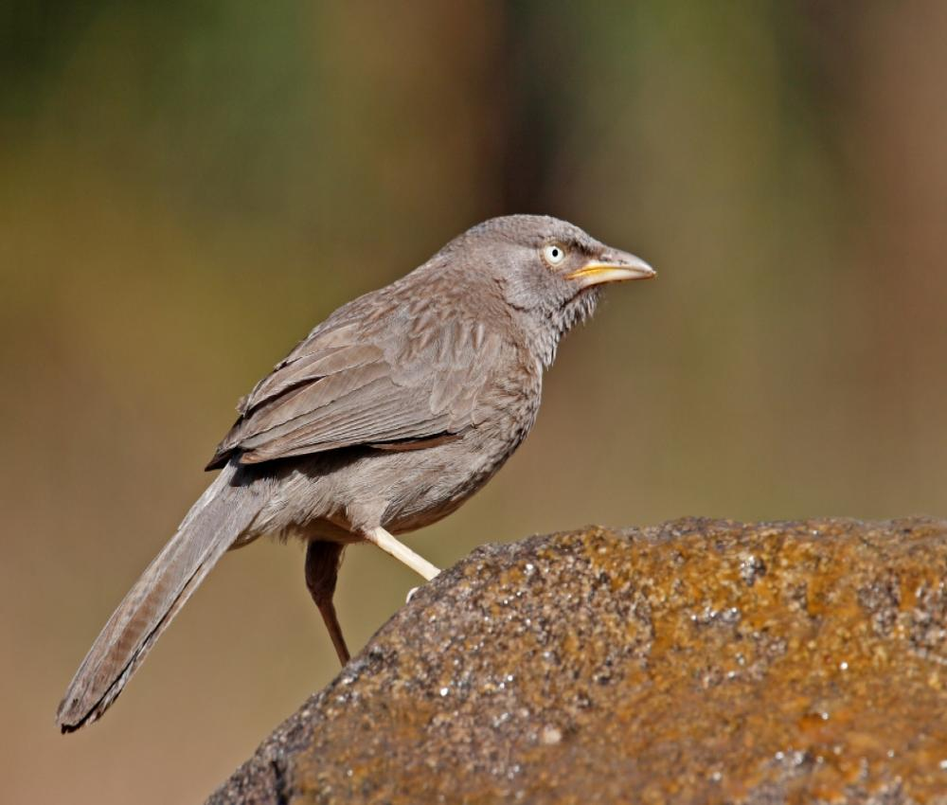

Slide 12
Where do you find pictures?
In the passage.
Commentaries
Web-site Bible studies
Sermons of others
sermoncentral.com
Logos
Biblegateway.com

Slide 13
Where do you find pictures?
In the passage.
In literature.
In life.

