Slide 1
Preacher, Preparation,
Presentation
A class on making and preaching sermons
Session 4
Preparing
To
Preach 2

Slide 2
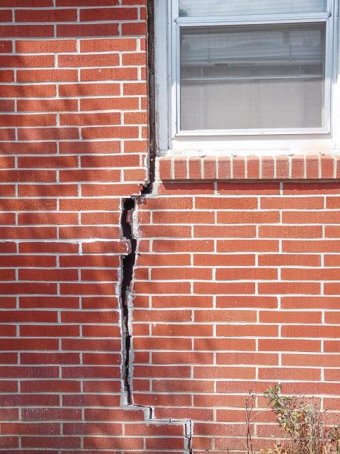

Slide 4
65% of Builders
34% of Boomers
17% of Busters
4% of Millennials

Slide 6
Session 3
Preparing for Preaching
- Pray
- Get others to pray

Slide 7
Session 4
Preaching for Preaching
The Bible

Slide 8
I Timothy 4:1-4
“In the presence of God and of Christ Jesus, who will judge the living and the dead, and in view of his appearing and his kingdom, I give you this charge:

Slide 9
Preach the word; be prepared in season and out of season; correct, rebuke and encourage—with great patience and careful instruction.”

Slide 10
For the time will come when people will not put up with sound doctrine. Instead, to suit their own desires, they will gather around them a great number of teachers to say what their itching ears want to hear.”

Slide 11
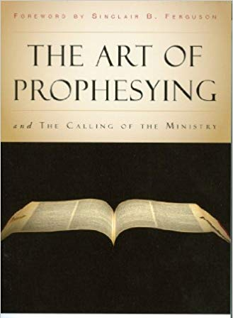

Slide 12
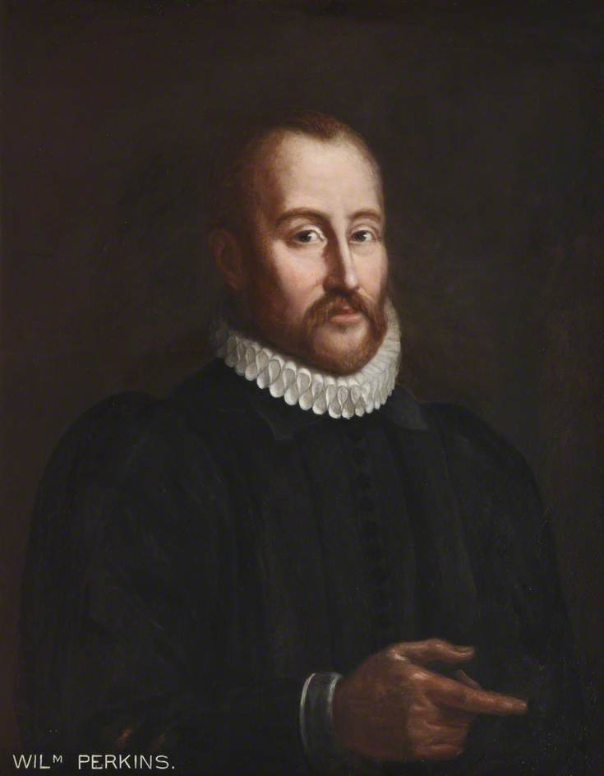
1558-1602

Slide 13
“The Word of God alone is to be preached, in its perfection and inner consistency.”

Slide 14
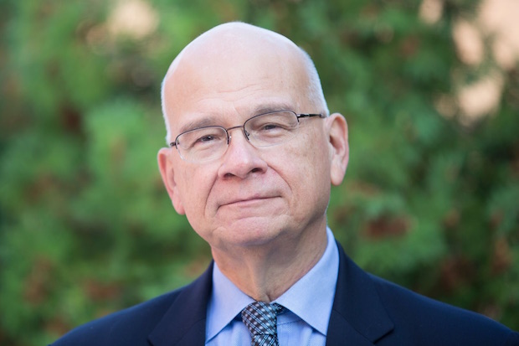

Slide 15
“William Perkins and his contemporaries reacted against ‘the cultivated oratory’ of their time. They believed that the main aim in preaching had been lost: that we let the Bible itself speak, so it can pour forth its own power.” Preaching, p. 28

Slide 16
Why
even make the point?

Slide 17
Historically
- Roman Catholic Church
- Then the Reformation
- Sola Scriptura
- Sola Fide
- Sola Gratia
- Sola Christus
- Sola Deo Gloria

Slide 19
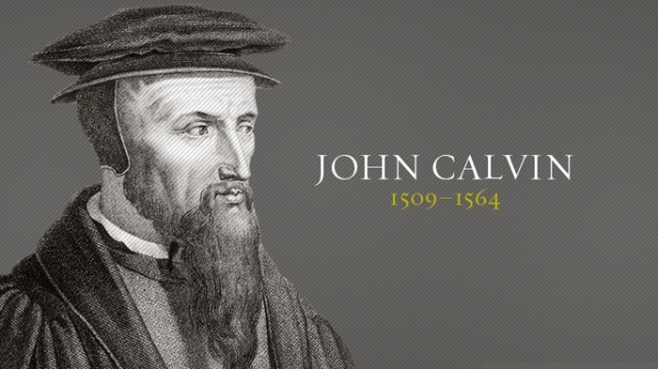

Slide 20
17th Century
England and Scotland

Slide 21
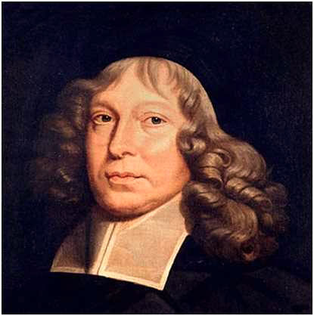
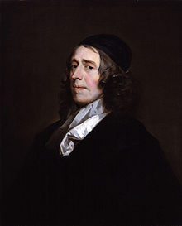
17th Century
England and Scotland
Samuel Rutherford
John Owen

Slide 22
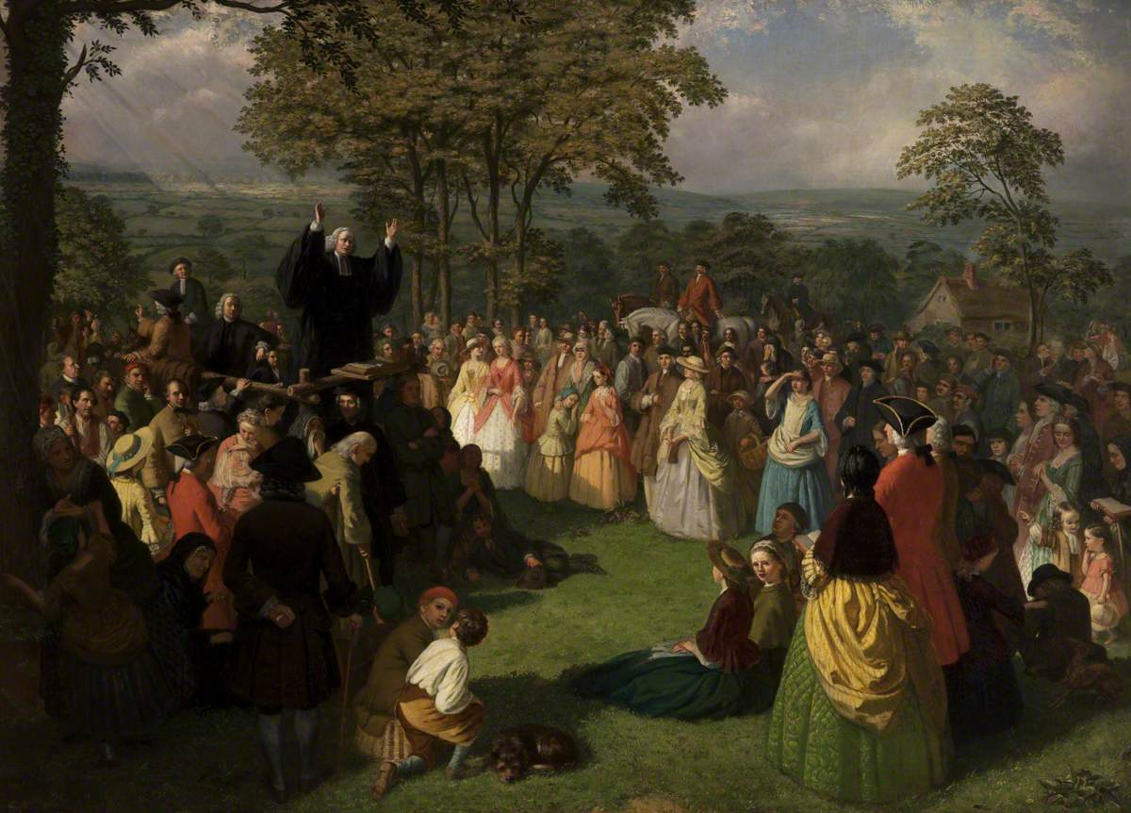
18th Century
George Whitfield

Slide 23
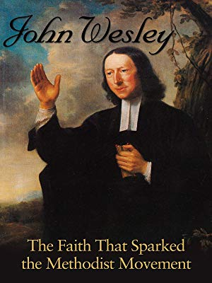
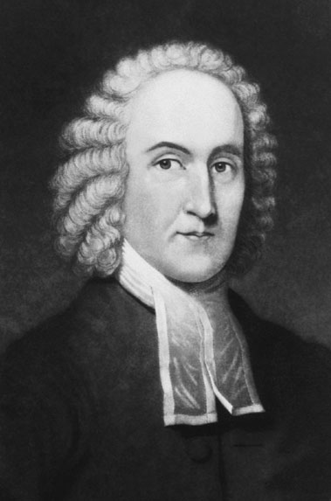
Jonathan Edwards

Slide 24
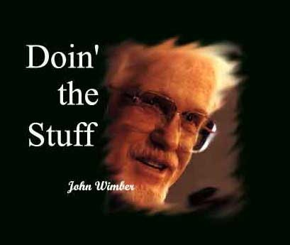
The Modern Era
- Tradition

Slide 25
The Modern Era
- Tradition
- Amos revisited
The days are coming, says the Lord, when I will send a famine through the land—not a famine of food or a thirst for water, but a famine of hearing the words of the Lord. Amos 8:11

Slide 26
For the word of God is alive and active. Sharper than any double-edged sword, it penetrates even to dividing soul and spirit, joints and marrow; it judges the thoughts and attitudes of the heart. Hebrews 4:12

Slide 27
2 Timothy 4 New International Version (NIV)
In the presence of God and of Christ Jesus, who will judge the living and the dead, and in view of his appearing and his kingdom, I give you this charge: ² Preach the word; be prepared in season and out of season; correct, rebuke and encourage—with great patience and careful instruction.

