Slide 1
Mental Health Integration
Week 9 Part 1- Shame

Slide 2
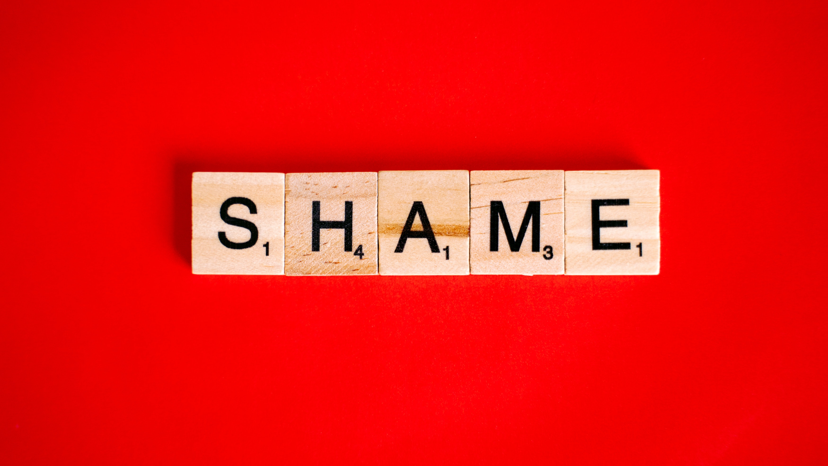
Photo by Anna Tarazevich from Pexels

Slide 3
: a painful emotion caused by consciousness of guilt, shortcoming, or impropriety -Merriam-Webster

Slide 4
“the intensely painful feeling or experience of believing that we are flawed and therefore unworthy of love and belonging — something we’ve experienced, done, or failed to do makes us unworthy of connection.” -brene brown

Slide 5
Everything was linked to land
Gods were localized upon their lands
Provision came from the land
Identity came from the land
Photo by Aaditya Arora from Pexels

Slide 6
Land
identity

Slide 7
Everything is linked to capacity
Our idea of God is often based on that god’s demands of us, and our capacity to fulfill those demands
Provision comes from our capacity
Identity comes from our capacity
Relationships come from our capacity
Photo by SHVETS production from Pexels

Slide 8
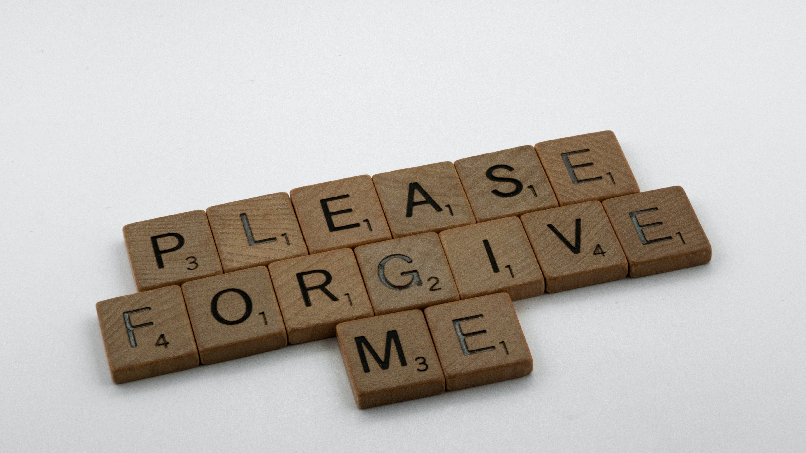
Photo by Brett Jordan from Pexels

Slide 9
Isaiah 61:1-3
The Spirit of the Sovereign Lord is on me, because the Lord has anointed me to proclaim good news to the poor. He has sent me to bind up the brokenhearted, to proclaim freedom for the captives and release from darkness for the prisoners,^{[a]} ² to proclaim the year of the Lord’s favor and the day of vengeance of our God, to comfort all who mourn, ³ and provide for those who grieve in Zion— to bestow on them a crown of beauty instead of ashes, the oil of joy instead of mourning, and a garment of praise instead of a spirit of despair. They will be called oaks of righteousness, a planting of the Lord for the display of his splendor.

Slide 10
Isaiah 61:4-7
⁴ They will rebuild the ancient ruins and restore the places long devastated; they will renew the ruined cities that have been devastated for generations. ⁵ Strangers will shepherd your flocks; foreigners will work your fields and vineyards. ⁶ And you will be called priests of the Lord, you will be named ministers of our God. You will feed on the wealth of nations, and in their riches you will boast.
⁷ Instead of your shame you will receive a double portion, and instead of disgrace you will rejoice in your inheritance. And so you will inherit a double portion in your land, and everlasting joy will be yours.

Slide 11
Isaiah 61:8-11
⁸ “For I, the Lord, love justice; I hate robbery and wrongdoing. In my faithfulness I will reward my people and make an everlasting covenant with them. ⁹ Their descendants will be known among the nations and their offspring among the peoples. All who see them will acknowledge that they are a people the Lord has blessed.”
¹⁰ I delight greatly in the Lord; my soul rejoices in my God. For he has clothed me with garments of salvation and arrayed me in a robe of his righteousness, as a bridegroom adorns his head like a priest, and as a bride adorns herself with her jewels. ¹¹ For as the soil makes the sprout come up and a garden causes seeds to grow, so the Sovereign Lord will make righteousness and praise spring up before all nations.

Slide 12
Isaiah 54:1-3
“Sing, barren woman, you who never bore a child; burst into song, shout for joy, you who were never in labor; because more are the children of the desolate woman than of her who has a husband,” says the Lord. ² “Enlarge the place of your tent, stretch your tent curtains wide, do not hold back; lengthen your cords, strengthen your stakes. ³ For you will spread out to the right and to the left; your descendants will dispossess nations and settle in their desolate cities.

Slide 13
Isaiah 54:4-8
⁴ “Do not be afraid; you will not be put to shame. Do not fear disgrace; you will not be humiliated. You will forget the shame of your youth and remember no more the reproach of your widowhood. ⁵ For your Maker is your husband— the Lord Almighty is his name— the Holy One of Israel is your Redeemer; he is called the God of all the earth. ⁶ The Lord will call you back as if you were a wife deserted and distressed in spirit— a wife who married young, only to be rejected,” says your God. ⁷ “For a brief moment I abandoned you, but with deep compassion I will bring you back. ⁸ In a surge of anger I hid my face from you for a moment, but with everlasting kindness I will have compassion on you,” says the Lord your Redeemer.

Slide 14
identity
land

Slide 15
Zephaniah 3:18-20
¹⁸ “I will remove from you all who mourn over the loss of your appointed festivals, which is a burden and reproach for you. ¹⁹ At that time I will deal with all who oppressed you. I will rescue the lame; I will gather the exiles. I will give them praise and honor in every land where they have suffered shame. ²⁰ At that time I will gather you; at that time I will bring you home. I will give you honor and praise among all the peoples of the earth when I restore your fortunes^{[e]} before your very eyes,” says the Lord.

Slide 16
Psalm 23:1-6
¹ The Lord is my shepherd, I lack nothing. ² He makes me lie down in green pastures, he leads me beside quiet waters, ³ he refreshes my soul. He guides me along the right paths for his name’s sake. ⁴ Even though I walk through the darkest valley, I will fear no evil, for you are with me; your rod and your staff, they comfort me.
⁵ You prepare a table before me in the presence of my enemies. You anoint my head with oil; my cup overflows. ⁶ Surely your goodness and love will follow me all the days of my life, and I will dwell in the house of the Lord forever.

Slide 17
beloved
Good place

Slide 18
John 17:1-5
17 After Jesus said this, he looked toward heaven and prayed:
“Father, the hour has come. Glorify your Son, that your Son may glorify you. ² For you granted him authority over all people that he might give eternal life to all those you have given him. ³ Now this is eternal life: that they know you, the only true God, and Jesus Christ, whom you have sent. ⁴ I have brought you glory on earth by finishing the work you gave me to do. ⁵ And now, Father, glorify me in your presence with the glory I had with you before the world began.

Slide 19
John 17:6-12
⁶ “I have revealed you to those whom you gave me out of the world. They were yours; you gave them to me and they have obeyed your word. ⁷ Now they know that everything you have given me comes from you. ⁸ For I gave them the words you gave me and they accepted them. They knew with certainty that I came from you, and they believed that you sent me. ⁹ I pray for them. I am not praying for the world, but for those you have given me, for they are yours. ¹⁰ All I have is yours, and all you have is mine. And glory has come to me through them. ¹¹ I will remain in the world no longer, but they are still in the world, and I am coming to you. Holy Father, protect them by the power of your name, the name you gave me, so that they may be one as we are one. ¹² While I was with them, I protected them and kept them safe by that name you gave me. None has been lost except the one doomed to destruction so that Scripture would be fulfilled.

Slide 20
John 17:13-19
¹³ “I am coming to you now, but I say these things while I am still in the world, so that they may have the full measure of my joy within them. ¹⁴ I have given them your word and the world has hated them, for they are not of the world any more than I am of the world. ¹⁵ My prayer is not that you take them out of the world but that you protect them from the evil one. ¹⁶ They are not of the world, even as I am not of it. ¹⁷ Sanctify them by the truth; your word is truth. ¹⁸ As you sent me into the world, I have sent them into the world. ¹⁹ For them I sanctify myself, that they too may be truly sanctified.

Slide 21
John 17:20-25
²⁰ “My prayer is not for them alone. I pray also for those who will believe in me through their message, ²¹ that all of them may be one, Father, just as you are in me and I am in you. May they also be in us so that the world may believe that you have sent me. ²² I have given them the glory that you gave me, that they may be one as we are one— ²³ I in them and you in me—so that they may be brought to complete unity. Then the world will know that you sent me and have loved them even as you have loved me.
²⁴ “Father, I want those you have given me to be with me where I am, and to see my glory, the glory you have given me because you loved me before the creation of the world.
²⁵ “Righteous Father, though the world does not know you, I know you, and they know that you have sent me. ²⁶ I have made you^{[e]} known to them, and will continue to make you known in order that the love you have for me may be in them and that I myself may be in them.”

Slide 22
Mental Health Integration
Week 9 Part 2- Anxiety and Depression

Slide 23
shame Photo by cottonbro from Pexels
Who I am

Slide 24
anxiety
What I do

Slide 25
Matthew 6:25-34
²⁵ “Therefore I tell you, do not worry about your life, what you will eat or drink; or about your body, what you will wear. Is not life more than food, and the body more than clothes? ²⁶ Look at the birds of the air; they do not sow or reap or store away in barns, and yet your heavenly Father feeds them. Are you not much more valuable than they? ²⁷ Can any one of you by worrying add a single hour to your life?
²⁸ “And why do you worry about clothes? See how the flowers of the field grow. They do not labor or spin. ²⁹ Yet I tell you that not even Solomon in all his splendor was dressed like one of these. ³⁰ If that is how God clothes the grass of the field, which is here today and tomorrow is thrown into the fire, will he not much more clothe you—you of little faith? ³¹ So do not worry, saying, ‘What shall we eat?’ or ‘What shall we drink?’ or ‘What shall we wear?’ ³² For the pagans run after all these things, and your heavenly Father knows that you need them. ³³ But seek first his kingdom and his righteousness, and all these things will be given to you as well. ³⁴ Therefore do not worry about tomorrow, for tomorrow will worry about itself. Each day has enough trouble of its own.

Slide 26
Luke 10:41-42
⁴¹ “Martha, Martha,” the Lord answered, “you are worried and upset about many things, ⁴² but few things are needed—or indeed only one. Mary has chosen what is better, and it will not be taken away from her.”

Slide 27
Luke 12:22-31
²² Then Jesus said to his disciples: “Therefore I tell you, do not worry about your life, what you will eat; or about your body, what you will wear. ²³ For life is more than food, and the body more than clothes. ²⁴ Consider the ravens: They do not sow or reap, they have no storeroom or barn; yet God feeds them. And how much more valuable you are than birds! ²⁵ Who of you by worrying can add a single hour to your life? ²⁶ Since you cannot do this very little thing, why do you worry about the rest?
²⁷ “Consider how the wild flowers grow. They do not labor or spin. Yet I tell you, not even Solomon in all his splendor was dressed like one of these. ²⁸ If that is how God clothes the grass of the field, which is here today, and tomorrow is thrown into the fire, how much more will he clothe you—you of little faith! ²⁹ And do not set your heart on what you will eat or drink; do not worry about it. ³⁰ For the pagan world runs after all such things, and your Father knows that you need them. ³¹ But seek his kingdom, and these things will be given to you as well.

Slide 28
Philippians 4:4-7
⁴ Rejoice in the Lord always. I will say it again: Rejoice! ⁵ Let your gentleness be evident to all. The Lord is near. ⁶ Do not be anxious about anything, but in every situation, by prayer and petition, with thanksgiving, present your requests to God. ⁷ And the peace of God, which transcends all understanding, will guard your hearts and your minds in Christ Jesus.

Slide 29
How many of you can make your anxiety go away by trying?

Slide 30
Does is get better or worse?

Slide 31
Galatians 5:22-23
²² But the fruit of the Spirit is love, joy, peace, forbearance, kindness, goodness, faithfulness, ²³ gentleness and self-control. Against such things there is no law.
Photo by Brett Jordan: https://www.pexels.com/photo/wood-typography-photography-branches-8354722/

Slide 33
Proverbs 12:20
Deceit is in the hearts of those who plot evil, but those who promote peace have joy.

Slide 34
Romans 12:12
Be joyful in hope, patient in affliction, faithful in prayer.

Slide 35
Romans 14:16-18
¹⁶ Therefore do not let what you know is good be spoken of as evil. ¹⁷ For the kingdom of God is not a matter of eating and drinking, but of righteousness, peace and joy in the Holy Spirit, ¹⁸ because anyone who serves Christ in this way is pleasing to God and receives human approval.

Slide 36
John 16:24
²⁴ Until now you have not asked for anything in my name. Ask and you will receive, and your joy will be complete.

Slide 37
Does depression turn to joy by trying?

Slide 38
What is the impact of blame?

Slide 39
Mental Health Integration
Week 9 Part 3- Suffering

Slide 40
James 1:2-3
² Consider it pure joy, my brothers and sisters, whenever you face trials of many kinds, ³ because you know that the testing of your faith produces perseverance.

Slide 41
Romans 5:1-5
5 Therefore, since we have been justified through faith, we have peace with God through our Lord Jesus Christ, ² through whom we have gained access by faith into this grace in which we now stand. And we boast in the hope of the glory of God. ³ Not only so, but we also glory in our sufferings, because we know that suffering produces perseverance; ⁴ perseverance, character; and character, hope. ⁵ And hope does not put us to shame, because God’s love has been poured out into our hearts through the Holy Spirit, who has been given to us.

Slide 42
What is suffering a sign of?

Slide 43
But, what do we believe?

Slide 44
Genesis 30:29-30
²⁹ Jacob said to him, “You know how I have worked for you and how your livestock has fared under my care. ³⁰ The little you had before I came has increased greatly, and the Lord has blessed you wherever I have been. But now, when may I do something for my own household?”
Photo by Cup of Couple from Pexels

Slide 45
Genesis 39:2-6
² The Lord was with Joseph so that he prospered, and he lived in the house of his Egyptian master. ³ When his master saw that the Lord was with him and that the Lord gave him success in everything he did, ⁴ Joseph found favor in his eyes and became his attendant. Potiphar put him in charge of his household, and he entrusted to his care everything he owned. ⁵ From the time he put him in charge of his household and of all that he owned, the Lord blessed the household of the Egyptian because of Joseph. The blessing of the Lord was on everything Potiphar had, both in the house and in the field. ⁶ So Potiphar left everything he had in Joseph’s care; with Joseph in charge, he did not concern himself with anything except the food he ate.

Slide 46
Psalm 107:33-38
³³ He turned rivers into a desert, flowing springs into thirsty ground, ³⁴ and fruitful land into a salt waste, because of the wickedness of those who lived there. ³⁵ He turned the desert into pools of water and the parched ground into flowing springs; ³⁶ there he brought the hungry to live, and they founded a city where they could settle. ³⁷ They sowed fields and planted vineyards that yielded a fruitful harvest; ³⁸ he blessed them, and their numbers greatly increased, and he did not let their herds diminish.

Slide 47
Being with God
Having plenty

Slide 48
Hebrews 11:32-35a
³² And what more shall I say? I do not have time to tell about Gideon, Barak, Samson and Jephthah, about David and Samuel and the prophets, ³³ who through faith conquered kingdoms, administered justice, and gained what was promised; who shut the mouths of lions, ³⁴ quenched the fury of the flames, and escaped the edge of the sword; whose weakness was turned to strength; and who became powerful in battle and routed foreign armies. ³⁵ Women received back their dead, raised to life again…

Slide 49
Hebrews 11:35b-40
There were others who were tortured, refusing to be released so that they might gain an even better resurrection. ³⁶ Some faced jeers and flogging, and even chains and imprisonment. ³⁷ They were put to death by stoning;^{[e]} they were sawed in two; they were killed by the sword. They went about in sheepskins and goatskins, destitute, persecuted and mistreated— ³⁸ the world was not worthy of them. They wandered in deserts and mountains, living in caves and in holes in the ground.
³⁹ These were all commended for their faith, yet none of them received what had been promised, ⁴⁰ since God had planned something better for us so that only together with us would they be made perfect.

Slide 50
Hebrews 2:9-11
⁹ But we do see Jesus, who was made lower than the angels for a little while, now crowned with glory and honor because he suffered death, so that by the grace of God he might taste death for everyone.
¹⁰ In bringing many sons and daughters to glory, it was fitting that God, for whom and through whom everything exists, should make the pioneer of their salvation perfect through what he suffered. ¹¹ Both the one who makes people holy and those who are made holy are of the same family. So Jesus is not ashamed to call them brothers and sisters.

Slide 51
Blessing often comes after suffering

Slide 52
Genesis 30:29-30
Jacob
Joseph
Photo by Cup of Couple from Pexels

Slide 53
What are the ramifications of your relationship to suffering?

