Slide 1
Preacher, Preparation,
Presentation
A class on making and preaching sermons
Session 2
The Call

Slide 2
The Call to Preach
- Not for everyone
Some have it and…
Some may serve in other capacities…

Slide 3
The Call in Scripture:
Jeremiah:
“Before I formed you in the womb, I knew you, before you were born I set you apart; I appointed you as a prophet to the nations.” 1:5

Slide 5
The Call in Scripture:
Jeremiah:
Samuel:

Slide 7
“The Lord continued to appear at Shiloh, and there he revealed himself to Samuel through his word.” I Samuel 3:21

Slide 8
The Call in Scripture:
Jeremiah:
Samuel:
Isaiah:

Slide 9
“Then I heard the voice of the Lord saying, “Whom shall I send? And who will go for us?” And I said, “Here am I. Send me!” Isaiah 6:8

Slide 10
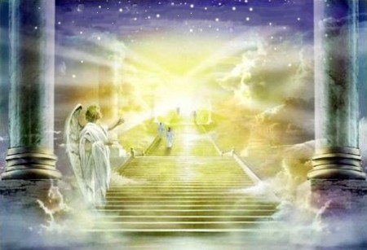

Slide 11
The Call in Scripture:
Jeremiah:
Samuel:
Isaiah:
Ezekiel:

Slide 12
“Son of man, I am sending you to the Israelites, to a rebellious nation that has rebelled against me;… The people to whom I am sending you are obstinate and stubborn. Say to them, ‘This is what the Sovereign Lord says….” Ezekiel 2:3, 4

Slide 14
The Call in Scripture:
Jeremiah:
Samuel:
Isaiah:
Ezekiel:
Hosea:

Slide 15
“The word of the Lord that came to Hosea, son of Beeri during the reigns of Uzziah, Jothan, Ahaz and Hezekiah, kings of Judah....
Hosea 1:1

Slide 17
The Call in Scripture:
Jeremiah:
Samuel:
Isaiah:
Ezekiel:
Hosea:
Jonah:

Slide 18
“The word of the Lord came to Jonah son of Amittai: ‘Go to the great city of Ninevah and preach against it, because its wickedness has come up before me.’” Jonah 1:1

Slide 20
The Call in Scripture:
Jeremiah: Elisha:
Samuel:
Isaiah:
Ezekiel:
Hosea:
Jonah:

Slide 21
“Elijah went up to him and threw his cloak around him.”
1 Kings 19:19

Slide 22
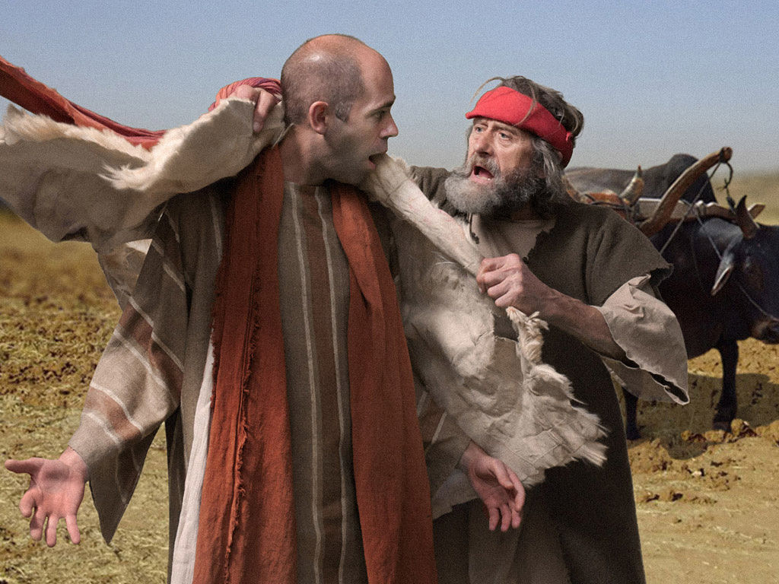

Slide 23
The Call in Scripture:
Jeremiah: Elisha:
Samuel: John the Baptist
Isaiah:
Ezekiel:
Hosea:
Jonah:

Slide 24
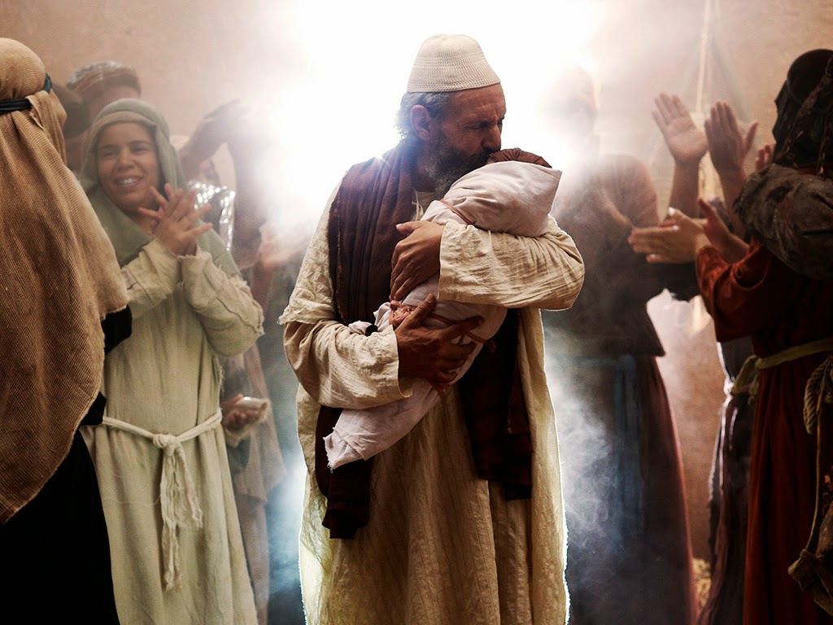

Slide 25
“And he will go on before the Lord, in the spirit and power of Elijah, to turn the hearts of the parents to their children and the disobedient to the wisdom of the righteous—to make ready a people prepared for the Lord.” Luke 1:17

Slide 26
The Call in Scripture:
Jeremiah: Elisha:
Samuel: John the Baptist:
Isaiah: Paul:
Ezekiel:
Hosea:
Jonah:

Slide 27
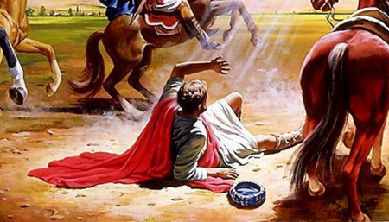
Acts 9

Slide 28
What is your call like?

Slide 29
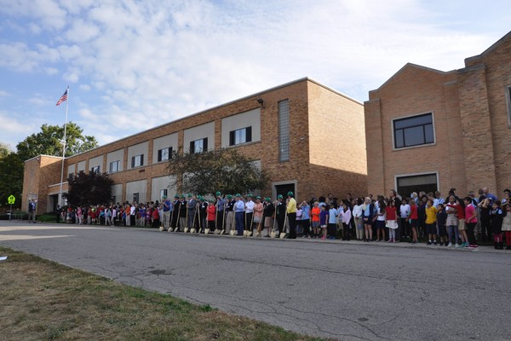

Slide 30
“The words of the wise are like goads, their collected sayings like firmly embedded nails—given by one shepherd. Be warned, my son, of anything in addition to them. Of making of books there is no end, and much study wearies the body.”
Ecclesiastes 12:11, 12

Slide 31
What is your call like?
-child, “I want to do that”
- invitation, “It feels right”
- A burden
- “Try it, and see”

Slide 32
Inner and Outer Call
Bible, Bearings, Burden

