Slide 2
Cognitive Appraisal
Cognitive interpretations that accompany emotions

Slide 3
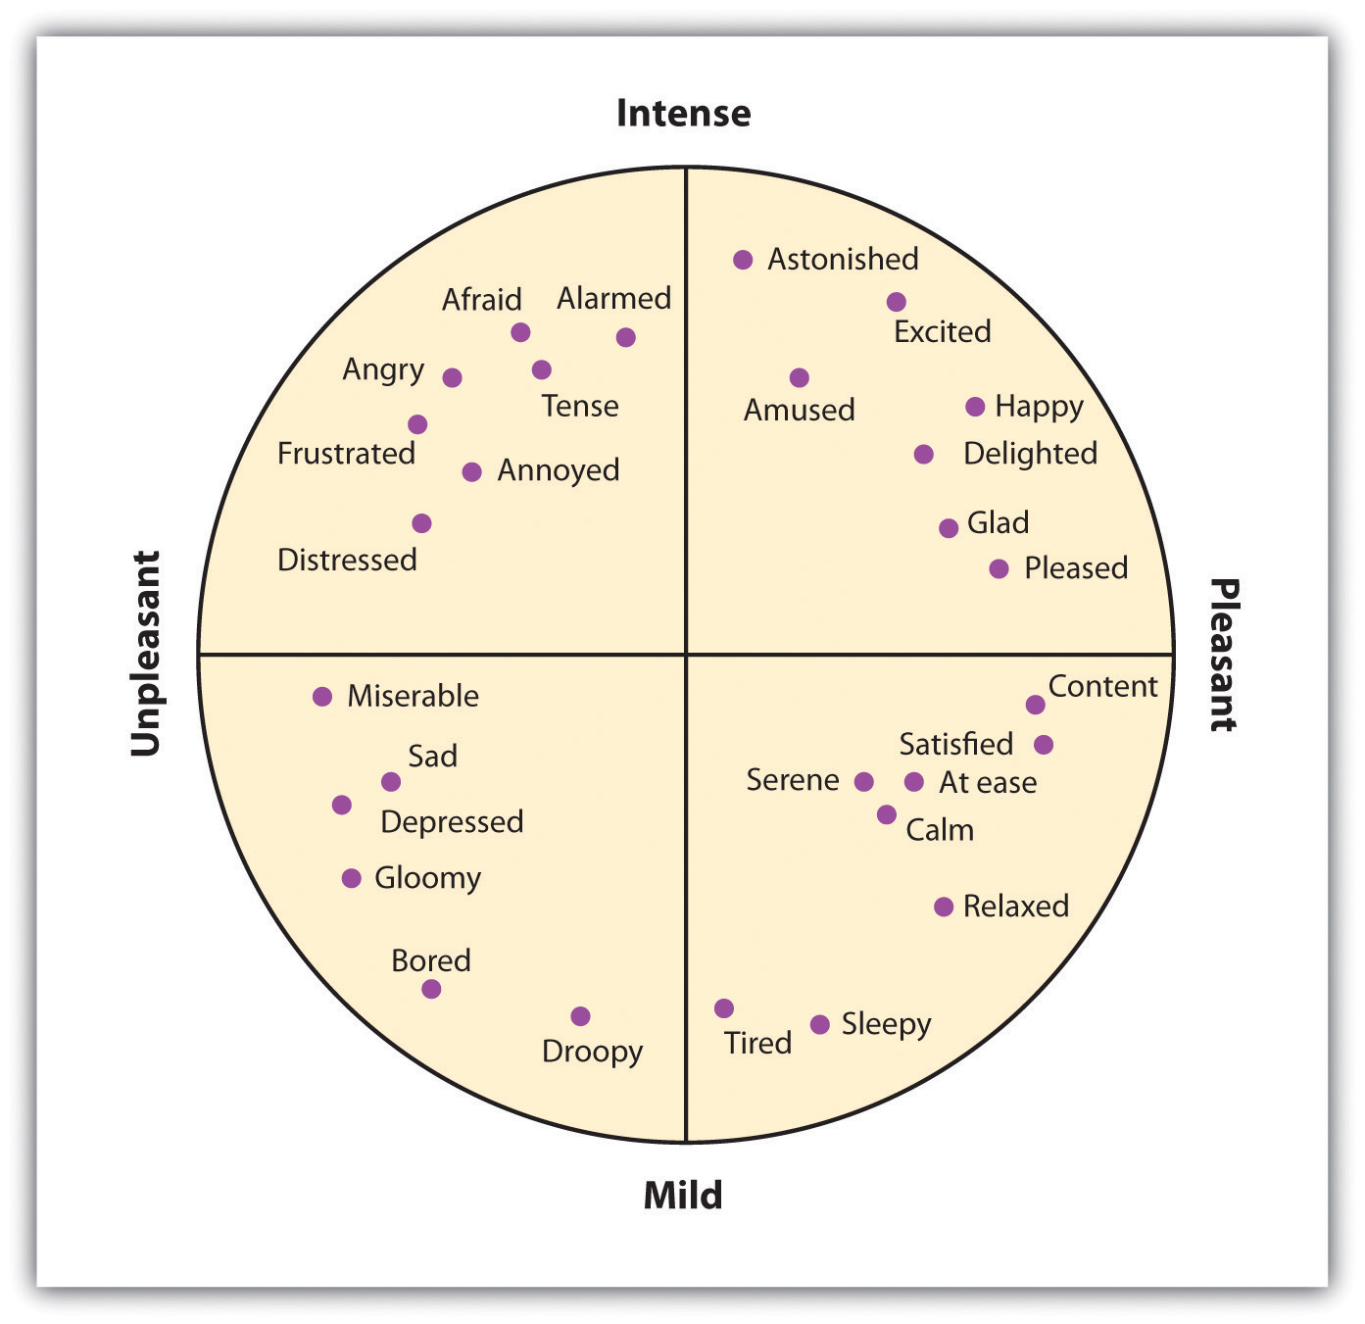

Slide 4
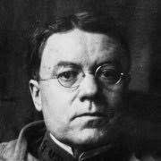
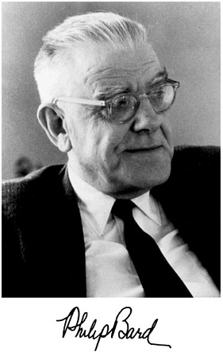
William Cannon

Slide 5
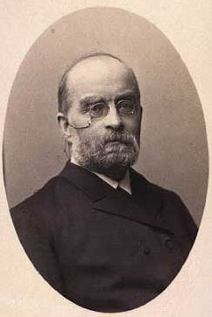
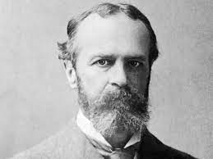
Carl Lang
William James

Slide 6
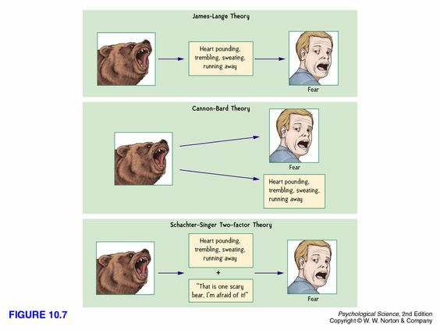

Slide 7
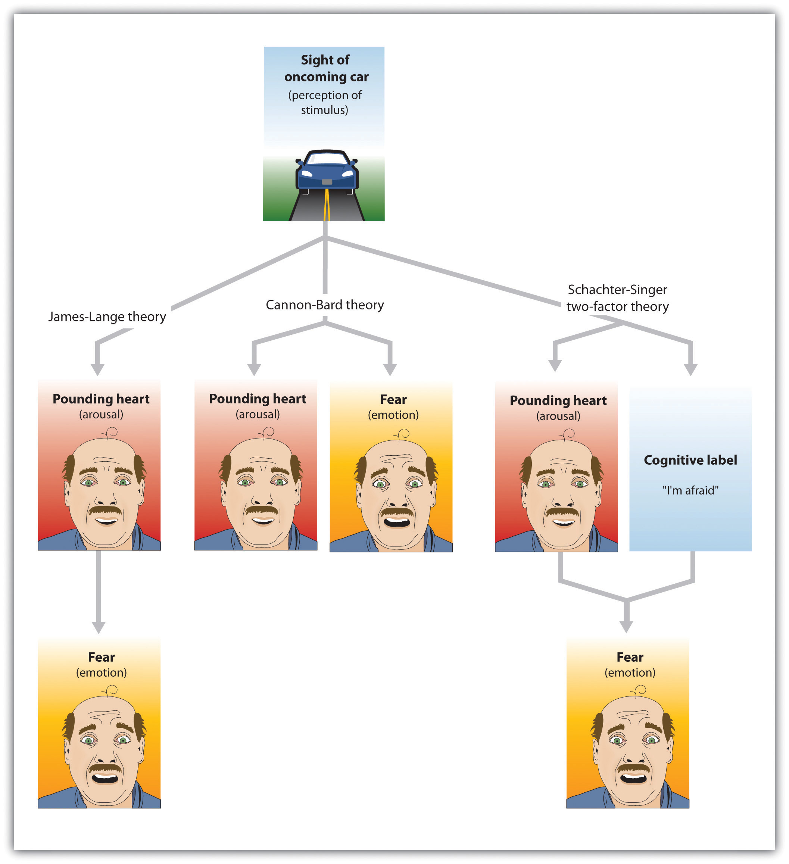

Slide 8
The experience of emotion is determined by the intensity of the arousal we are experiencing, but that the cognitive appraisal of the situation determines what the emotion will be.

Slide 9
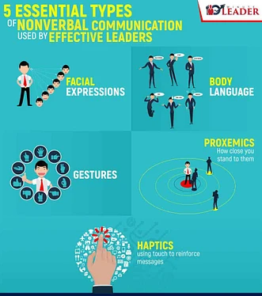
Non-Verbal Communication
Communication, primarily of liking or disliking, that does not involve words

Slide 11
