Slide 1
10 Slaves

Slide 2
Slaves in the Roman Empire were omnipresent
in one of the great world slave societies.
The economy depended on slavery.
“Enslaved persons”

Slide 3
Principal means of acquisition:
War and vernae (house born)

Slide 4
No difference in dress or appearance
Predominance of males;
implications for demography

Slide 5
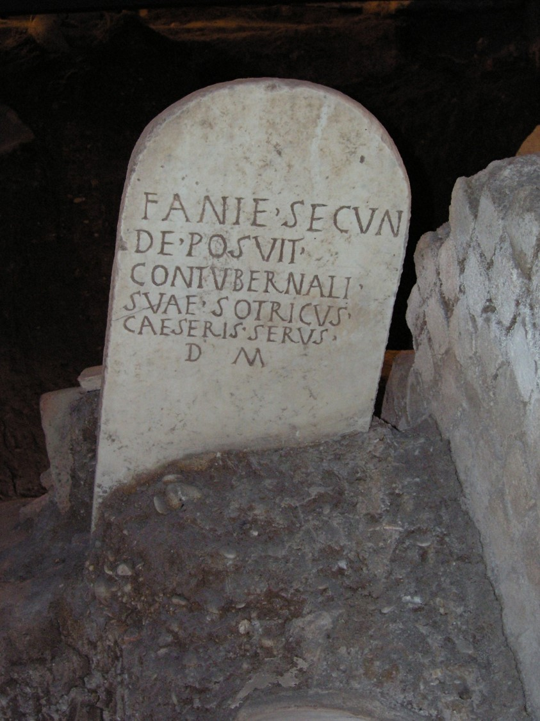
Relative autonomy of the enslaved

Slide 6
Manumission and freedmen/women:
The most upwardly mobile segment of Roman society
Roman freedwomen

Slide 7
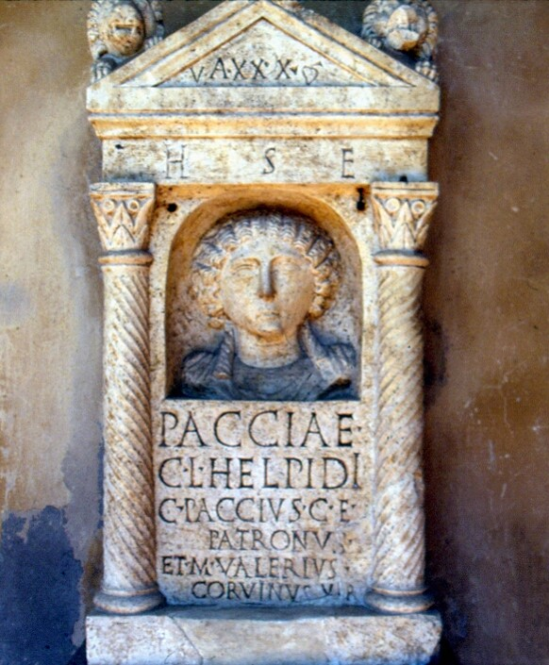
Manumission matrimonii causa and for other reasons

Slide 8
Many probable freedmen/women in the New Testament, e.g.,
Joseph Barsabbas Justus (Acts 1:23)
Lydia (Acts 16)
Antonius Claudius Felix (Acts 24:22-26), Roman procurator of Judea 52-60
Synagogue of the freedmen (not libertines!) Acts 6:9

Slide 9
Paul’s possible origins:
Jerome’s testimony that Paul’s parents were enslaved by a Roman
and gained freedom with citizenship
Paul was born a Roman citizen Acts 22:28

Slide 10
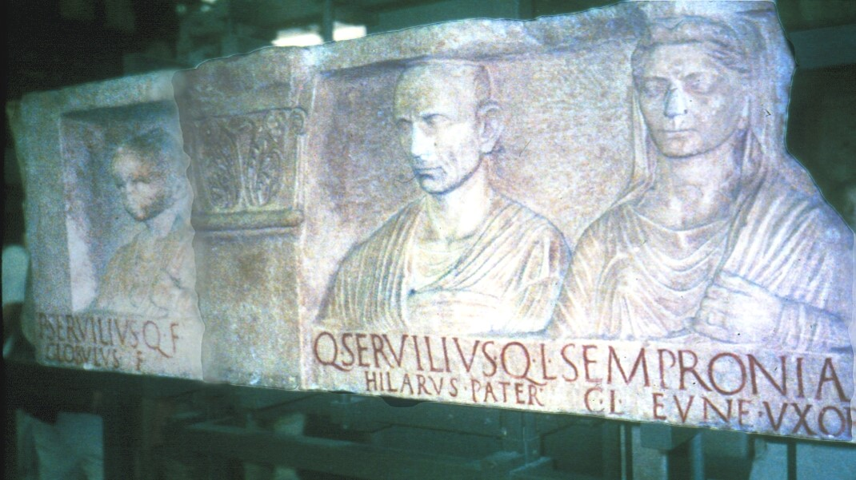
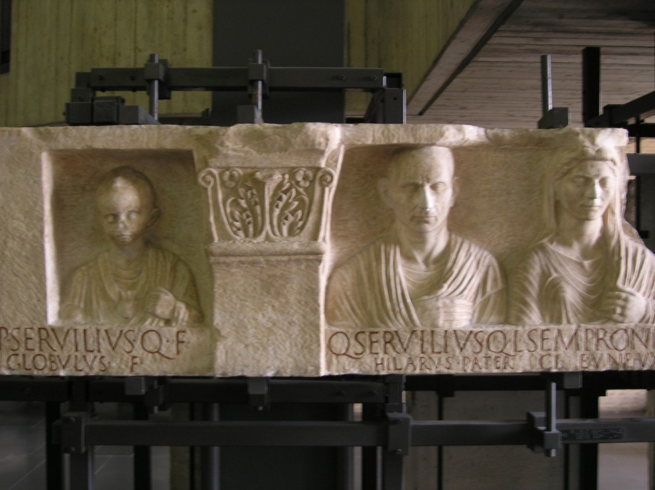

Slide 11
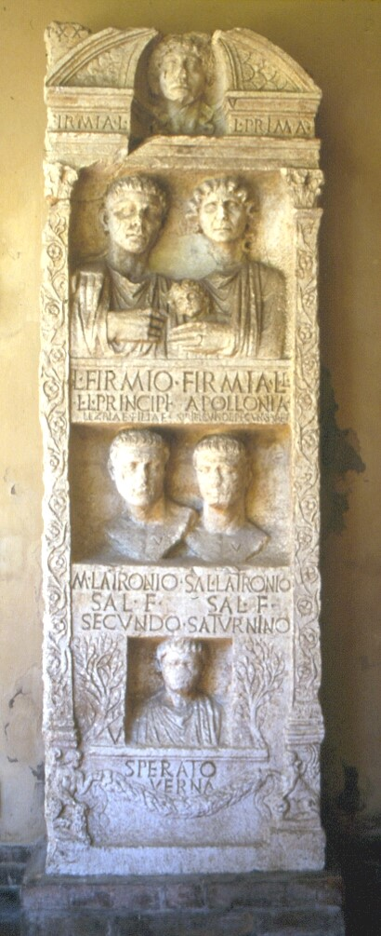
Once more, the Firmius family

