Slide 1
Preacher, Preparation,
Presentation
A class on making and preaching sermons
Session 7
Preparing
To
Preach
From Exegesis
To Sermon

Slide 2
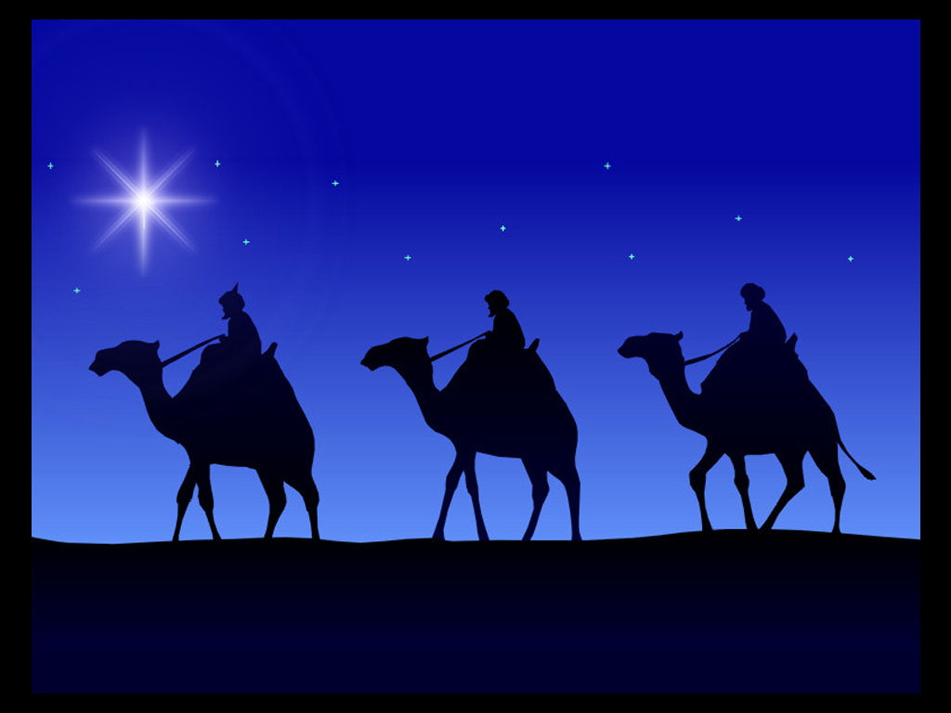
Wise People Seek
Matthew 2:1-12

Slide 3
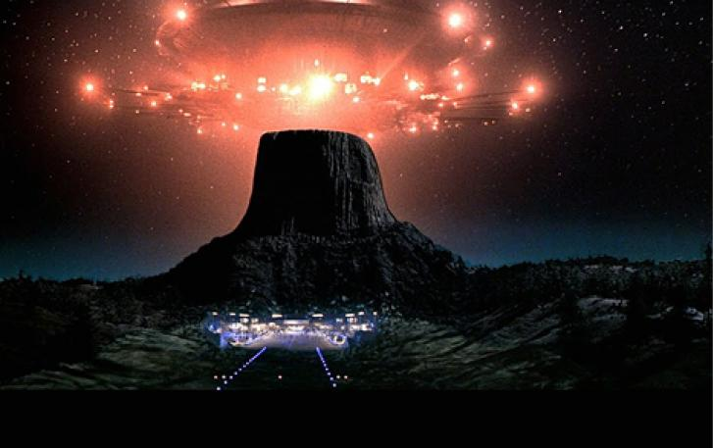

Slide 4
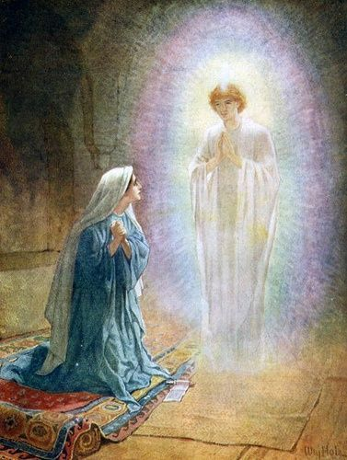

Slide 5
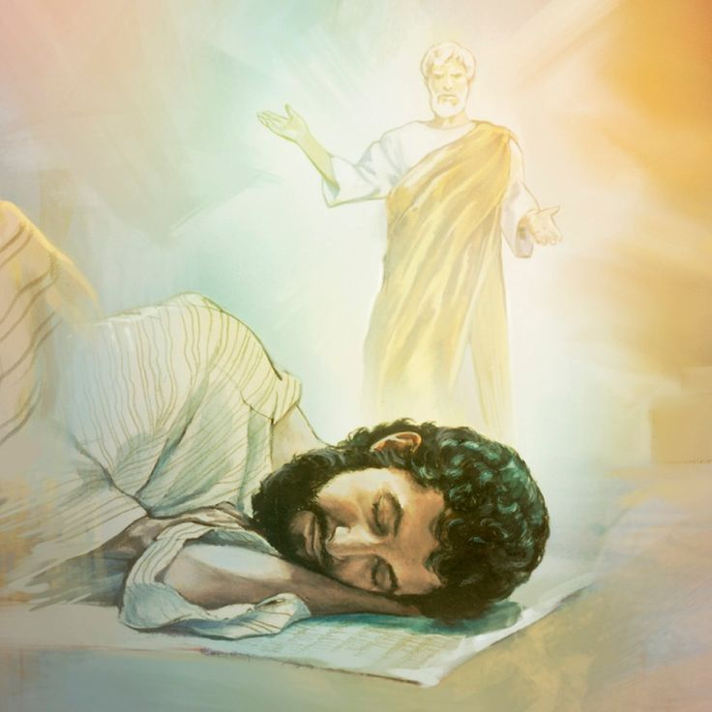

Slide 6
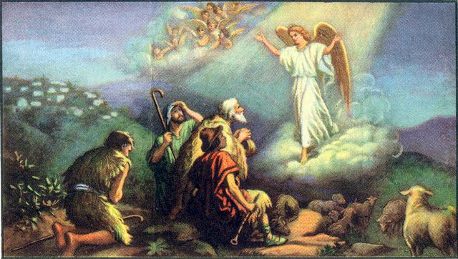

Slide 7
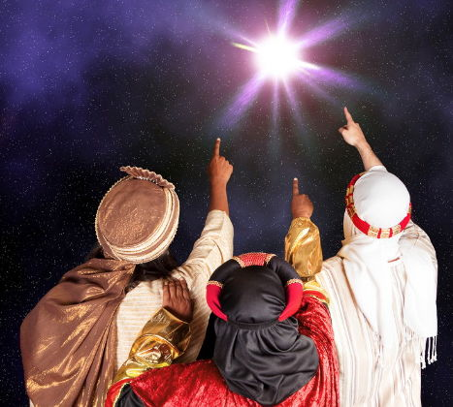

Slide 8
We don’t know who they were

Slide 9
We don’t know who they were
We don’t know how many

Slide 10
We don’t know who they were
We don’t know how many
We don’t know why they came

Slide 11
We don’t know who they were
We don’t know how many
We don’t know why they came
We don’t know what the star
was

Slide 13
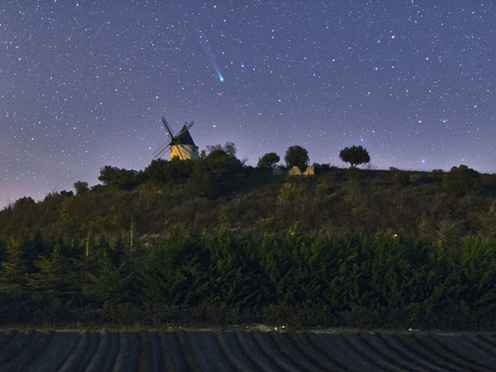

Slide 14
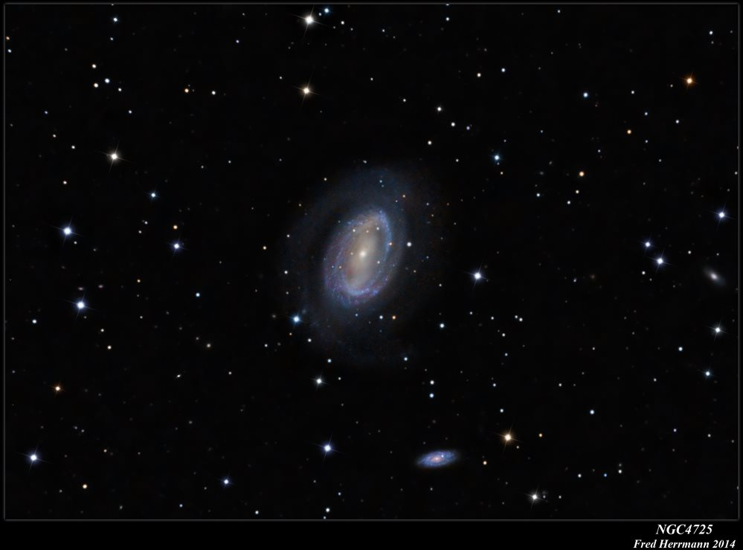

Slide 15
Gold
Frankincense
Myrrh
Mark 15:23
John 19:29

Slide 16
Religious Leaders Missed It
- A generational hunger
- Where
- When
- What

Slide 17
Why?

Slide 18
Didn’t need a Messiah?
tax collector

Slide 19
Didn’t need a Messiah?
Didn’t want a Messiah?
disappointment with God?

Slide 20
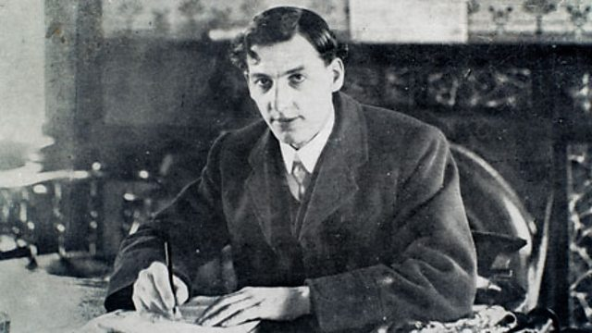

Slide 22
Disturbed
= troubled, emotionally
engaged
In Charge

Slide 23
Fear

Slide 24
Are you seeking a Savior?

