Slide 1
Preacher, Preparation,
Presentation
A class on making and preaching sermons
Session 31
Presenting
Your Sermon
Notes?
Manuscript?
No notes?

Slide 2
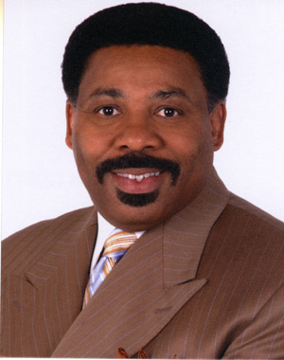
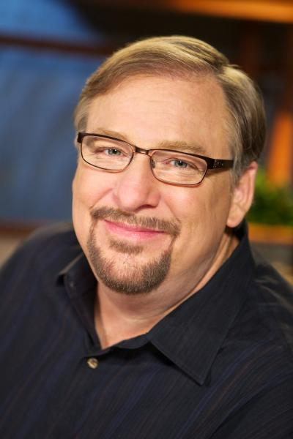
Well-Known Communicators

Slide 3
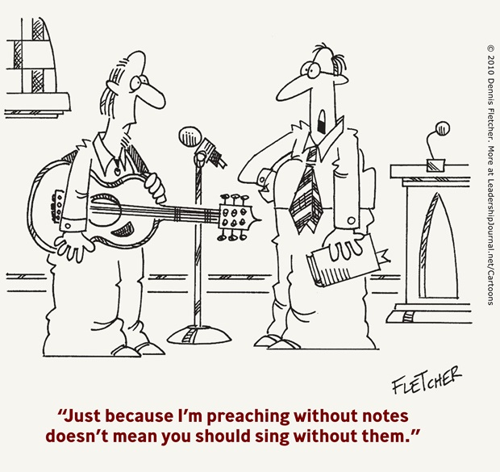

Slide 4
Options for Presentation

Slide 5
Options for Presentation
1. Full manuscript and read
2. Full manuscript memorized
3. Full manuscript converted to an
outline
4. Extended outline
5. Bare-bones outline
6. Extemporizing

Slide 6
Full manuscript and Read
Advantages:
Ensured preparation
Precision of expression

Slide 7
Full manuscript and Read
Advantages:
Ensured preparation
Precision of expression
Disadvantages
Eye contact limited
Limits freedom of expression
Spontaneity limited
Extensive preparation

Slide 8
Full Manuscript Memorized
Advantages
Precision of expression
Promotes eye contact
Disadvantages
Difficulty
Woodenness of expression
Extensive preparation time

Slide 9
Full Manuscript—Outline
Advantages
Complete preparation of thought
Maintains eye contact
Maintains spontaneity
Disadvantages
Primarily extensive preparation

Slide 10
Extensive Outline
Advantages
More is better
written and practiced
Disadvantages
Can be too wooden

Slide 11
Bare-Bones Outline
Advantages
Spontaneous expression
Eye Contact
Rapid preparation
Disadvantages
Encourages ill-prepared thought
Leads to brevity or length

Slide 12
No Notes
Advantages
Immediacy of communication
Eye contact
Body language
Disadvantages
Preparation
Forgetfulness

Slide 13
Internalizing the Message

Slide 14
Internalizing the Message
Memorize Movements
Memorize illustrations
Get familiar with small
parts
Build in crutches
Practice, Practice, Practice

