Slide 1
Preacher, Preparation,
Presentation
A class on making and preaching sermons
Session 22
Developing
A Sermon
Organizing
The Message
Continued

Slide 2
Organization/Structure

Slide 3
Dr. Frank A. Thomas
Situation
Complication of the situation
Resolution of the complication
Celebration of the resolution

Slide 4
Map or Ladder Structure

Slide 5
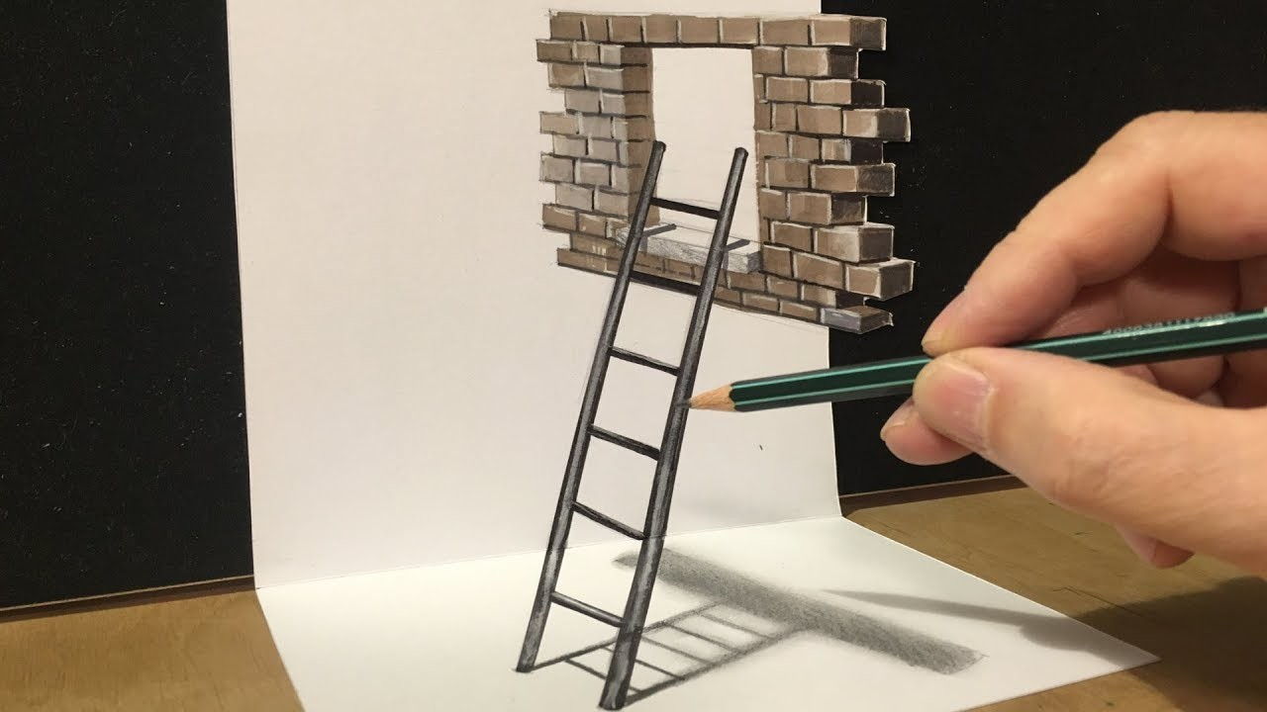

Slide 6
Map or Ladder Structure
Main point: God cares about condemned people.

Slide 7
Main point: God cares about condemned people.
- God’s concern for Nineveh
- Jonah’s Commission
- God’s confrontation with Jonah
- Jonah’s cry from the fish
- Jonah’s communication
- Jonah’s confrontation with God

Slide 8
Textual Structure
Main points from the text
Sub-points from outside of
text
Expository Structure
Main points from the text
Sub-points from the text

Slide 9
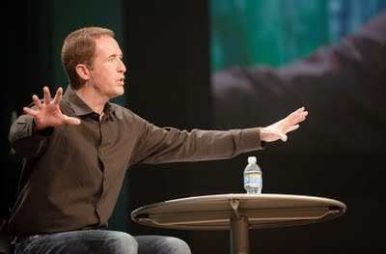

Slide 10
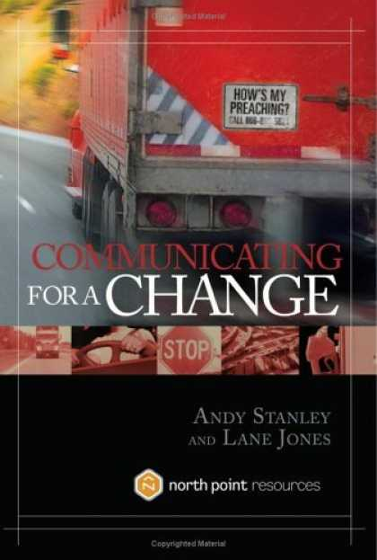

Slide 11
Conversational Structure
Me:
We:
God:
You:
Conclusion
We:

Slide 12
Submission Is the Best Decision

Slide 13
Submission Is the Best Decision
Me: Wondering how to respond
to situations in my marriage.

Slide 14
Submission Is the Best Decision
Me: Wondering how to respond
to situations in my marriage.
We: You probably wonder, too.

Slide 15
Submission Is the Best Decision
Me: Wondering how to respond
to situations in my marriage.
We: You probably wonder, too.
God: The Bible teaches that we are
to submit to one another,
put the desires and needs of
our spouse ahead of ours.

Slide 16
Submission Is the Best Decision
Me: Wondering how to respond
to situations in my marriage.
We: You probably wonder, too.
God: The Bible teaches that we are
to submit to one another.
You: Next time: How can I?

Slide 17
Submission Is the Best Decision
Me: Wondering how to respond
to situations in my marriage.
We: You probably wonder, too.
God: The Bible teaches that we are
to submit to one another.
You: Next time: How can I?
Conclusion: Submission is the best
decision.

Slide 18
Me: Wondering how to respond
to situations in my marriage.
We: You probably wonder, too.
God: The Bible teaches that we are
to submit to one another.
You: Next time: How can I?
Conclusion: Submission is the best
decision.
We: Imagine what would happen…

Slide 21
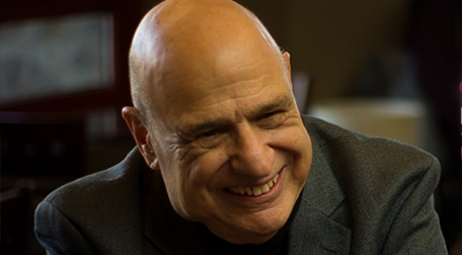

Slide 22
https://youtu.be/TuYk_D3OwpU

