Slide 1
Preacher, Preparation,
Presentation
A class on making and preaching sermons
Session 8
Preparing
To
Preach
Topical Preaching

Slide 2
Topical Preaching:
“Free text preaching”
“Synthetic outlining”

Slide 3
“…when the preacher has an idea and then searches for a biblical text (or texts treating that idea…(and) feels free to develop the sermon without rigid adherence to the structure of the text and without the compulsion to deal fully with every verse, phrase, or word in that text.”
- Michael Duduit

Slide 4
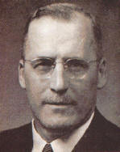
The Preacher and His Preaching
“…choosing a certain subject, or topic, then searching through all of the Scriptures to discover what light can be thrown on the subject under consideration.”

Slide 5
Process
Preacher starts with a topic
Finds Bible passages that deal
with that topic; seeks key principles
Arranges them to exhort or
encourage
Finds anecdotes and quotes
Conclusion to apply the truth

Slide 6
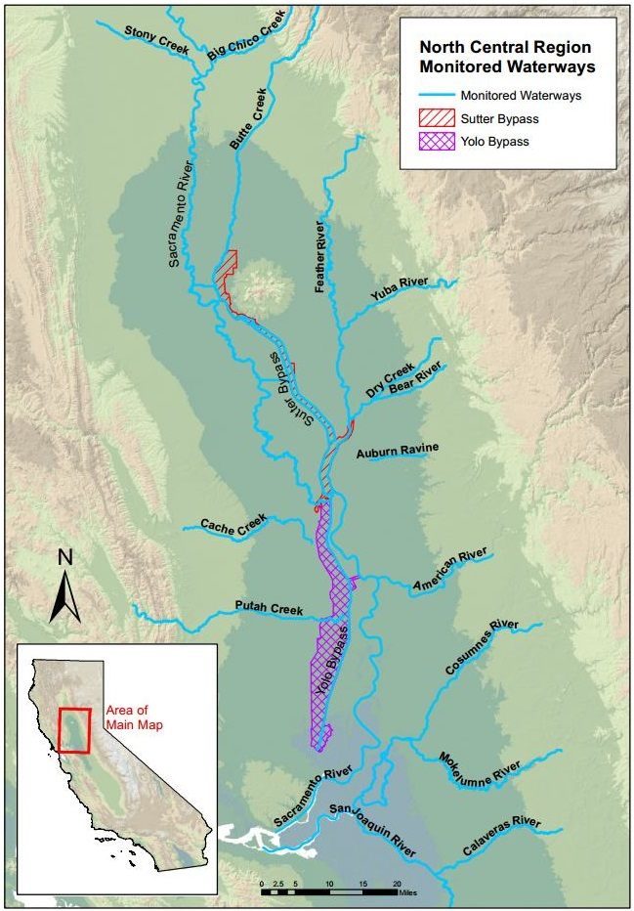

Slide 7
Related:
Expository-Topical method
- Historical, grammatical and literary study of the passages

Slide 8
Pros
1. Allows an exploration of Bible truth beyond a single passage
2. Encourages seeing the Bible as a whole—not all truth contained in one place.
3. Application to felt needs.

Slide 9
1. Allows an exploration of Bible truth beyond a single passage
2. Encourages seeing the Bible as a whole—not all truth contained in one place.
3. Application to felt needs.
4. Great Bible themes/doctrines are best explored this way.

Slide 10
Cons
Taking verses out of context

Slide 12
“Let him which is on the top not come down.”
Matthew 24:17
“Judas went and hanged himself.”

Slide 13
Cons
Taking verses out of context.
Moral lessons rather than the whole counsel of God.

Slide 14
Cons
Taking verses out of context.
Moral lessons rather than the whole counsel of God.
Become need-centered as the main way of preaching.

Slide 15
Cons
Taking verses out of context.
Moral lessons rather than the whole counsel of God.
Become need-centered as the main way of preaching.
Preacher focuses on his own agenda, rather than God’s.

Slide 16
An Example
What is Sabbath?
The first thing called Holy.
“God blessed the seventh day and made it holy, because on it he rested from all the creating he had done.” Genesis 2:2-3

Slide 17
An Example
What is Sabbath?
1. The first thing called Holy.
2. A gift for humanity.
Mark 2:27-28: “The sabbath was made for man, not man for the sabbath.”

Slide 18
What is Sabbath?
1. The first thing called Holy.
2. A gift for humanity.
3. A foretaste of eternal rest.
Hebrews 4:9-11: “There remains, then, a Sabbath-rest for the people of God…Let us therefore make every effort to enter that rest.”

Slide 19
What is Sabbath?
What does God command us to do on the Sabbath?
Remember (Exodus 20:8)
Observe (Deut. 5:12)
Rest (Deut. 5:14-15)

Slide 20
What is Sabbath?
What does God command us to do on the sabbath?
What are the blessings of the sabbath?
Not being ruined (Lev. 19:30-31)
Not being ruled (I Cor. 6:12)
Security (Deut. 33:12)

Slide 21
What is Sabbath?
What does God command us to do on the sabbath?
What are the blessings of the sabbath?
Not being ruined (Lev. 19:30-31)
Not being ruled (I Cor. 6:12)
Security (Deut. 33:12)

