Slide 1
Restoring Relationships Transforming Justice
Lecture 20
Pursuing a Healthy Perspective on Conflict
Part 1

Slide 2
The Peacefire Triangle

Slide 3
The Peacefire Triangle
When we pursue God’s purpose in our conflict stories, it changes our priorities.

Slide 4
The Peacefire Triangle
When we pursue God’s purpose in our conflict stories, it changes our priorities.
When we use God’s power to extinguish conflict wildfires, it changes our possibilities.

Slide 5
The Peacefire Triangle
When we pursue God’s purpose in our conflict stories, it changes our priorities.
When we use God’s power to extinguish conflict wildfires, it changes our possibilities.
When we seek God’s presence in our conflict stories, it changes our perspective on the conflict.

Slide 6
Seeking God’s Presence - Worship
Perspective is very important in conflict.

Slide 7
Seeking God’s Presence - Worship
Perspective is very important in conflict.
In most conflicts, everyone thinks that they are right – and most of the time, they are!

Slide 8
Seeking God’s Presence - Worship
Perspective is very important in conflict.
In most conflicts, everyone thinks that they are right – and most of the time, they are!
Everyone looks at the conflict from their own unique perspective – and sometimes our perspectives differ.

Slide 9
Seeking God’s Presence - Worship
Sometimes our perspective is so important to us that we forget that God also has a perspective on our conflict stories.

Slide 10
Seeking God’s Presence - Worship
Sometimes our perspective is so important to us that we forget that God also has a perspective on our conflict stories.
We can often spend time seeking God and praying that He will give us what we want according to our perspective.

Slide 11
Seeking God’s Presence - Worship
Sometimes our perspective is so important to us that we forget that God also has a perspective on our conflict stories.
We can often spend time seeking God and praying that He will give us what we want according to our perspective.
But if our perspective doesn’t align with His perspective, He will not grant our request.

Slide 12
Seeking God’s Presence - Worship
How do we get God’s perspective on our conflict stories?

Slide 13
Seeking God’s Presence - Worship
How do we get God’s perspective on our conflict stories?
By spending time with Him.

Slide 14
Seeking God’s Presence - Worship
How do we get God’s perspective on our conflict stories?
By spending time with Him.
Time in prayer. Time in Bible study. Time in worship with other Christians.

Slide 15
Seeking God’s Presence - Worship
In the next few lectures, we will examine four attributes of a person God can use in the midst of a conflict wildfire.
These are four attributes of a person who can enter God’s presence with confidence that his/her prayers will be answered.

Slide 16
Seeking God’s Presence - Worship
In the next few lectures, we will examine four attributes of a person God can use in the midst of a conflict wildfire.
These are four attributes of a person who can enter God’s presence with confidence that his/her prayers will be answered.
These are people who write Peacefire conflict stories rather than shallow wildfire stories.

Slide 17
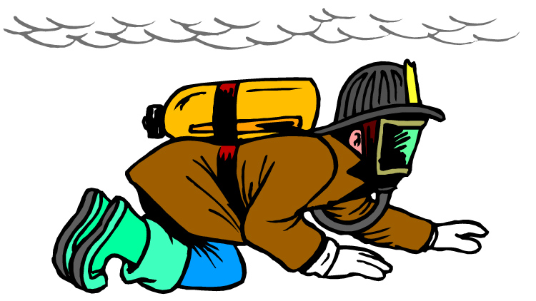
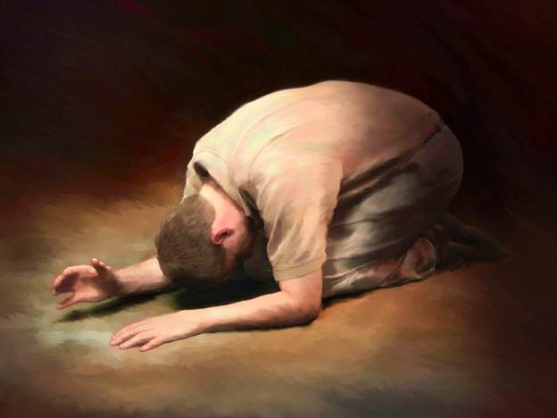
Attribute #1 - Humility - The Fire Crawl

Slide 18
Humility
The Lord desires that we walk humbly with Him.
He has shown you, O man, what is good. And what does the LORD require of you? To act justly and to love mercy and to walk humbly with your God. Micah 6:8

Slide 19
Humility
God welcomes the humble into His presence.
For thus says the High and Lofty One Who inhabits eternity, whose name is Holy: "I dwell in the high and holy place, With him wh] has a contrite and humble spirit, To revive the spirit of the humble, And to revive the heart of the contrite ones. Isaiah 57:15

Slide 20
Humility
The Lord promises to exalt the humble.
Humble yourselves in the sight of the Lord, and He will lift you up. James 4:10

Slide 21
Humility
Pride is the enemy of humility and the Peacefire.
A man's pride will bring him low, But the humble in spirit will retain honor. Proverbs 29:23

Slide 22
Humility
Humility is a measure of greatness in the Heavenly Kingdom.
At that time the disciples came to Jesus and asked, “Who, then, is the greatest in the kingdom of heaven?” He called a little child to him, and placed the child among them. And he said: “Truly I tell you, unless you change and become like little children, you will never enter the kingdom of heaven. Therefore, whoever takes the lowly position of this child is the greatest in the kingdom of heaven. Matthew 18:1-4

Slide 23
Humility
Humility is a measure of greatness in the Heavenly Kingdom.
At that time the disciples came to Jesus and asked, “Who, then, is the greatest in the kingdom of heaven?” He called a little child to him, and placed the child among them. And he said: “Truly I tell you, unless you change and become like little children, you will never enter the kingdom of heaven. Therefore, whoever takes the lowly position of this child is the greatest in the kingdom of heaven. Matthew 18:1-4

Slide 24
Humility
Jesus Christ displayed the humility that pleases the Father when he came to earth as a man and laid down his life for us.
In your relationships with one another, have the same mindset as Christ Jesus: Who, being in very nature God, did not consider equality with God something to be used to his own advantage; rather, he made himself nothing by taking the very nature of a servant, being made in human likeness. And being found in appearance as a man, he humbled himself by becoming obedient to death— even death on a cross! Therefore God exalted him to the highest place and gave him the name that is above every name, that at the name of Jesus every knee should bow, in heaven and on earth and under the earth, and every tongue acknowledge that Jesus Christ is Lord, to the glory of God the Father. Philippians 2:5-11

Slide 25
Humility
Jesus Christ is the greatest in the Heavenly Kingdom.

Slide 26
Humility
Jesus Christ is the greatest in the Heavenly Kingdom.
Jesus Christ is the most humble man who ever lived.

Slide 27
Humility
The same humble mind (attitude/way of thinking) that was in Jesus Christ is formed in us as He transforms us into his image.
. . . But we have the mind of Christ. 1 Cor. 2:16b

Slide 28
Humility
When we humble ourselves before the Lord, it takes our focus off of what is happening in the Wildfire and onto what the Lord has for us at the Peacefire.

Slide 29
Lecture 20
When we seek God’s presence, He changes our perspective on conflict.
We seek God’s presence by spending time with Him in worship, Bible study, prayer, and fellowship with other Christians.
We are examining four attributes of people who God can use in conflict to accomplish His purposes.

Slide 30
Lecture 20
Humility is the first attribute.
The Lord welcomes the humble into His presence and He exalts them in due time.
Humility is a measure of greatness in God’s kingdom.
Jesus Christ is the most humble man in the Heavenly Kingdom.

