Slide 1
Leadership 29
Building Your Team

Slide 2
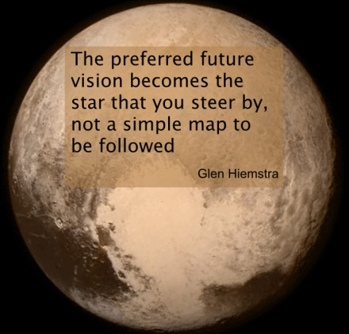
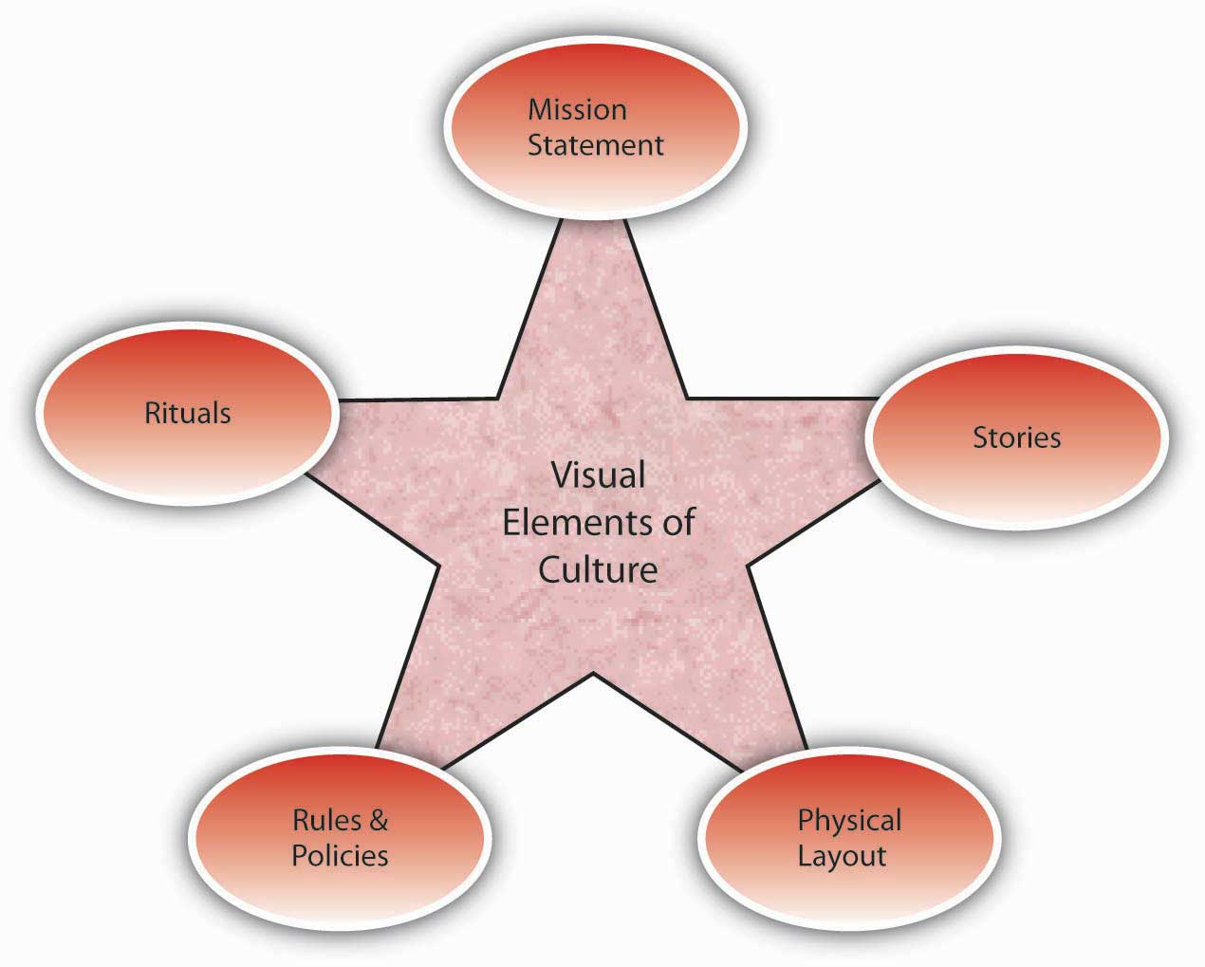
Vision
Culture
Prayer and Planning
Leader

Slide 3
Prayer and Planning

Slide 4
Who Do You Choose?
Law of the Lid

Slide 5
John Wooden?

Slide 6
Bill Hybels Patrick Lencioni
Character Humble
Competence Hungry
Chemistry Smart

Slide 7
Character Qualities – Randy Fox
Alertness Forgiveness Self-control
Attentiveness Generosity Sensitivity
Availability Gentleness Sincerity
Benevolence Gratefulness Thoroughness
Boldness Honor Thriftiness
Cautiousness Hospitality Tolerance
Compassion Humility Truthfulness
Contentment Initiative Virtue
Creativity Joyfulness Wisdom
Decisiveness Justice
Deference Loyalty
Dependability Meekness
Determination Obedience
Diligence Orderliness
Discernment Patience
Discretion Persuasiveness
Endurance Punctuality
Enthusiasm Resourcefulness
Faith Responsibility
Flexibility Security

Slide 8
Character Qualities – Randy Fox
Alertness Forgiveness Self-control
Attentiveness Generosity Sensitivity
Availability Gentleness Sincerity
Benevolence Gratefulness Thoroughness
Boldness Honor Thriftiness
Cautiousness Hospitality Tolerance
Compassion Humility Truthfulness
Contentment Initiative Virtue
Creativity Joyfulness Wisdom
Decisiveness Justice
Deference Loyalty
Dependability Meekness
Determination Obedience
Diligence Orderliness
Discernment Patience
Discretion Persuasiveness
Endurance Punctuality
Enthusiasm Resourcefulness
Faith Responsibility
Flexibility Security

Slide 9
What if there are questions?
Before—don’t hire
After—confront and counsel

Slide 10
Competence
Shoot High!
Match person’s gifts with job
Someone with a track record

Slide 11
Chemistry
Do they energize or deplete?

Slide 12
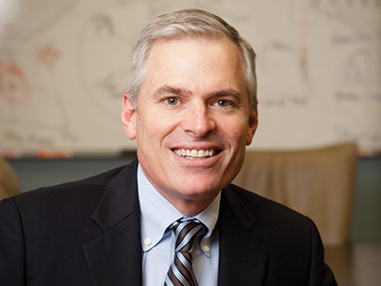
Patrick Lencioni

Slide 13
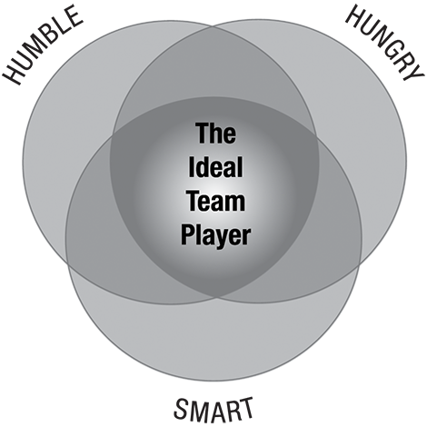

Slide 14
https://www.tablegroup.com/ideal-team-player/assessment
https://www.tablegroup.com/imo/media/doc/IdealTeamPlayerINTERVIEWQUESTIONS(11)singlepages.pdf

Slide 15
The Ideal Team Player Model
HUMBLE
Lack Ego
Share Credit
Emphasize Team

Slide 16
HUNGRY
Self-Motivated
Passionate
Diligent
Smart
Interpersonally Appropriate
Interpersonally Aware
People Smart

Slide 17
Get Help!!

Slide 18
Look Inside as well as Outside
e.g. of banking

