Slide 1
Leadership 15
Why is Vision
Important?

Slide 2
A leader, with all his plusses and minuses, strengths and weaknesses, interacts with a group of people to define the culture (the way things are done here) in order to develop a vision for a preferable future, and then provides the impetus for doing the actions necessary to bring about that future with plans and prayer.

Slide 3
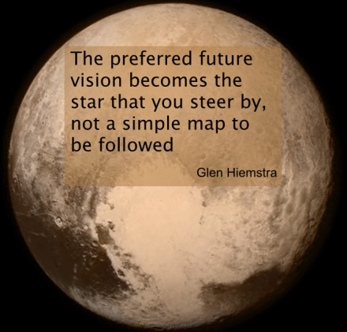
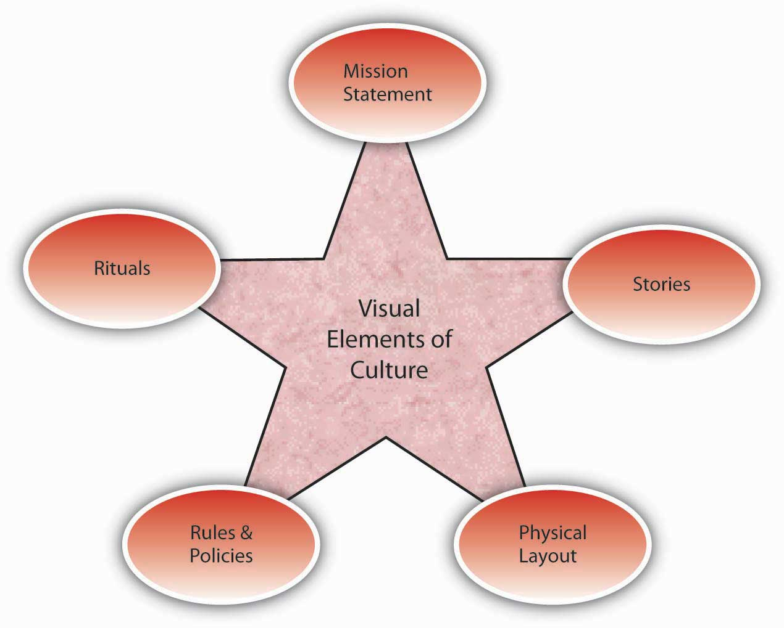
Vision
Culture
Prayer and Planning
Leader

Slide 5
Proverbs 29:18:
Where there is no vision, the people perish. KJV

Slide 6
Proverbs 29:18:
Where there is no vision, the people perish. KJV
Where there is no revelation, the people cast off restraint. NIV

Slide 7
Proverbs 29:18:
Where there is no vision, the people perish. KJV
Where there is no revelation, the people cast off restraint. NIV
Where there is no vision, the people are unrestrained. NASB

Slide 8
Proverbs 29:18:
Where there is no vision, the people perish. KJV
Where there is no revelation, the people cast off restraint. NIV
Where there is no vision, the people are unrestrained. NASB
Where there is no vision, the people run wild. MLB

Slide 9
Andy Stanley, Visioneering
“Vision weaves four things into the fabric of our daily experience.”

Slide 10
Andy Stanley, Visioneering
“Vision weaves four things into the fabric of our daily experience.”
- Passion (anticipated future)
- Motivation (pulls you forward)
- Direction (selling equipment)
- Purpose (get up in the morning)

Slide 11
Mission and Vision
Mission:
Defines present state or purpose of an organization
Answers three questions of why the organization exists.

Slide 12
Three Questions:
What it does
Who it does it for
How it does what it does

Slide 13
A vision statement:
Defines a future state—what the
organization wants to accomplish over time.
Gives guidance to long-range planning
Functions as a “north star”
Is succinct and inspirational

Slide 14
 | Mission Statement | Vision Statement
About | A Mission statement talks about HOW you will get to where you want to be. Defines the purpose and primary objectives related to your customer needs and team values. | A Vision statement outlines WHERE you want to be. Communicates both the purpose and values of your business.
Answer | It answers the question, “What do we do? What makes us different?” | It answers the question, “Where do we aim to be?”
Time | A mission statement talks about the present leading to its future. | A vision statement talks about your future.
Function | It lists the broad goals for which the organization is formed. Its prime function is internal; to define the key measure or measures of the organization's success and its prime audience is the leadership, team and stockholders. | It lists where you see yourself some years from now. It inspires you to give your best. It shapes your understanding of why you are working here.
Change | Your mission statement may change, but it should still tie back to your core values, customer needs and vision. | As your organization evolves, you might feel tempted to change your vision. However, mission or vision statements explain your organization's foundation, so change should be kept to a minimum.
Developing a statement | What do we do today? For whom do we do it? What is the benefit? In other words, Why we do what we do? What, For Whom and Why? | Where do we want to be going forward? When do we want to reach that stage? How do we want to do it?
Features of an effective statement | Purpose and values of the organization: Who are the organization's primary "clients" (stakeholders)? What are the responsibilities of the organization towards the clients? | Clarity and lack of ambiguity: Describing a bright future (hope); Memorable and engaging expression; realistic aspirations, achievable; alignment with organizational values and culture.

Slide 15
The Reformed Church in America is a fellowship of congregations called by God and empowered by the Holy Spirit to be the very presence of Jesus Christ in the world.
Our shared task is to equip congregations for ministry—a thousand churches in a million ways doing one thing—following Christ in mission, in a lost and broken world so loved by God.

Slide 16
Peoples Church is called to proclaim the Gospel of Christ and the beliefs of the evangelical Christian faith, to maintain the worship of God, and to inspire in all persons a love for Christ, a passion for righteousness, and a consciousness of their duties to God and their fellow human beings. We pledge our lives to Christ and covenant with each other to demonstrate His Spirit through worship, witnessing, and ministry to the needs of the people of this church and the community

Slide 17
Score: 2.9

Slide 18
The mission of Seeds of Hope is to sow “the Seed of Hope,” Jesus Christ, in the hearts of many in Bloomfield, Pittsburgh, and to the ends of the earth. Our context is the emerging post-modern culture. Post-moderns have rejected the “trinity” of modernism: reason, nature and progress-and the church that is built on it. Lacking a meta-narrative, post-moderns turn to a sort of primitive tribalism, or bury their pain in technology or consumerism. Our mission involves creating a Church that can be a safe gathering place for post-modern people to come experience the grace and forgiveness of God; a family of believers where they can find healing for the things that have hurt and wounded their souls; where they can “belong to believe”-that is, where they can be nurtured and discipled into faith in the one true God and in Jesus Christ whom He has sent.

Slide 19
Score: 2.0

Slide 20
Journey Church:
Fairbanks, AK
To connect people to Jesus Christ and to each other.

Slide 21
Score: 4.0

Slide 22
Murray Temple, Aniston, AL
God has called this congregation to courageously represent the kingdom of God through witness, discipleship and service to others. We take seriously the Scriptures, prayer and the call to “do justice, love mercy and walk humbly before God” (Micah 3:8). God is preparing us, through prophetic preaching and teaching, to bring the hope of the Gospel to our community and “take every thought captive to Christ.”

Slide 23
Score: 3.5

Slide 24
To help each other take the next step
In our relationship with Jesus Christ.

Slide 25
