Slide 1
Leadership Session 5
Dealing with Despair

Slide 2
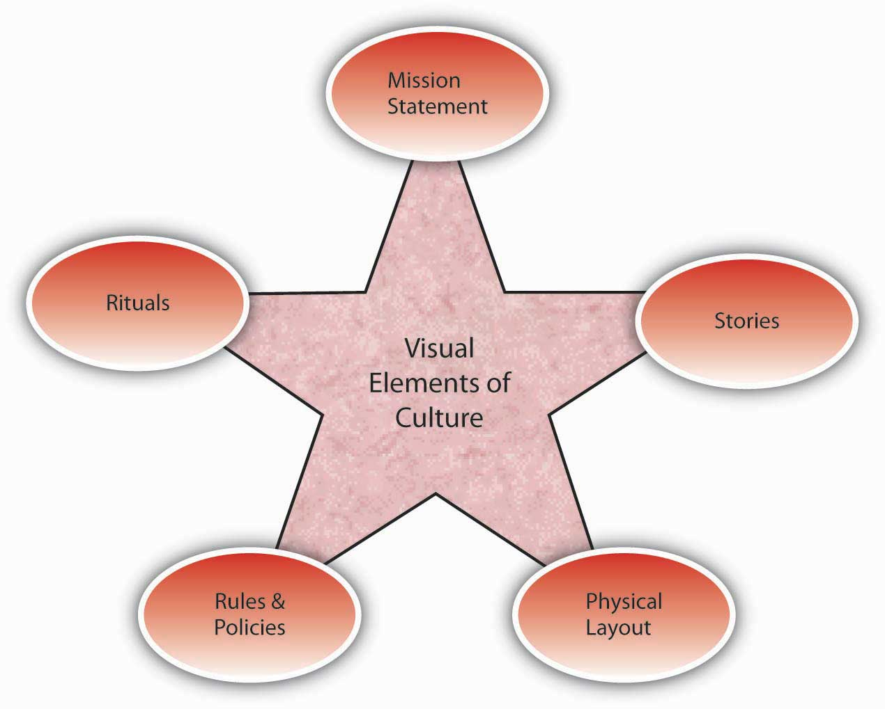
Vision
Culture
Prayer and Planning
Leader

Slide 3
A leader, with all his plusses and minuses, strengths and weaknesses, interacts with a group of people to define the culture (the way things are done here) in order to develop a vision for a preferable future, and then provides the impetus for doing the actions necessary to bring about that future with plans and prayer.

Slide 5
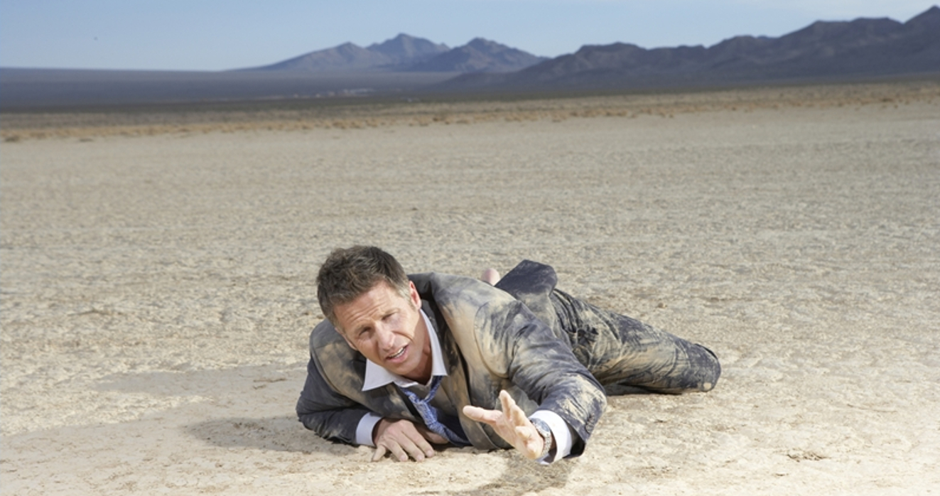

Slide 6
Losing your passion
“It is action without heart, oratory without power, doctrine without love. Inside they experience a rising turbulence—confused goals and motives and inconsistent, unexplainable patterns of personal performance.”
Gordon MacDonald, Restoring your Spiritual Passion, p. 49

Slide 7
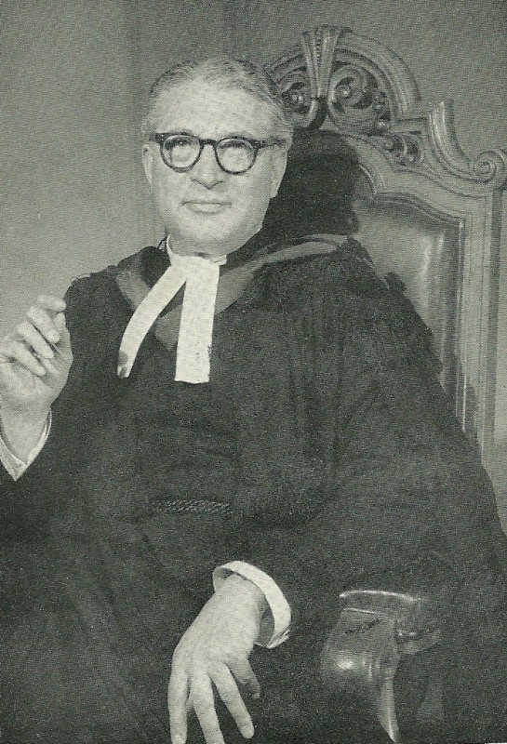

Slide 8
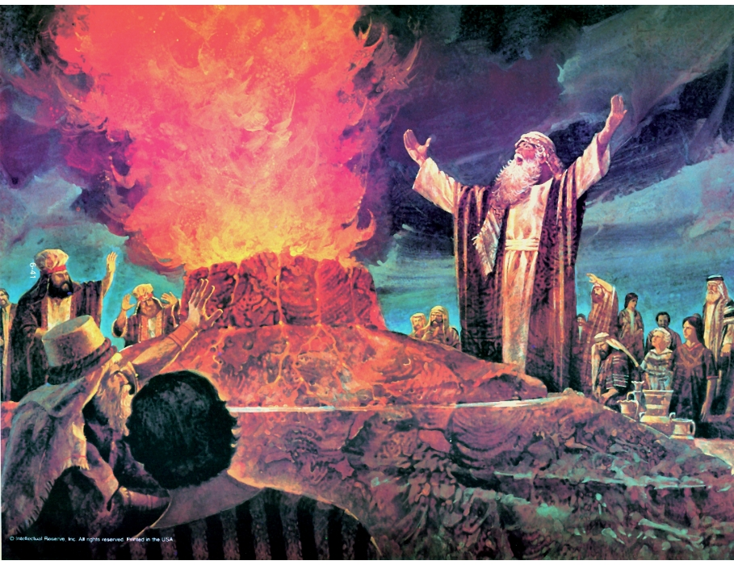

Slide 9
“Elijah was afraid and ran for his life…he came to a broom bush, sat down under it and prayed that he might die. ‘I have had enough, Lord,’ he said. ‘Take my life; I am no better than my ancestors.’”
I Kings 19:3-4

Slide 10
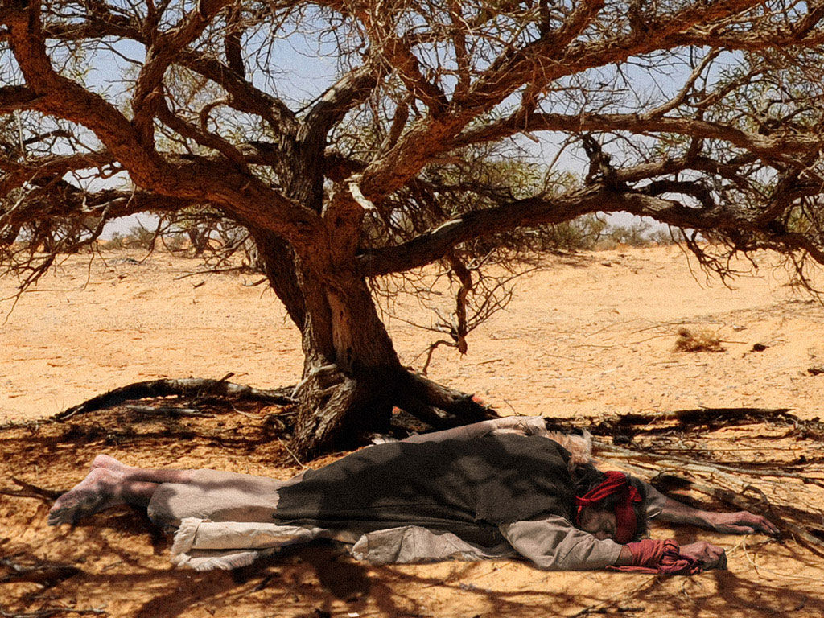

Slide 11
God’s Response?
- Rest

Slide 12
God’s Response?
- Rest
- Feeding

Slide 13
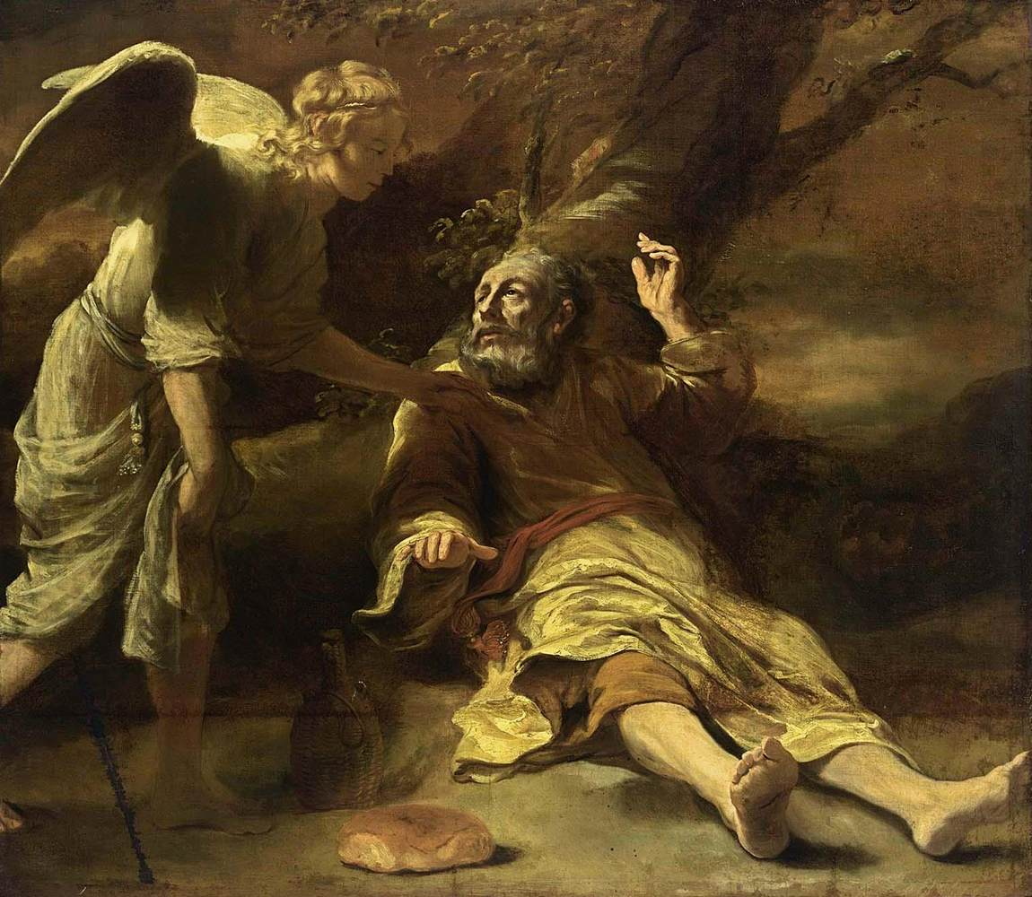

Slide 14
God’s Response?
- Rest
- Feeding
- An Experience with God

Slide 15
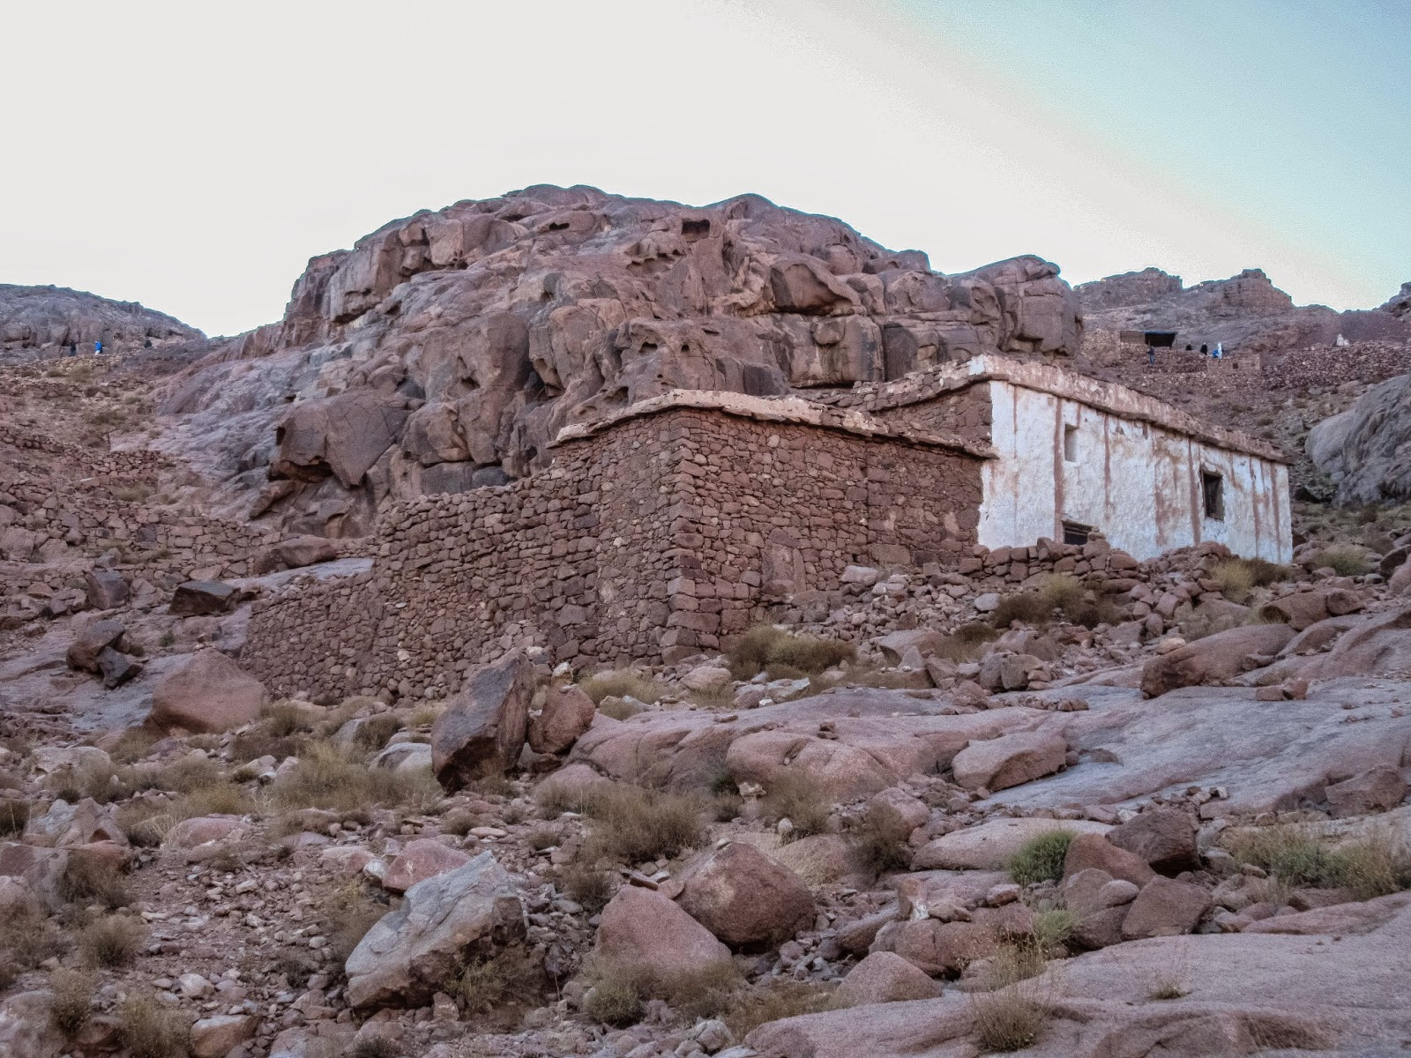

Slide 17
God’s Response?
- Rest
- Feeding
- An Experience with God
- A new mission

Slide 18
God’s Response?
- Rest
- Feeding
- An Experience with God
- A new mission
- A mentor/partner

Slide 19
