Slide 1
Learning To Lead
Session 3)
What is an
effective leader?

Slide 2
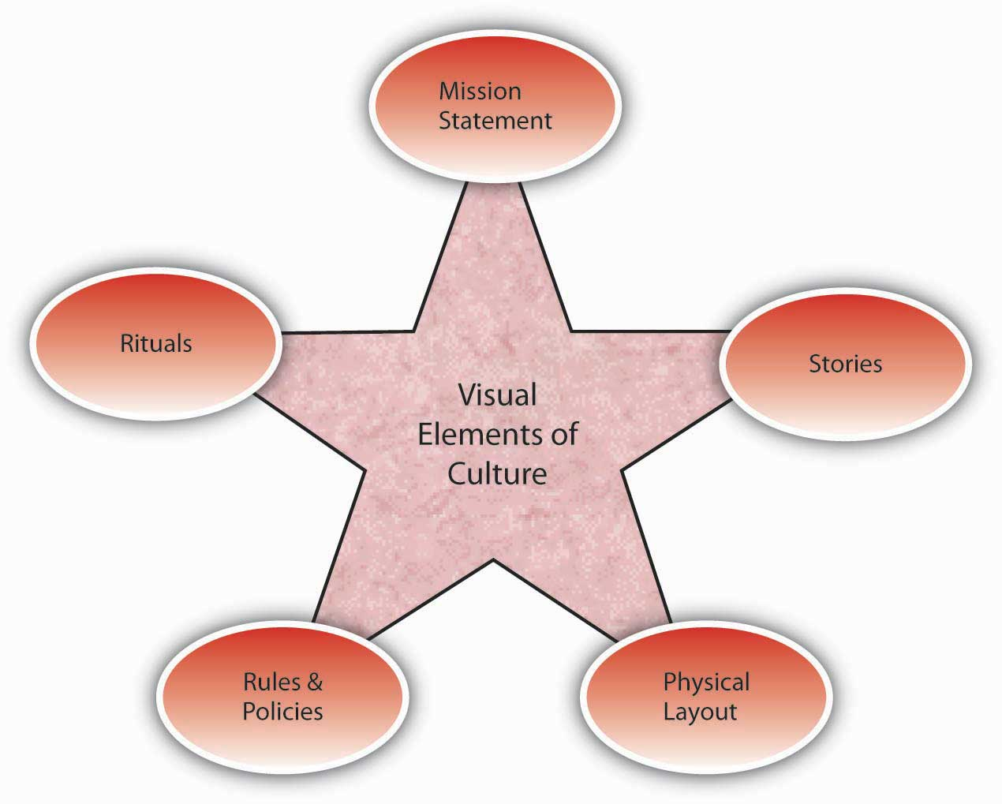
Vision
Culture
Prayer and Planning
Leader

Slide 3
A leader, with all his plusses and minuses, strengths and weaknesses, interacts with a group of people to define the culture (the way things are done here) in order to develop a vision for a preferable future, and then provides the impetus for doing the actions necessary to bring about that future with plans and prayer.

Slide 4
The Bible’s Models for Leadership

Slide 5
The Bible’s Models for Leadership
Joseph Genesis 37 – 50

Slide 6
The Bible’s Models for Leadership
Joseph Genesis 37 – 50
Vision – Stars and Sheaves
Competence
Character – Potiphar’s wife
“The Lord was with him”
Big Picture
“You intended to harm me, but God intended it for good….” 50:21

Slide 7
The Bible’s Models for Leadership
Joseph Genesis 37 – 50
Moses Exodus-Deuteronomy

Slide 8
The Bible’s Models for Leadership
Joseph Genesis 37 – 50
Moses Exodus-Deuteronomy
Definite Call Ex. 3
Influence of Pharaoh and Israel
Learned from others
Jethro Ex. 18
Preferable Future
Close to God (face glowing)
Ex. 34-35

Slide 9
The Bible’s Models for Leadership
Joseph Genesis 37 – 50
Moses Exodus-Deuteronomy
David 1 and 2 Samuel

Slide 10
The Bible’s Models for Leadership
Joseph Genesis 37 – 50
Moses Exodus-Deuteronomy
David 1 and 2 Samuel
Chosen, appointed by God
Obedient (man after God’s own
heart)
Sought God
Trusted God (Goliath)
Failed Forward

Slide 11
The Bible’s Models for Leadership
Joseph Genesis 37 – 50
Moses Exodus-Deuteronomy
David 1 and 2 Samuel
Nehemiah Nehemiah
Called by God
Vision
Communication
Problem solving
Focus

Slide 12
The Bible’s Models for Leadership
Joseph Genesis 37 – 50
Moses Exodus-Deuteronomy
David 1 and 2 Samuel
Nehemiah Nehemiah
Jesus Gospels
Chosen, appointed by the Father
Sought God
Gathered a guiding coalition
Gave a Kingdom vision
Poured himself out

Slide 13
The Bible’s Models for Leadership
Joseph Genesis 37 – 50
Moses Exodus-Deuteronomy
David 1 and 2 Samuel
Nehemiah Nehemiah
Jesus Gospels
Apostles Acts
Presented vision
Sacrificed themselves
Listened for God
Acts 15

