Slide 1
ACCT 2020 – Fundamentals of Accounting 1
Unit 5 The Journal

Slide 2
The Journal
In explaining the rules of debit and credit, we recorded transactions directly in the accounts. Each ledger (general ledger) account shows only the increases and decreases in that account. Thus, all the effects of a single business transaction would not appear in any one account. For example, the Cash account contains only data on changes in cash and does not show how the cash was generated or how it was spent. To have a permanent record of an entire transaction, the accountant uses a book or record known as a journal.

Slide 3
The Journal
A journal is a chronological (arranged in order of time) record of business transactions. A journal entry is the recording of a business transaction in the journal. A journal entry shows all the effects of a business transaction as expressed in debit(s) and credit(s) and may include an explanation of the transaction. A transaction is entered in a journal before it is entered in ledger accounts. Because each transaction is initially recorded in a journal rather than directly in the ledger, a journal is called a book of original entry.

Slide 4
The Journal
A business usually has more than one journal. Earlier we briefly describes several special journals. In this Unit, we use the basic form of journal, the general journal. As shown in Exhibit 8, a general journal contains the following columns:

Slide 5
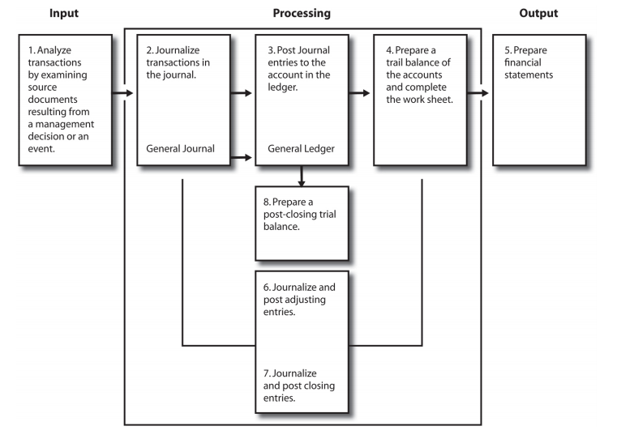
The Journal

Slide 6
The Journal

Slide 7
The Journal
Date column. The first column on each journal page is for the date. For the first journal entry on a page, this column contains the year, month, and day (number). For all other journal entries on a page, this column contains only the day of the month, until the month changes.
Account titles and explanation column. The first line of an entry shows the account debited. The second line shows the account credited. Notice that we indent the credit account title to the right. For instance, in Exhibit 8 we show the debit to the Cash account and then the credit to the Capital Stock account. Any necessary explanation of a transaction appears on the line(s) below the credit entry and is indented halfway between the accounts debited and credited. A journal entry explanation should be concise and yet complete enough to describe fully the transaction and prove the entry's accuracy. When a journal entry is self-explanatory, we omit the explanation.

Slide 8
The Journal
Posting reference column. This column shows the account number of the debited or credited account. For instance, in Exhibit 8, the number 100 in the first entry means that the Cash account number is 100. No number appears in this column until the information has been posted to the appropriate ledger account.
Debit column. In the debit column, the amount of the debit is on the same line as the title of the account debited.
Credit column. In the credit column, the amount of the credit is on the same line as the title of the account credited.

Slide 9
The Journal
A summary of the functions and advantages of using a journal follows:
The journal—
Records transactions in chronological order.
Shows the analysis of each transaction in debits and credits.
Supplies an explanation of each transaction when necessary.
Serves as a source for future reference to accounting transactions.
Eliminates the need for lengthy explanations from the accounts.
Makes possible posting to the ledger at convenient times.
Assists in maintaining the ledger in balance because the debit(s) must always equal the credit(s) in each journal entry.
Aids in tracing errors when the ledger is not in balance.

