Slide 1
June 02-03, 2018 9am-7pm
Financial Freedom & Success Institute
Presents
Alex Barrón

Slide 2
LESSON 1: THE DESIRE AND THE DREAM

Slide 3
Defining The WHY is More Important Than the WHAT
“Whatever you vividly imagine, ardently desire, sincerely believe, and enthusiastically act upon must inevitably come to pass.”
– Paul J. Meyer
What is my purpose in life?
What is God’s will for my life?
Why do I want to achieve financial prosperity?

Slide 4
Breakthrough Thought: Financial Prosperity is For You!
Financial Success is mental first, physical second.
Adopt an Abundance Mentality – There’s more than enough for Everyone!
Think and Grow Rich – We become what we think about all the time.
Prosperity can be taught.
And prosperity can be learned.
God wants me to prosper even as my soul prospers.

Slide 5
Read: The Man Who Desired Gold
“We do not wish to go on year after year living slavish lives. Working, working, working! Getting nowhere!”
“The reason most people have never found any measure of wealth is because they never sought it.”
“In those things toward which we exerted our best endeavors we succeeded. We need to learn more that we may prosper more. With a new understanding we shall find honorable ways to accomplish our desires.”
Bansir the Chariot Builder

Slide 6
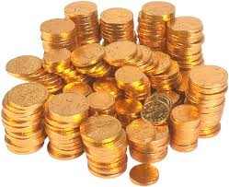
Breakthrough Thought: To Be Financially Free, You Must Desire to be Financially Free!
You must make it your burning desire – and focus on it day and night!
A Burning Desire is the WHAT!
Without a strong desire to achieve financial prosperity, you will never achieve it.

Slide 7
How Do Desires Work?
“Decide that if you are to achieve what you desire, time and study will be required. As for time, all men have it in abundance. As for study, learning is of two kinds: the one kind being the things we learn and know, and the other being the training that teaches us how to find out what we do not know.
Decide to find out how you might accumulate wealth, and when you find out, make this your task and do it well.
I had the desire to prosper before I found out how to make wealth.
Preceding accomplishment must be desire.”
– Richest Man in Babylon

Slide 8
Desires Must Be Definite
Your desires must be strong and definite. For a man to wish to be rich is of little purpose. For a man to desire five pieces of gold is a tangible desire which he can press to fulfillment. After he has backed his desire for five pieces of gold with strength of purpose to secure it, next he can find twenty pieces and later a thousand pieces and, behold, he has become wealthy.
In learning to secure his one definite small desire, he has trained himself to secure a larger one. This is the process by which wealth is accumulated: first in small sums, then in larger ones as a man learns and becomes more capable.
Desires must be simple and definite. They defeat their own purpose should they be too many, too confusing, or beyond a man's training to accomplish.
Act like a free man and succeed like one! Decide what you desire to accomplish and then work will aid you to achieve it!”
– Richest Man in Babylon

Slide 9
Watch: The Master Key to Riches
http://www.youtube.com/watch?v=KJBQL0MHqg4
Desire is the starting point of all achievement – the first step toward riches.
We must have a consuming obsession in life – a burning desire!
Desire is not a hope! It is not a wish! It is a keen, pulsating desire, which transcends everything else. It is definite.
A desire when it first appears in the mind may be a wish, but after a long time it becomes a dominating desire.
Desires can transform themselves into reality.
The dominating dream of your life can become a reality.
– Napoleon Hill

Slide 10
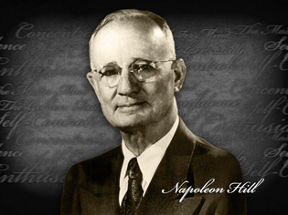
The Formula For Achieving Any Desire
Any DESIRE for riches can be transmuted into its financial equivalent in 6 definite, practical steps.
1. Be Definite: Fix in your mind the exact amount of money you desire. It is not sufficient merely to say, I want plenty of money.” Be definite as to the amount. There is a psychological reason for definiteness which will be described later.
2. Determine the Exchange: Determine exactly what you intend to give in return for the money you desire. (There is no such reality as “Something for nothing.”)
3. Establish a Date: Establish a definite date when you intend to possess the money you desire. – Napoleon Hill

Slide 11
The Formula For Achieving Any Desire
Any DESIRE for riches can be transmuted into its financial equivalent in 6 definite, practical steps.
4. Create a Plan. Create a definite plan for carrying out your desire, and begin at once, whether you are ready or not, to put this plan into action.
5. Write it Out. Write out a clear, concise statement of the amount of money you intend to acquire, name the time limit for its acquisition, state what you intend to give in return for the money, and describe clearly the plan through which you intend to accumulate it.
6. Read it Aloud. Read your written statement aloud, twice daily, once just before retiring at night, and once after arising in the morning. As you read – see and feel and believe yourself already in possession of the money.
– Napoleon Hill

Slide 12
A Burning Desire is the Seed of All Achievement
The accumulation of money cannot be left to chance, good fortune, and luck.
Realize that all who have accumulated great fortunes, first did a certain amount of dreaming, hoping, wishing, desiring, and planning before they acquired money.
You can never have riches in great quantities, unless you can work yourself into a white heat of desire for money, and actually believe you will possess it.
There is one quality which one must possess to win, and that is definiteness of purpose, the knowledge of what one wants, and a burning desire to possess it.
– Napoleon Hill

Slide 13
A Burning Desire is Not a Mere Wish
There is a difference between Wishing for a thing and being ready to receive it. No one is ready for a thing, until he believes he can acquire it. The state of mind must be belief, not mere hope or wish.
Our only limitations are those we set up in our own minds.
Nothing is impossible to the person who backs desire with enduring faith.
All achievement, no matter what may be its nature or its purpose, must begin with an intense burning desire for something definite.
Nature wraps up in the impulse of strong desire “that something” which recognizes no such word as impossible, and accepts no such reality as failure. – Napoleon Hill

Slide 14
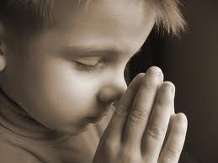
What Do You Desire?
“Delight yourself also in the LORD, And He shall give you the desires of your heart.” - Psalms 37:4
You should have the desire to create wealth for a noble purpose and believe that you can.“ – Peter J. Daniels
"To foster a vision there must be one dominant desire or requirement. The easiest way to assess the dominance and importance to you is to compare its value with the life that will be expended and forfeited in its achievement.“ – Peter J. Daniels
"Whatever you vividly imagine, ardently desire, sincerely believe and enthusiastically act upon must inevitably come to pass.“
– Paul J. Meyer

Slide 15
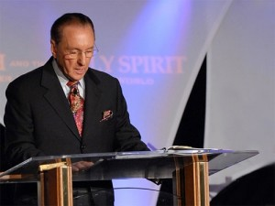
Watch: Peter J Daniels
“What do you do when your dreams start to fade? You reach for one more dream!”
“What is this dream that you have?”
“We would like to turn back on your dream machine!”
https://www.youtube.com/watch?v=xNSnm_nYPyc&t=1263s

Slide 16
What is This Dream That You Have?
For many of you it was alive and well when you were a little younger…
You’d lay under the starry heavens of a hot summer’s night and you would contrast that picture of what you are against what you would like to become.

Slide 17
Now Its Time to Define the WHAT
What is your Dream?
Stop working?
Be your own boss?
Pay off your debts?
Fancy cars and homes?
Travel to exotic destinations?
Why do you want to achieve this Dream?
You were born for something bigger!

Slide 18
What Do You Dream About?
“Nothing is impossible to him who believes!” - Jesus
“Never discard a good idea, because your ideas are the beginnings of dreams for you to personally achieve”. – Peter J. Daniels
“I have a dream…” - Martin Luther King Jr
“Failure will never overtake you if your desire to succeed is strong enough!”
- Og Mandino
“If the thing you wish to do is right, and you believe in it, go ahead and do it! Put your dream across, and never mind what “they” say if you meet with temporary defeat, for “they” perhaps do not know that every failure brings with it the seed of an equivalent success.”
– Napoleon Hill

Slide 19
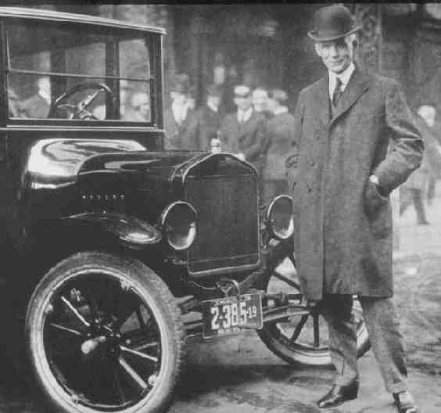
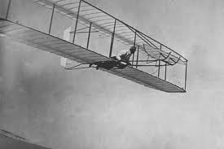
Dreams Really Do Come True!
Henry Ford dreamed of a horseless carriage
Thomas Edison dreamed of a lamp that could be operated by electricity
Lincoln dreamed of freedom, put his dream into action, and translated his dream into reality.
The Wright brothers dreamed of a machine that would fly through the air.
The world has shown a willingness to reward the dreamer who gives the world a new idea.
The greatest achievement was, at first, but a dream.
Dreams are the seedlings of reality!
The world is filled with an abundance of opportunity which the dreamers of the past never knew.

Slide 20
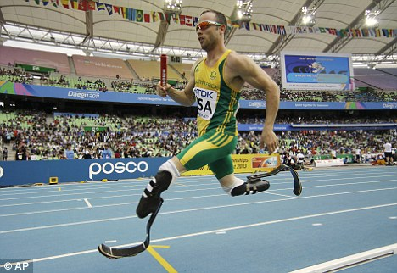
Anything is Possible if You Can Believe!
Oscar Pistorious had a dream and competed in the 2012 Olympics without feet!

Slide 21
Turn On Your Dream Machine Again!
A burning desire to be, and to do is the starting point from which the dreamer must take off. Dreams are not born of indifference, laziness, or a lack of ambition. – Napoleon Hill
“What is this dream that you have?” Can you see it in your imagination? Believe in it once again… because it can become reality. Every great accomplishment in life starts with a dream. Turn on your dream machine again!
"Dreaming, if selectively promoted, creates a sense of grandeur towards life, because when you dream, you are on the periphery of destiny itself.” – Peter J. Daniels

Slide 22
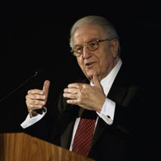
Dream Bigger and Bigger!
Turn the energy of your dreams into motivation.
Look at dreams with a particular goal in mind: becoming an effective and prolific giver.
Turn your dream machine back on. See possibilities and potentialities the average person never sees. Relate the normally unrelated. Think outside the box. Dreams make this type of creative thinking possible.
Dreaming contains enormous creative potential. It provides a window into our hearts, telling us what really matters to us, what we really desire.
We should treat our dreams with respect. Turn a wish into a direction, a dream into a plan. – John Edmund Haggai

Slide 23
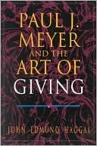
Attempt Something So Great!
Turn your dream into a plan. Making that transition isn't easy. It demands two things. One, suspending the critical faculty that says to each dream "That's impossible ― forget it!" And two, taking dreams seriously enough to write them down.
Define a dream a desired return. Write it down, define it, sharpen it, and translate it into specific actions. You have to know what your dreams are, and how they connect to your "real" life. How much of your daily life do your dreams really cover?
Attempt something so great for God its doomed to failure unless God be in it.” – John Edmund Haggai

Slide 24
Conclusion: Dare to Dream!!!
Financial Success, Freedom and Prosperity is For you! You CAN Do It if you Dare to Dream!

