Slide 1
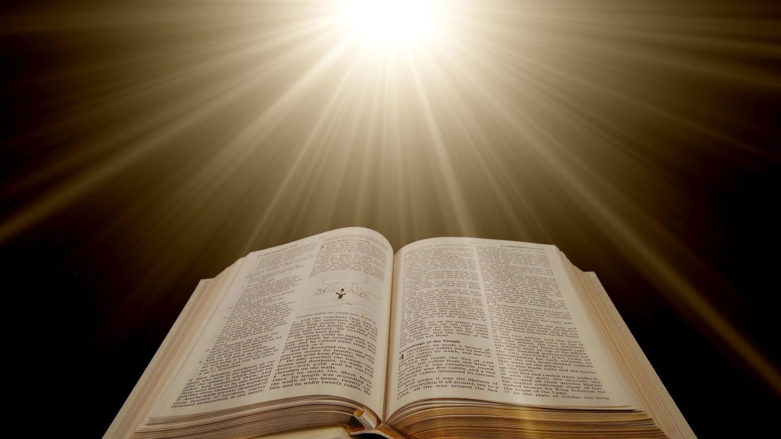
Preacher, Preparation,
Presentation
A class on making and preaching sermons
Session 27
Presenting
Your Sermon
Make Your
Message
Memorable
Illustrations

Slide 2
Why?

Slide 3
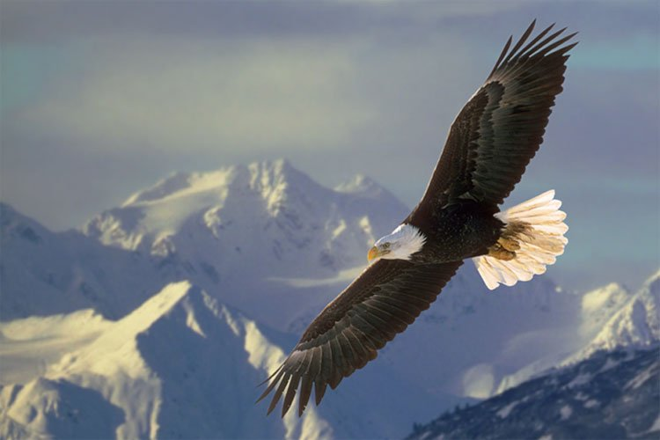
Why?
Authors in the Bible

Slide 4
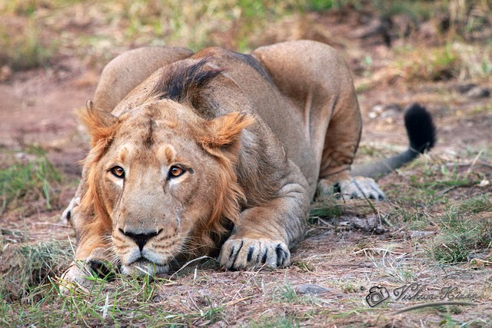
Why?
Authors in the Bible

Slide 5
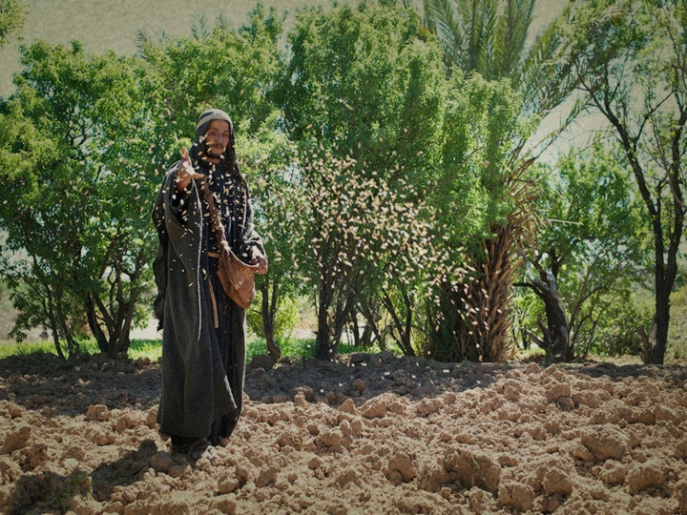
Why?
Authors in the Bible

Slide 6
Why?
Authors in the Bible
They open windows

Slide 7
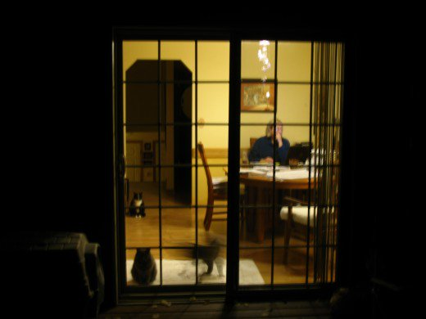

Slide 8
https://www.youtube.com/watch?v=uGIcEULEkPc&feature=youtu.be

Slide 9
Why?
Authors in the Bible
They open windows
Move toward obedience

Slide 10
Why?
Authors in the Bible
They open windows
Move toward obedience
Hold attention

Slide 11
What?

Slide 12
What?
Stories
Personal
Hearing/reading
Solicited

Slide 13
What?
Stories
Humor

Slide 14
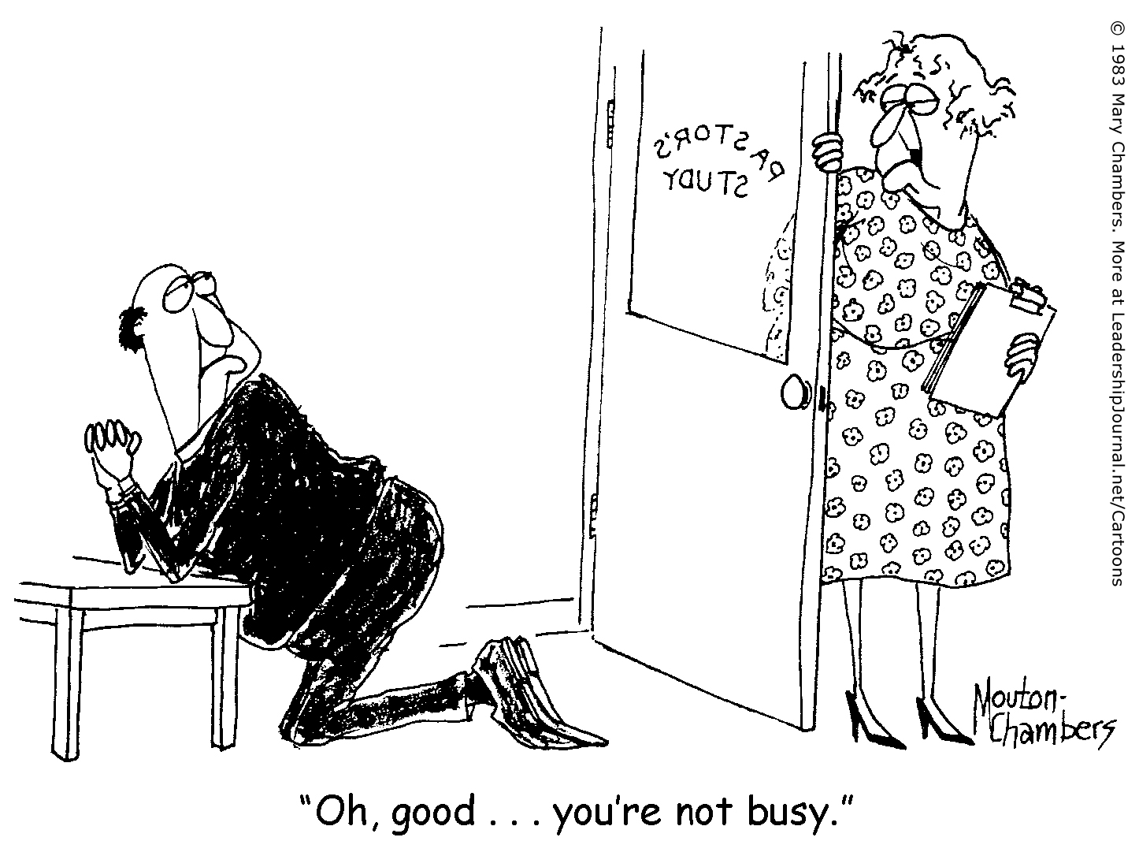

Slide 15
What?
Stories
Humor
Observation/metaphor

Slide 16
What?
Stories
Humor
Observation/metaphor
Television/movies

Slide 17
Where?
Commentary
Sermons
Plagiarism warning

