Slide 1
Preacher, Preparation,
Presentation
A class on making and preaching sermons
Session 19
Developing
A Sermon
Introductions
Continued

Slide 2
Introductions and Story

Slide 4
An Intriguing Question

Slide 5
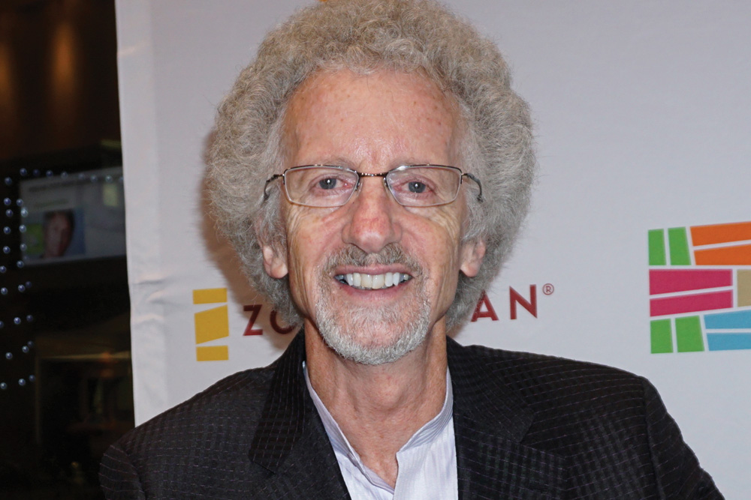

Slide 6
Through 9:10 when feeling like about to die.
https://youtu.be/ubtCZXM0o5Q

Slide 7
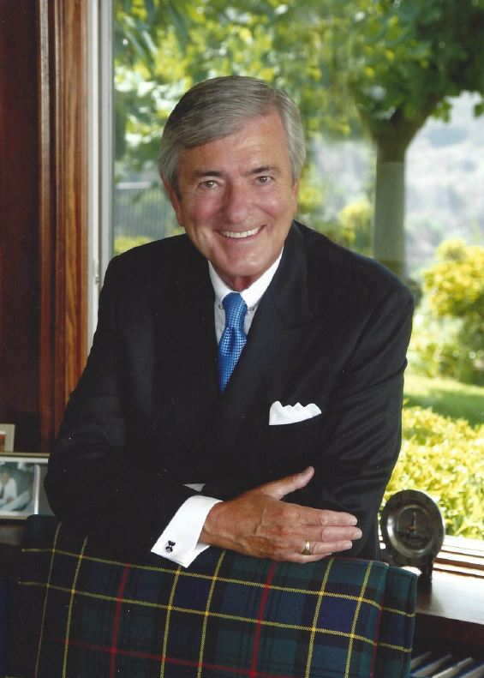

Slide 9
Jesus and the Intriguing Question

Slide 10
Jesus and the Intriguing Question
Matthew 16:13: “Who do people say the Son of Man is?
Mathew 16:15: “Who do you say I am?”

Slide 11
“Blessed are you, Simon son of Jonah, for this was not revealed to you by flesh and blood, but by my Father in heaven…on this rock I will build my church.
vss. 17, 18

Slide 12
Consider some of these 7 questions of Jesus:
1. "Do you believe that I am able to do this?" (Matt. 9:28)
2. "Why are you afraid, O you of little faith?" (Matt. 8:26)
3. "What do you think about the Christ?" (Matt. 22:42)
4. "Do you love Me?" (John 21:17)
5. "Why do you call Me 'Lord, Lord', and not do what I tell you?" (Luke 6:46)
6. "What do you want Me to do for you?" (Luke 18:41)
7. "Why do you see the speck that is in your brother's eye, but do not notice the log that is in your own eye?" (Matt. 7:3)

Slide 14
Why does God allow children to die of starvation?
Can I really forgive and forget?
Does God forgive me, even if I do the same sin over and over?
Is God really in control?

