Slide 1
Deciding what to do
Steve Elzinga

Slide 2
Coaching is
Remember: coaching is about getting your client to some form of …
Action!

Slide 3
Three things coaches do to accomplish this:
Help client figure out what they want to do (decision)
Help client figure out how to do what they want to do (plan)
Help client do what they plan to do (management)

Slide 4
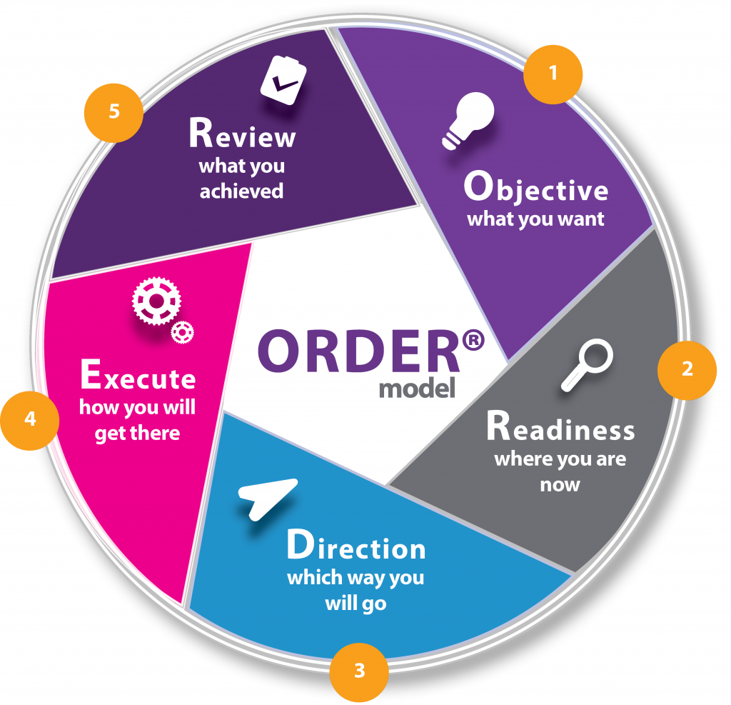
The 7 connections model
Needs vs. wants model
Obligations and commitments model
Dreams model
Opportunities model

Slide 5
1. Help client figure out what they want to do (decision)

Slide 6
Why do people need help deciding what they want to do?
Lack of focus (ADD)
Priority of the urgent
Conflicting expectations
Too many commitments
No reflection time
No disciplined process to figure it out

Slide 7
How does coaching help people decide what they want to do?
Forces focus
Pushes for Priority what is truly a priority
Answers expectations
Helps narrow commitments
Reserves reflection time
Uses a process (models) that can be learned and repeated

Slide 8
The 3 basic model categories
Brainstorm
Prioritize
Commitment

Slide 9
Brainstorm areas of action
The 7 connections model
Needs vs. wants model
Obligations and commitments model
Dreams model
Opportunities model
Problems model
Emotions model
State of being model

Slide 10
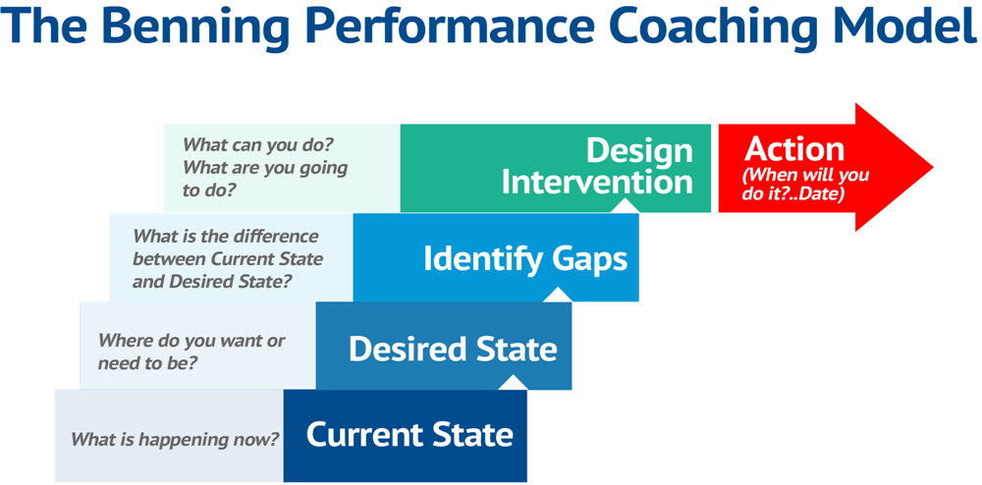
i.e. State of being model

Slide 11
Prioritize action items
Easiest vs. hardest
Biggest bang for the buck
Fun/boring continuum
Opportunities
Most interesting

Slide 12
Commitment to action items
Try it for a season
Throw mud on the wall and see what sticks
Make a commitment of time and energy

