Slide 1
The Richest Man In Babylon

Slide 2
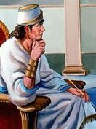
The Man Who Desired Gold
Bansir, the chariot builder of Babylon, was thoroughly discouraged. From his seat upon the low wall surrounding his property, he gazed sadly at his simple home and the open workshop in which stood a partially completed chariot.
His wife frequently appeared at the open door. Her furtive glances in his direction reminded him that the meal bag was almost empty and he should be at work finishing the chariot, hammering and hewing, polishing and painting,
stretching taut the leather over the wheel rims, preparing it for delivery so he could collect from his wealthy customer.

Slide 3
The Man Who Desired Gold
Nevertheless, his fat, muscular body sat stolidly upon the wall. His slow mind was struggling patiently with a problem for which he could find no answer. The hot, tropical sun, so typical of this valley of the Euphrates, beat down upon him mercilessly. Beads of perspiration formed upon his brow and trickled down unnoticed to lose themselves in tie hairy jungle on his chest.
Beyond his home towered the high terraced wall surrounding the king's palace. Nearby, cleaving the blue heavens, was the painted tower of the Temple of Bel. In the shadow of such grandeur was his simple home and many others far less neat and well cared for.

Slide 4
The Man Who Desired Gold
Babylon was like this—a mixture of grandeur and squalor, of dazzling wealth and direst poverty, crowded together without plan or system within the protecting walls of the city.
Behind him, had he cared to turn and look, the noisy chariots of the rich jostled and crowded aside the sandaled tradesmen as well as the barefooted beggars.
Even the rich were forced to turn into the gutters to clear the way for the long lines of slave water carriers, on the "King's Business," each bearing a heavy goatskin of water to be poured upon the hanging gardens.

Slide 5
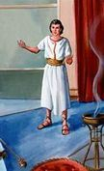
The Man Who Desired Gold
Bansir was too engrossed in his own problem to hear or heed the confused hubbub of the busy city. It was the unexpected twanging of the strings from a familiar lyre that aroused him from his reverie. He turned and looked into the sensitive, smiling face of his best friend—Kobbi, the musician.
"May the Gods bless thee with great liberality, my good friend," began Kobbi with an elaborate salute. "Yet, it does appear they have already been so generous thou needest not to labor. I rejoice with thee in thy good fortune. More, I would even share it with thee. Pray, from thy purse which must be bulging else thou wouldst be busy in your shop, extract but two humble shekels and lend them to me until after the noblemen's feast this night. Thou wilt not miss them ere they are returned."

Slide 6
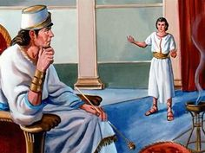
The Man Who Desired Gold
"If I did have two shekels," Bansir responded gloomily, "to no one could I lend them—not even to you, my best of friends; for they would be my fortune—my entire fortune. No one lends his entire fortune, not even to his best friend.“
"What," exclaimed Kobbi with genuine surprise, "Thou hast not one shekel in thy purse, yet sit like a statue upon a wall! Why not complete that chariot? How else canst thou provide for thy noble appetite? Tis not like thee, my friend. Where is thy endless energy? Doth something distress thee? Have
the Gods brought to thee troubles?“
"A torment from the Gods it must be," Bansir agreed.

Slide 7
The Man Who Desired Gold
"It began with a dream, a senseless dream, in which I thought I was a man of means. From my belt hung a handsome purse, heavy with coins. There were shekels which I cast with careless freedom to the beggars; there were pieces of silver with which I
did buy finery for my wife and whatever I did desire for myself; there were pieces of gold which made me feel assured of the future and unafraid to spend the silver.
A glorious feeling of contentment was within me! You would
not have known me for thy hardworking friend. Nor wouldst have known my wife, so free from wrinkles was her face and shining with happiness. She was again the smiling maiden of our early married days."

Slide 8
The Man Who Desired Gold
"A pleasant dream, indeed," commented Kobbi, "but why should such pleasant feelings as it aroused turn thee into a glum statue upon the wall?"
"Why, indeed! Because when I awoke and remembered how empty was my purse, a feeling of rebellion swept over me. Let us talk it over together, for, as the sailors do say, we ride in the same boat, we two. As youngsters, we went together to the priests to learn wisdom. As young men, we shared each
other's pleasures. As grown men, we have always been close friends. We have been contented subjects of our kind. We have been satisfied to work long hours and spend our earnings freely.

Slide 9
The Man Who Desired Gold
We have earned much coin in the years that have passed, yet to know the joys that come from wealth, we must dream about them. Bah! Are we more than dumb sheep? We live in the
richest city in all the world. The travelers do say none equals it in wealth. About us is much display of wealth, but of it we ourselves have naught. After half a lifetime of hard labor, thou, my best of friends, hast an empty purse and sayest to me, "May I borrow such a trifle as two shekels until after the noblemen's feast this night?" Then, what do I reply? Do I say, "Here is my purse; its contents will I gladly share?' No, I admit that my purse is as empty
as thine. What is the matter? Why cannot we acquire silver and gold—more than enough for food and robes?

Slide 10
The Man Who Desired Gold
"Consider, also, our sons," Bansir continued, "are they not 17 following in the footsteps of their fathers? Need they and their families and their sons and their sons' families live all their lives in the midst of such treasurers of gold, and yet, like us, be content to banquet upon sour goat's milk and porridge?“
"Never, in all the years of our friendship, didst thou talk like this before, Bansir.“ -Kobbi was puzzled.
"Never in all those years did I think like this before. From early dawn until darkness stopped me, I have labored to build the finest chariots any man could make, soft- heartedly hoping some day God would recognize my worthy deeds and bestow upon me great prosperity. This He has never done.

Slide 11
The Man Who Desired Gold
At last, I realize this He will never do. Therefore, my heart is sad. I wish to be a man of means. I wish to own lands and cattle, to have fine robes and coins in my purse.
I am willing to work for these things with all the strength in my back, with all the skill in my hands, with all the cunning in my mind, but I wish my labors to be fairly rewarded. What is the matter with us?
Again I ask you! Why cannot we have our just share of the good things so plentiful for those who have the gold with which to buy them?"

Slide 12
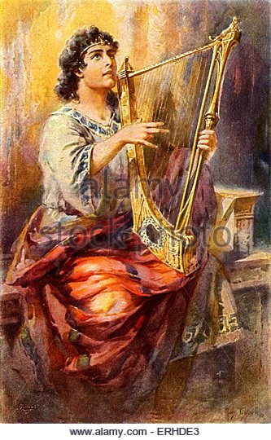
The Man Who Desired Gold
"Would I knew an answer!" Kobbi replied.
"No better than thou am I satisfied.”
“My earnings from my lyre are quickly gone. Often must I plan and scheme that my family be not hungry. Also, within my breast is a deep longing for a lyre large enough that it may truly sing the strains of music that do surge through my mind. With such an instrument could I make music finer than even the king has heard before."

Slide 13
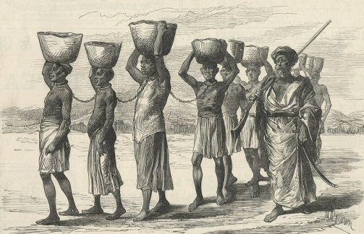
The Man Who Desired Gold
"Such a lyre thou shouldst have. No man in all Babylon could make it sing more sweetly; could make it sing so sweetly, not only the king but God himself would be delighted. But how mayest thou secure it while we both of us are as poor as the king's slaves?
¡Listen to the bell! Here they come."
He pointed to the long column of half naked, sweating water bearers plodding
laboriously up the narrow street from the river. Five abreast they marched, each bent under a heavy goatskin of water.

Slide 14
The Man Who Desired Gold
"A fine figure of a man, he who doth lead them." Kobbi indicated the wearer of the bell who marched in front without a load. "A prominent man in his own country, 'tis easy to see.“
"There are many good figures in the line," Bansir agreed, "as good men as we. Tall, blond men from the north, laughing black men from the south, little brown men from the nearer countries. All marching together from the river to the gardens, back and forth, day after day, year after year. Naught of happiness to look forward to. Beds of straw upon which to sleep—hard grain porridge to eat. Pity the poor brutes, Kobbi!"

Slide 15
The Man Who Desired Gold
"Pity them I do. Yet, thou dost make me see how little better off are we, free men though we call ourselves.“
“That is truth, Kobbi, unpleasant thought though it be. We do not wish to go on year after year living slavish lives. Working, working, working! Getting nowhere.“
"Might we not find out how others acquire gold and do as they do?" Kobbi inquired.
“Perhaps there is some secret we might learn if we but sought from those who knew," replied Bansir thoughtfully.

Slide 16
The Man Who Desired Gold
“This very day,” suggested Kobbi, "I did pass our old friend, Arkad, riding in his golden chariot. This I will say, he did not look over my humble head as many in his station might consider his right. Instead, he did wave his hand that all onlookers might see him pay greetings and bestow his smile of friendship upon Kobbi, the musician.“
"He is claimed to be the richest man in all Babylon," Bansir mused.
"So rich the king is said to seek his golden aid in affairs of the treasury," Kobbi replied.
"So rich," Bansir interrupted, "I fear if I should meet him in the
darkness of the night, I should lay my hands upon his fat wallet."

Slide 17
The Man Who Desired Gold
"Nonsense," reproved Kobbi, "a man's wealth is not in the purse he carries. A fat purse quickly empties if there be no golden stream to refill it. Arkad has an income that constantly keeps his purse full, no matter how liberally he spends.“
"Income, that is the thing," ejaculated Bansir. "I wish an income that will keep flowing into my purse whether I sit upon the wall or travel to far lands. Arkad must know how a man can make an income for himself. Dost suppose it is something he could make clear to a mind as slow as mine?"

Slide 18
The Man Who Desired Gold
"Methinks he did teach his knowledge to his son, Nomasir," Kobbi responded. "Did he not go to Nineveh and, so it is told at the inn, become, without aid from his father, one of the richest men in that city?“
"Kobbi, thou bringest to me a rare thought." A new light gleamed in Bansir's eyes. "It costs nothing to ask wise advice from a good friend and Arkad was always that. Never mind though our purses be as empty as the falcon's nest of a year ago. Let that not detain us. We are weary of being without gold in the midst of plenty. We wish to become men of means. Come, let us go to Arkad and ask how we, also, may acquire incomes for ourselves."

Slide 19
The Man Who Desired Gold
Thou speakest with true inspiration, Bansir. Thou bringeth to my mind a new understanding. Thou makest me to realize the reason why we have never found any measure of wealth. We never sought it. Thou hast labored patiently to build the staunchest chariots in Babylon. To that purpose was devoted your best
endeavors. Therefore, at it thou didst succeed. I strove to become a skillful lyre player. And, at it I did succeed.
"In those things toward which we exerted our best endeavors we succeeded. God was content to let us continue thus. Now, at last, we see a light, bright like that from the rising sun. It biddeth us to learn more that we may prosper more. With a new understanding we shall find honourable ways to accomplish our desires."

Slide 20
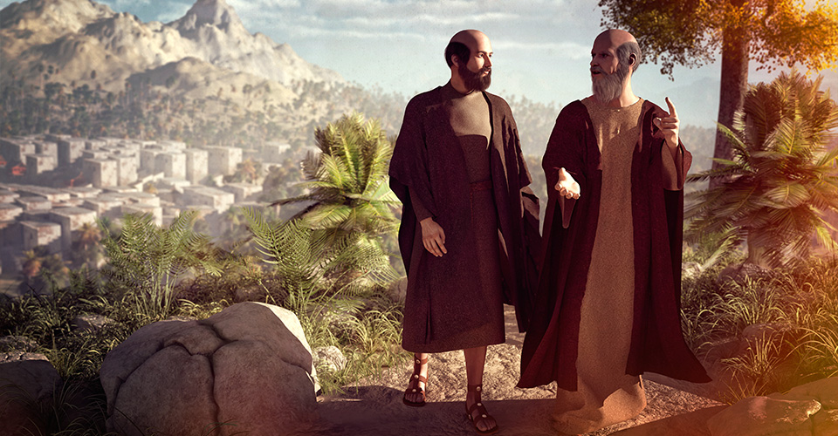
The Man Who Desired Gold
"Let us go to Arkad this very day," Bansir urged, "Also, let us ask other friends of our boyhood days, who have fared no better than ourselves, to join us that they, too, may share in his wisdom.“
"Thou wert ever thus thoughtful of thy friends, Bansir. Therefore hast thou many friends. It shall be as thou sayest. We go this day and take them with us."

