Slide 1
Leadership 36
Final Thoughts

Slide 2
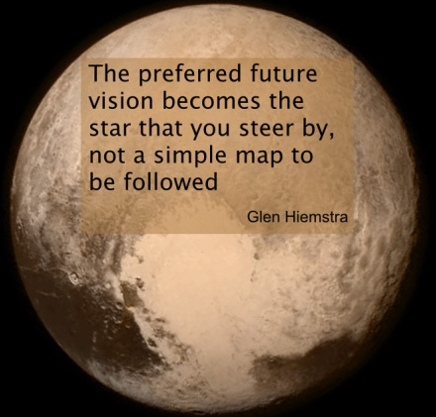
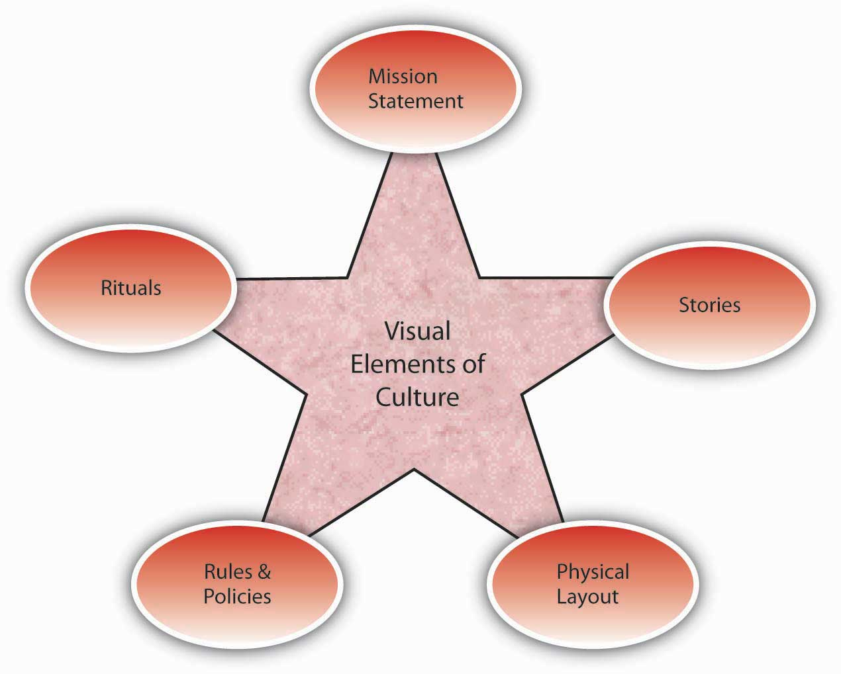
Vision
Culture
Prayer and Planning
Leader

Slide 3
A leader, with all his plusses and minuses, strengths and weaknesses, interacts with a group of people to define the culture (the way things are done here) in order to develop a vision for a preferable future, and then provides the impetus for doing the actions necessary to bring about that future with plans and prayer.

Slide 4
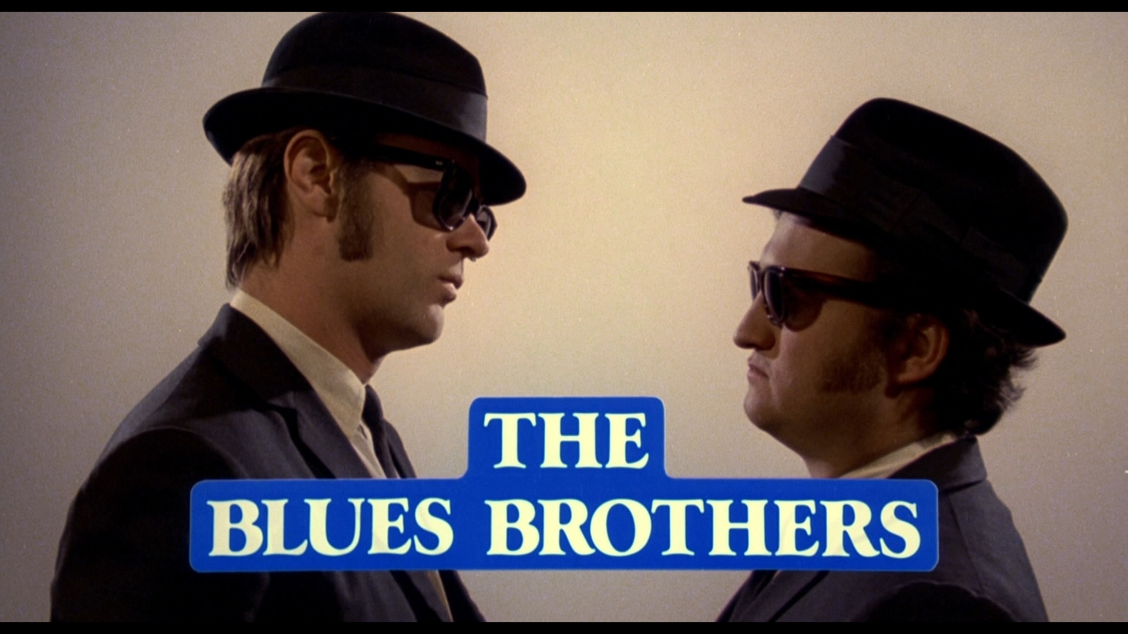

Slide 6
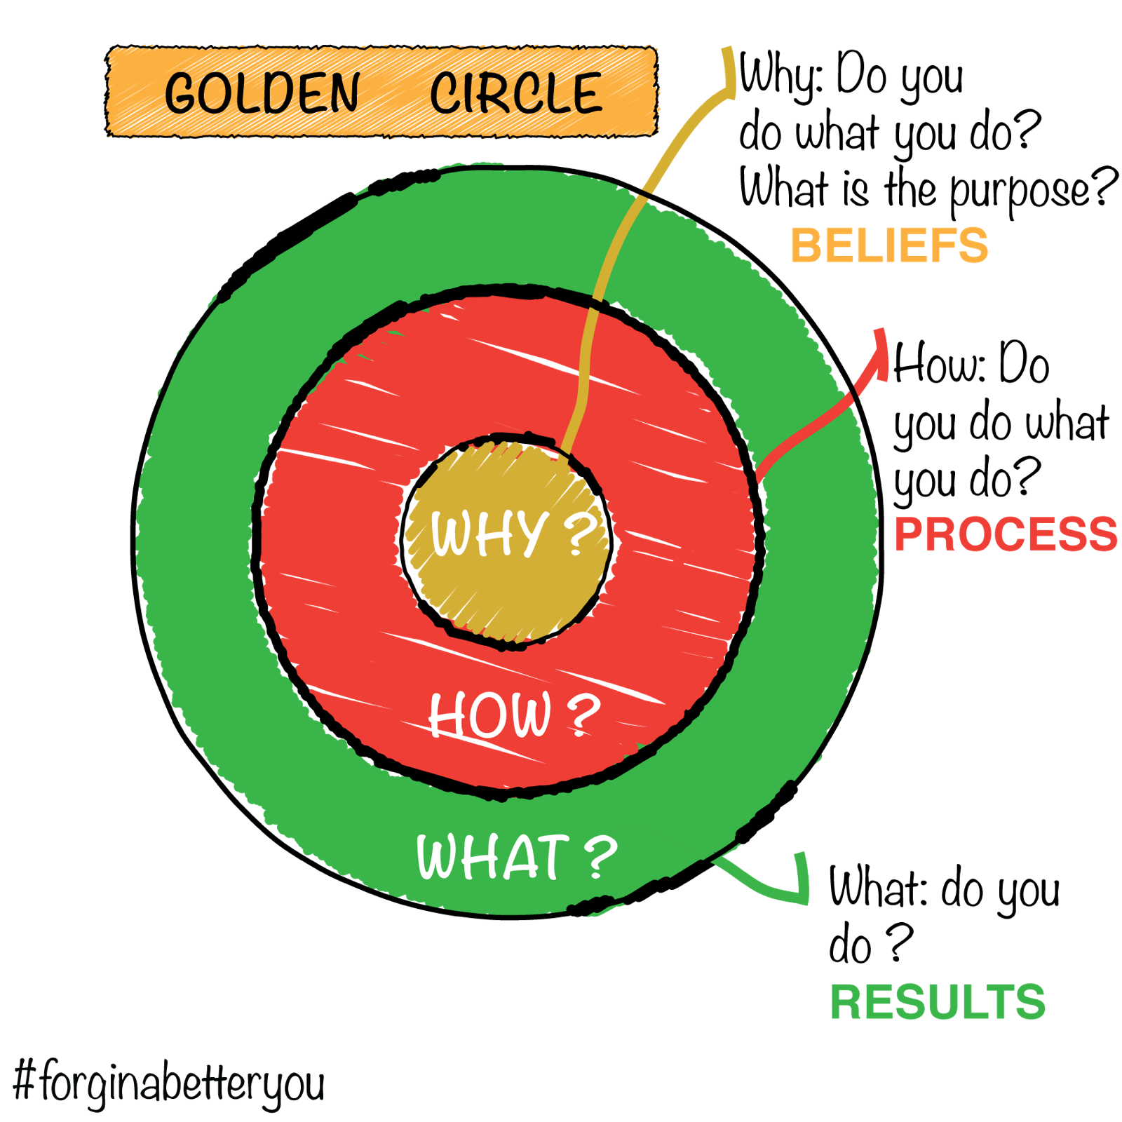

Slide 7
What is our why?

Slide 8
What is our why?
The Great Commandment
The Great Commission

Slide 9
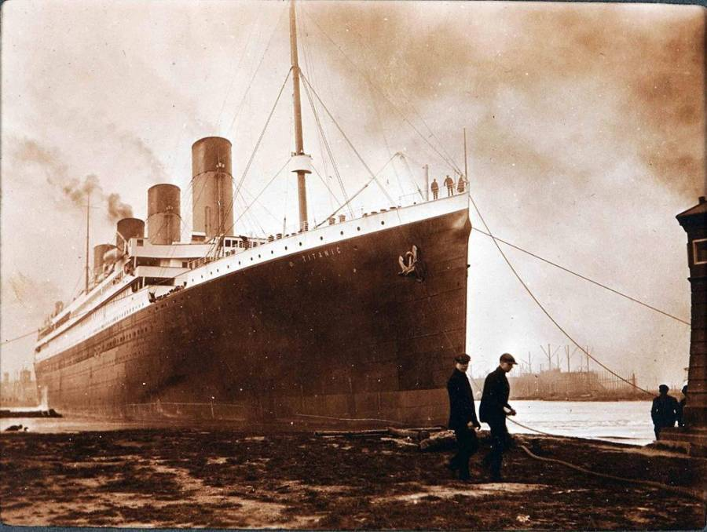

Slide 10
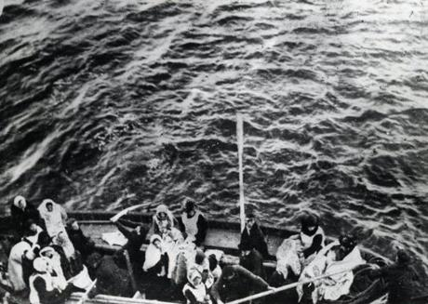

Slide 11
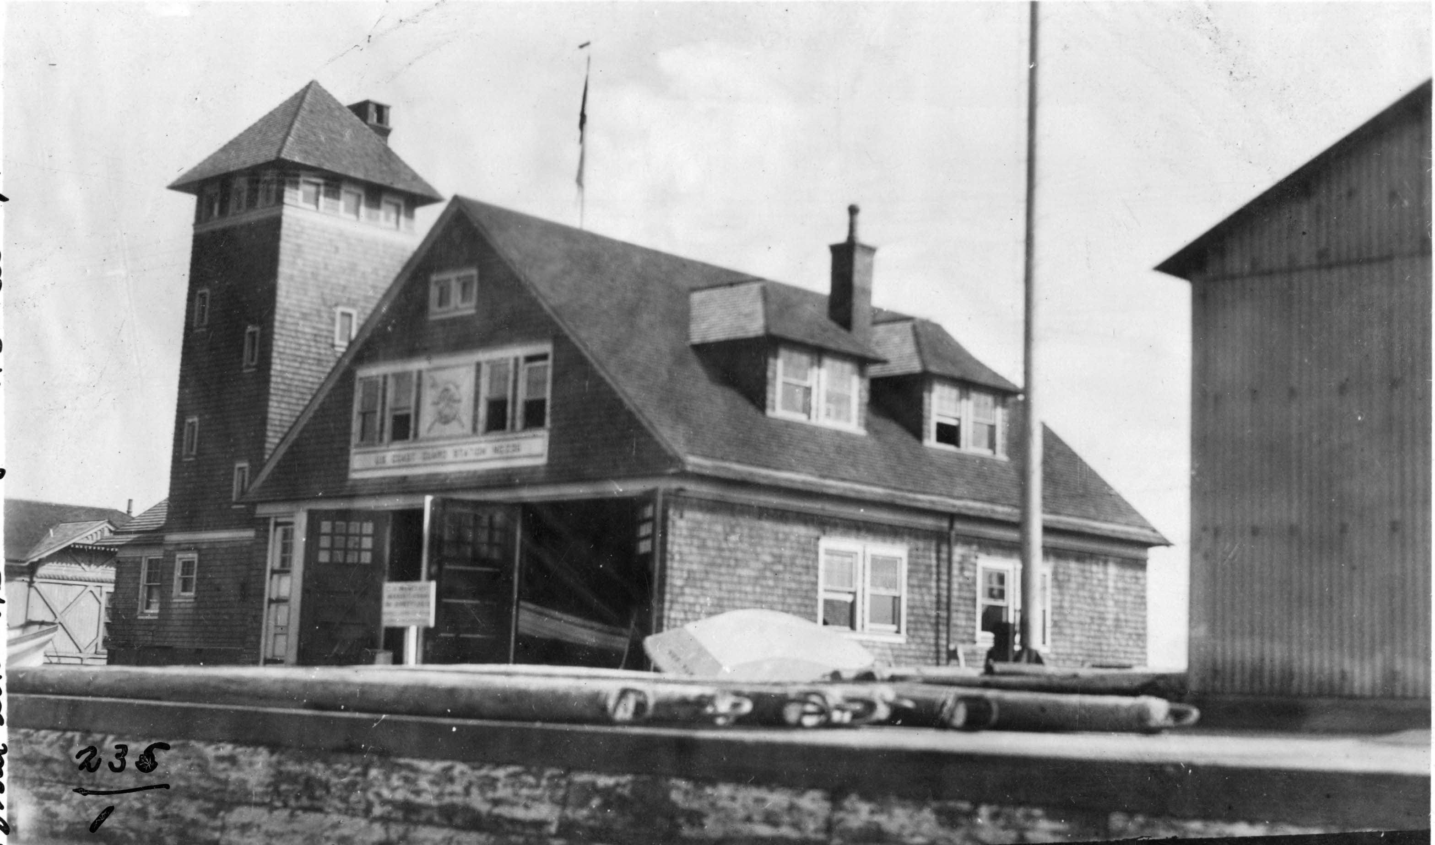

Slide 12
What is your why?

