Slide 1
Preacher, Preparation,
Presentation
A class on making and preaching sermons
Session 9
Preparing
To
Preach
Kinds of Sermons

Slide 2
Hermeneutics = the science of interpreting the Bible
Homiletics = the science of preaching

Slide 3
“There is no good preaching apart from good interpretation.”
David Allen

Slide 4
“There is no good preaching apart from good interpretation.”
David Allen
“Where the Word of God is faithfully taught, the voice of God is authentically heard.”
David Jackman

Slide 5
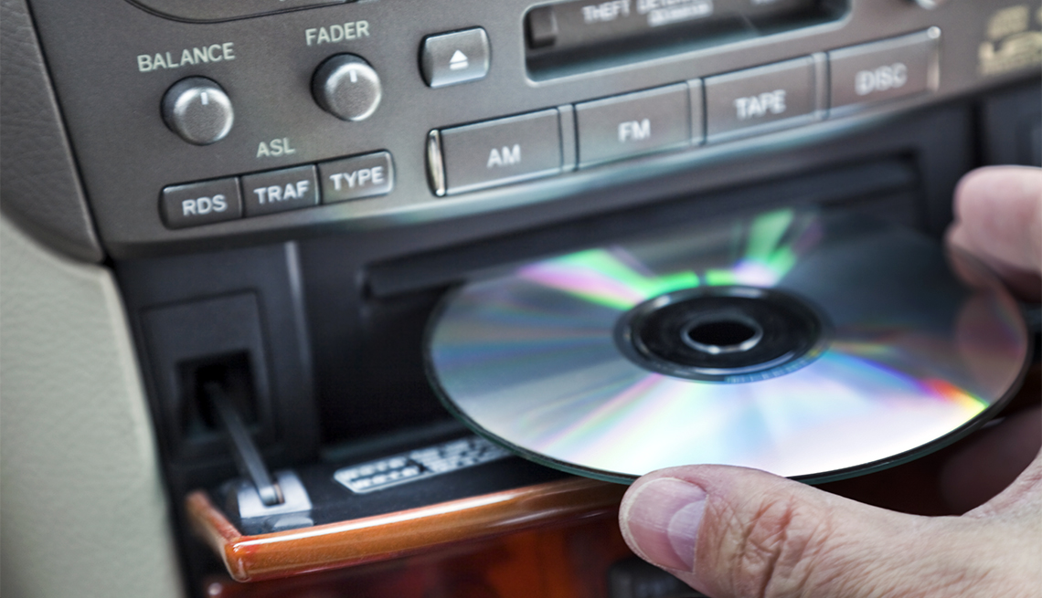
Example:

Slide 6
Implications for the Preacher
Must know the Bible well
principles of exegesis
principles of hermeneutics
kinds of literature

Slide 7
Kinds of Sermons
Greek words that are translated as, or describe the preaching event.

Slide 8
Euangelizo

Slide 9
Euangelizo
Strong’s Dictionary of the NT
1. The good news of the kingdom of God that has come to earth, and subsequently also of Jesus the Messiah, the founder of this kingdom.

Slide 10
2. The glad tidings of salvation through Christ.
3. The proclamation of the grace of God manifest and pledged in Christ.

Slide 11
4. The gospel
5. The narrative of Jesus’ life and teachings (i.e. the books of Matthew, Mark, Luke and John)

Slide 12
Geoffrey Plant: New Testament
Words
Fr Geoffrey Plant, parish priest of St Michael's Parish, within the Archdiocese of Sydney, Australia.

Slide 13
https://youtu.be/iU7VKCj7iZo

Slide 14
Jesus: “…this gospel of the kingdom must be reached to the whole world.” (Mark 14:9)

Slide 15
Pentecost Acts 2
Acts 10 with Cornelius
Paul in Athens Acts 17

Slide 16
Way of salvation:
Our sinfulness
God’s decision to save through the cross
Grace
Invitation

Slide 17
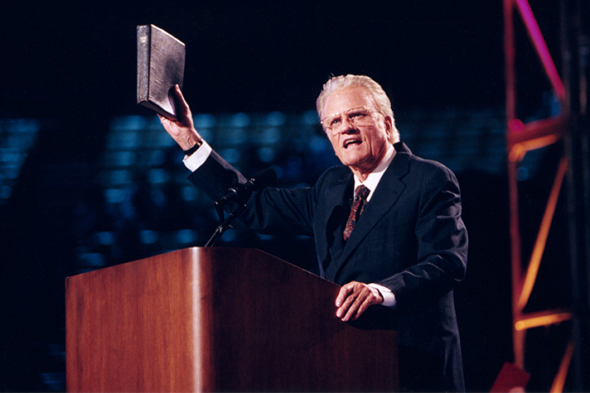

Slide 18
Where and When?
- Street preaching
- Rescue Mission
- Friendship Sunday
- Inter-faith gatherings
- As a regular part of preaching

Slide 19
Plan it!
Prepare it!
Preach it!
Celebrate!

