Slide 1
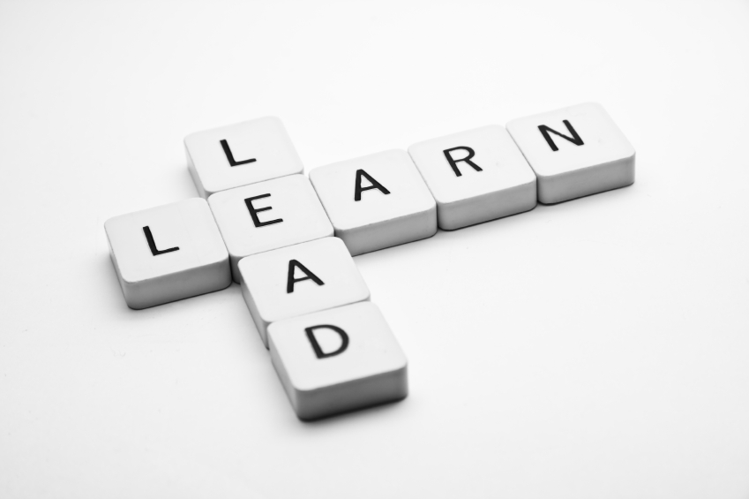
Learning To Lead
Session 8)
Leadership Levels

Slide 2
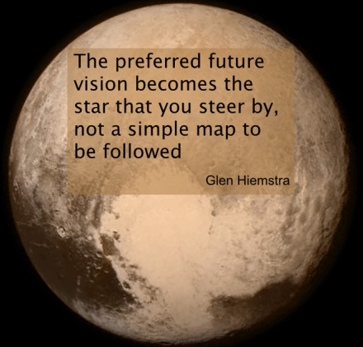
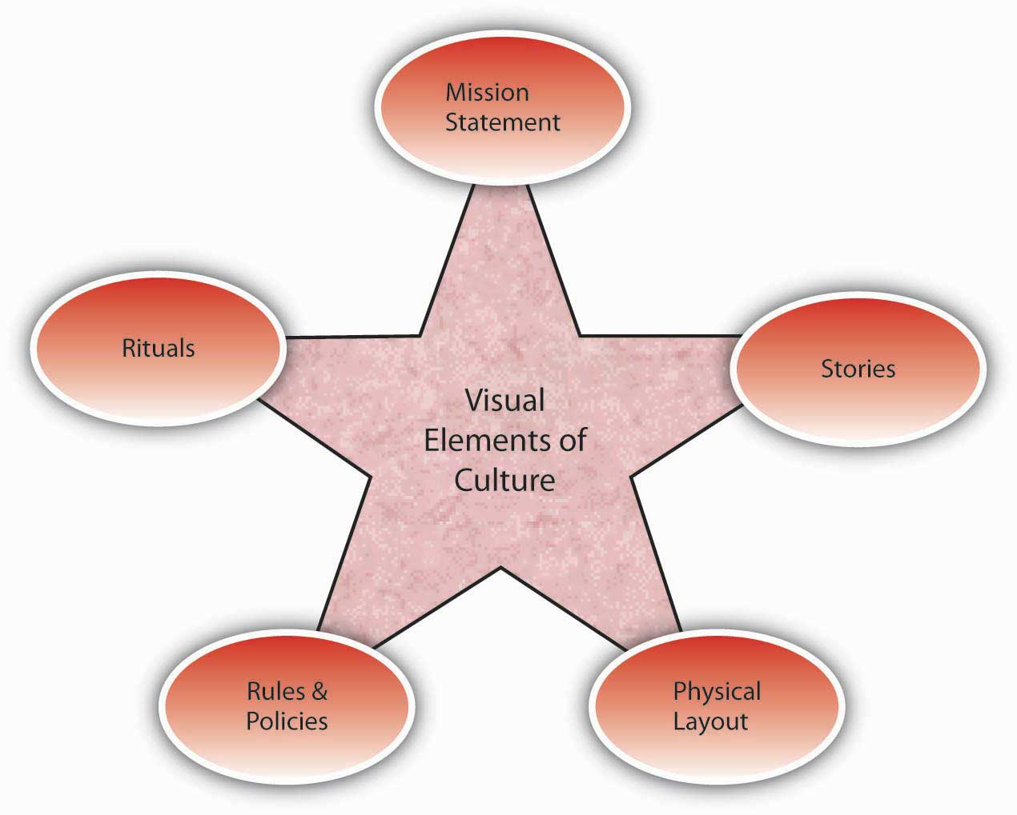
Vision
Culture
Prayer and Planning
Leader

Slide 3
Leadership Levels -- John Maxwell
Personhood
People
Development
Production
Permission
Position

Slide 4
Position
- stated authority
- younger generation
- doesn’t work well with volunteers
or white collar workers

Slide 5
If you are at this level:
Know your job description.
Accept Responsibility.
Do more than expected.
Offer ideas for change and
improvement.

Slide 6
Permission
Built on Relationships
“Leadership is getting people to work for you when they are not obligated.”
- Fred Smith
Don’t skip this level

Slide 7
If you are at this level:
Love your people more than
procedures.
Do “win-win” decisions with people.
Include others in your journey.
Deal with difficult people/
circumstances quickly.

Slide 8
Production
Built on doing something great.

Slide 9
“I seen this outfit which that ain’t never bot a dim’s worth of nothing from us and I sole them some goods. I’m now goin to Chcawgo.”

Slide 10
“I cum here and sole them haff a millyon.”

Slide 11
“We ben spendin two much time trying to spel instead of tryin to sel. Let’s wach those sails. I want everybody should read these letters from Gooch who is on the rode doin a grate job for us and you should go out and do like he done.”

Slide 12
If you are at this level:
Accept responsibility for growth.
Develop a statement of purpose.
Develop accountability for results.
Communicate strategy and vision.
Become a change agent.
Understand timing.

Slide 13
People Development
-From admiration to loyalty.
- Developing key leaders.

Slide 14
If you are at this level:
Place a priority on identifying and
equipping leaders under you.
Danger!!! Choosing low.
Be model for others to follow.
Send key people to growth
opportunities.
Develop an inner core that
complements your strengths.

Slide 15
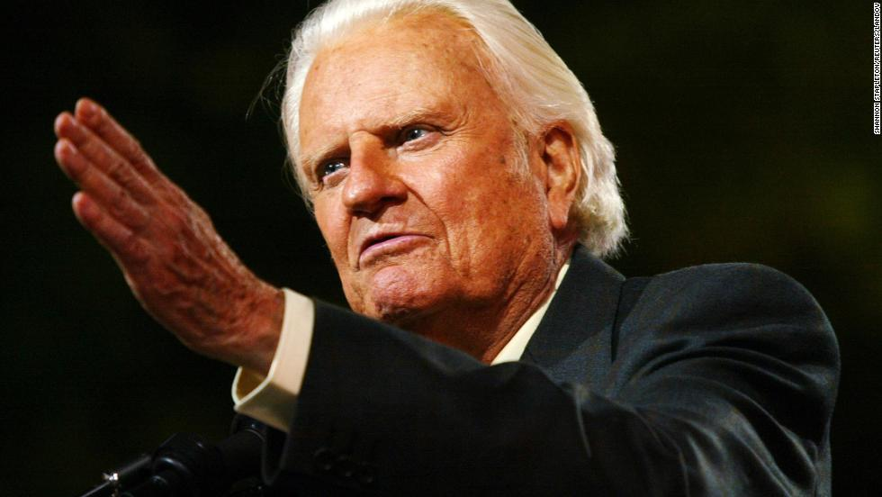
Personhood
Reached after a lifetime.

Slide 16
Follow Because:
Position Title have to
Permission Relationships want to
Production Success success
People Dev. Reproduction doing
Personhood Respect done

Slide 17
Vision
Culture
Prayer and Planning
Leader

