Slide 1
Leadership Session 3
Growing as a Leader

Slide 2
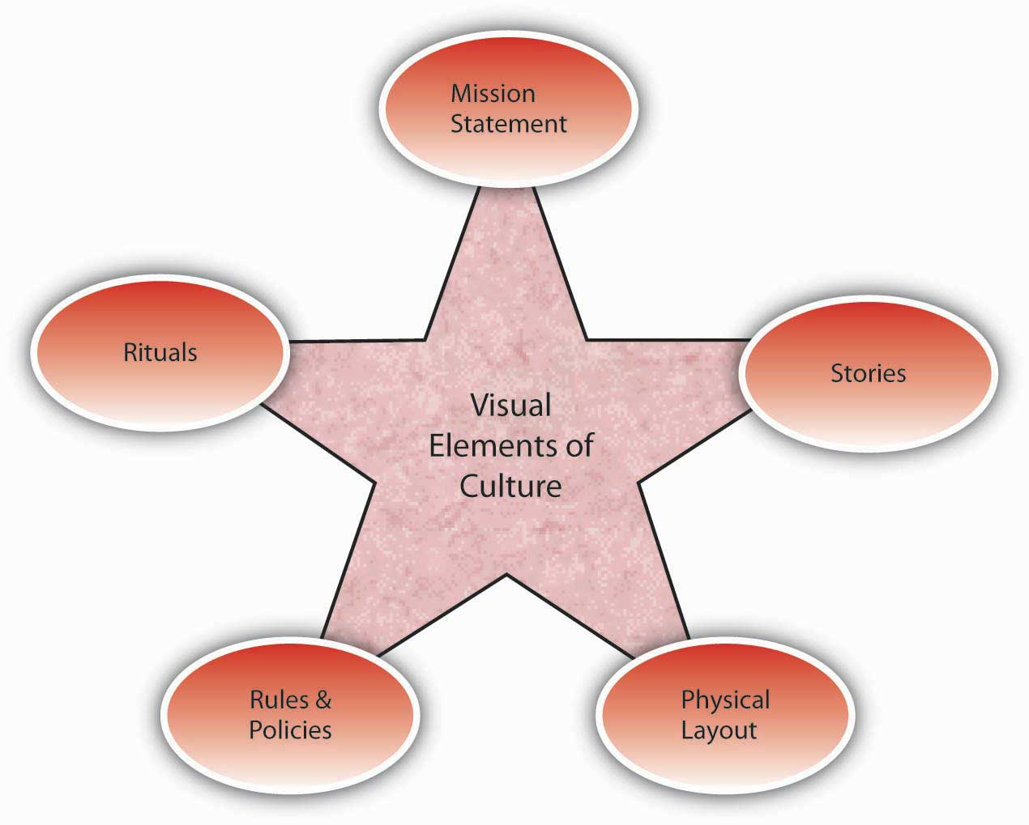
Vision
Culture
Prayer and Planning
Leader

Slide 3
Learning to Prioritize

Slide 4
What’s most important?
What will give me the greatest return?

Slide 5
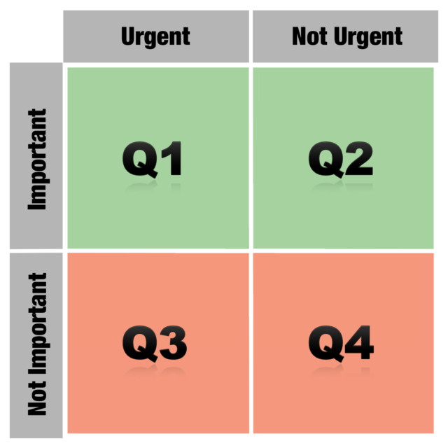

Slide 6
These are time-sensitive. Must be done and done now.
Planning, relationships,
Training, etc.
Necessary
Greatest Return
“Feel urgent”
Updating social
media for company
Most mail, most television, Facebook?
Distraction
Waste

Slide 8
Priorities with People

Slide 9
Priorities with People
VRP = Very Resourceful People
- ignite our passion
- mentor or shape our lives
- Needed

Slide 10
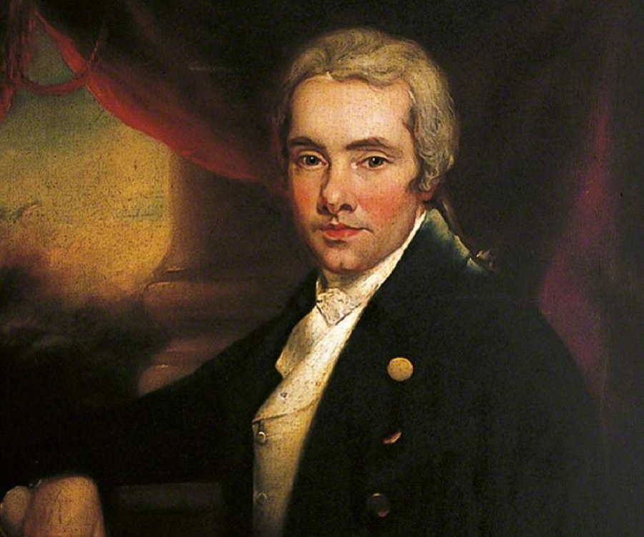
William
Wilberforce

Slide 11
Priorities with People
VRP = Very Resourceful People
VIP = Very Important People
- Share our passion
- Encourage and enrich us

Slide 12
Priorities with People
VRP = Very Resourceful People
VIP = Very Important People
VTP = Very Trainable People
- They catch our passion
- Elijah and Elisha
- Mordecai and Esther
- Joash and Jehoiada (2 Kings 12)

Slide 13
Priorities with People
VRP = Very Resourceful People
VIP = Very Important People
VTP = Very Trainable People
VNP = Very Nice People
- They are “nice” to us
- Take time, but don’t further the vision.
- Can become VTP (disciples)

Slide 14
Priorities with People
VRP = Very Resourceful People
VIP = Very Important People
VTP = Very Trainable People
VNP = Very Nice People
VDP = Very Draining People
- Demanding
- Take energy from us
- Needy
Whose crisis is it?

Slide 15
Vision
Culture
Prayer and Planning
Leader

