Slide 1
Leadership 19
Developing a Vision
Statement

Slide 2
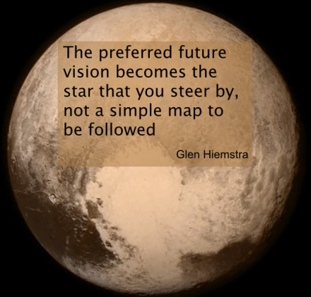

Slide 3
CASCADE executestrategy.net

Slide 4
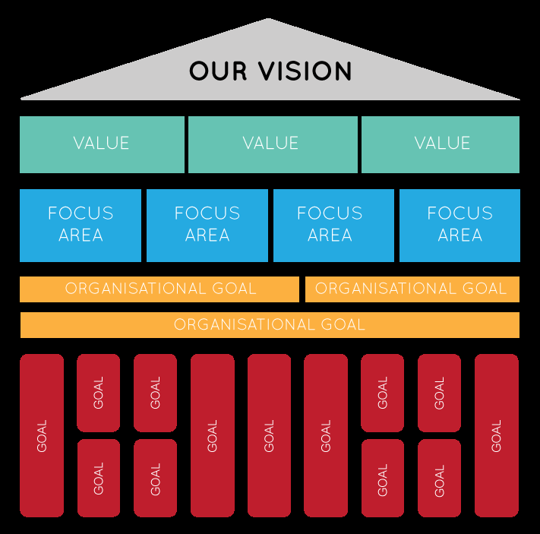

Slide 5
Creating a Vision Statement
Leader + Guiding Coalition
Prayer Careful!!! Group Think
Critical question is “Where are we going?”

Slide 6
Characteristics of a good vision statement
It is clear
It is challenging
Involves change
It is a mental picture
It is future oriented
It is achievable

Slide 7
Checklist
Future 5+ years
Directional (we aren’t there yet)
Audacious (It’s about “big”)
Descriptive (Paints a picture)

Slide 8
Exxon Mobil Corporation is committed to being the world's premier petroleum and petrochemical company.

Slide 9
The Potter’s House (Dallas, TX): We are the voice and the hand that encourages people to change their lives with hope, comfort and peace. (19)
NewSpring Church (Anderson, SC): To continue growing, impacting lives and using technology and the arts to reach 100,000 people for Jesus Christ. (18)
Perimeter Church (Johns Creek, GA): To make and deploy mature and equipped followers of Christ for the sake of Family, Community and Global transformation. (19)
Coral Ridge Presbyterian Church (Ft Lauderdale, FL): To rescue and replenish a world lost and broken by sin, thereby “making all things new” (Revelation 21:5). (19)

Slide 10
Redeemer Presbyterian New York: To build a great city for all people through a gospel movement that brings personal conversion, community formation, social justice and cultural renewal to New York City and, through it, to the world. (33)

Slide 11
Saddleback: “It is the dream of a place where the hurting, the depressed, the frustrated, and the confused can find love, acceptance, help, hope, forgiveness, guidance, and encouragement.
It is the dream of sharing the Good News of Jesus Christ with the hundreds of thousands of residents in south Orange County.
It is the dream of welcoming 20,000 members into the fellowship of our church family-loving, learning, laughing, and living in harmony together.
It is the dream of developing people to spiritual maturity through Bible studies, small groups, seminars, retreats, and a Bible school for our members.
It is the dream of equipping every believer for a significant ministry by helping them discover the gifts and talents God gave them.
It is the dream of sending out hundreds of career missionaries and church workers all around the world, and empowering every member for a personal life mission in the world. It is the dream of sending our members by the thousands on short-term mission projects to every continent. It is the dream of starting at least one new daughter church every year.
It is the dream of at least fifty acres of land, on which will be built a regional church for south Orange County-with beautiful, yet simple, facilities including a worship center seating thousands, a counseling and prayer center, classrooms for Bible studies and training lay ministers, and a recreation area. All of this will be designed to minister to the local person-spiritually, emotionally physically, and socially-and set in a peaceful, inspiring garden landscape.” (254)

Slide 12
To grow larger
To grow deeper
To grow younger
(reach a new generation)

Slide 14
River Oak Grace Church, River Oak CA
“20 X 2000”
It is our prayer and vision that by the year 2000,
River Oak Grace will experience:
-20 People will accept Jesus Christ as Lord and Savior regularly here at River Oak Grace
-20 Missionaries serving as part of the River Oak Grace International Ministries staff team
-20 New churches planted through River Oak Grace ministries
-20 Unreached people groups significantly impacted with the truth of the Gospel

Slide 15
Cherry Hills Community Church
Highlands Ranch, CO
To see the members of Cherry Hills be so Passionate about God’s heart
for the lost that they have become Proficient in ministry skills and are
Pro-actively involved in strategic outreach ministries locally, nationally and globally.

Slide 16
To grow larger
We envision 100 new believers
coming into our ministry, as well
as others who join us in our mission.
To grow deeper
We envision people walking together
in large groups and small with the
desire to become Christ-centered.
To grow younger
(reach a new generation)

Slide 17
We envision…
We believe God is calling us to…
We dream of…
We envision every kid in our community invited into relationship with Jesus Christ.

