Slide 1
Restoring Relationships Transforming Justice
Lecture 9
The War Between the Wildfire and the Peacefire

Slide 2
The War
The New Testament describes a war that every man and woman of God is engaged in on a daily basis.

Slide 3
The War
The New Testament describes a war that every man and woman of God is engaged in on a daily basis.
It’s a war between the Wildfire and the Peacefire.

Slide 4
The War
The New Testament describes a war that every man and woman of God is engaged in on a daily basis.
It’s a war between the Wildfire and the Peacefire.
It’s a war between the Kingdom of Darkness and the Heavenly Kingdom.

Slide 5
The War
The New Testament describes a war that every man and woman of God is engaged in on a daily basis.
It’s a war between the Wildfire and the Peacefire.
It’s a war between the Kingdom of Darkness and the Heavenly Kingdom.
It’s a war between the flesh (our natural desires) and the Spirit.

Slide 6
The War
It’s a war between a justice that punishes and a justice that requires accountability, but also restores relationships.

Slide 7
The War
Understanding the nature of this war helps us recognize that there is more going on in a conflict than who is right – or who’s to blame.

Slide 8
The War
Understanding the nature of this war helps us recognize that there is more going on in a conflict than who is right – or who’s to blame.
This is a spiritual war between the earthly kingdom – ruled by the devil – and God’s Heavenly Kingdom.

Slide 9
When Does the War Begin?
We are all born into this world as citizens of the earthly kingdom.

Slide 10
When Does the War Begin?
We are born into this world as citizens of the earthly kingdom.
When someone hears and believes the good news about Jesus Christ – that He came to this earth as a man – that He lived a sinless life – that He laid down His life on the cross to satisfy God’s justice – and that He rose from the dead to give his resurrection life to those who believe in him – that person is “born again.”

Slide 11
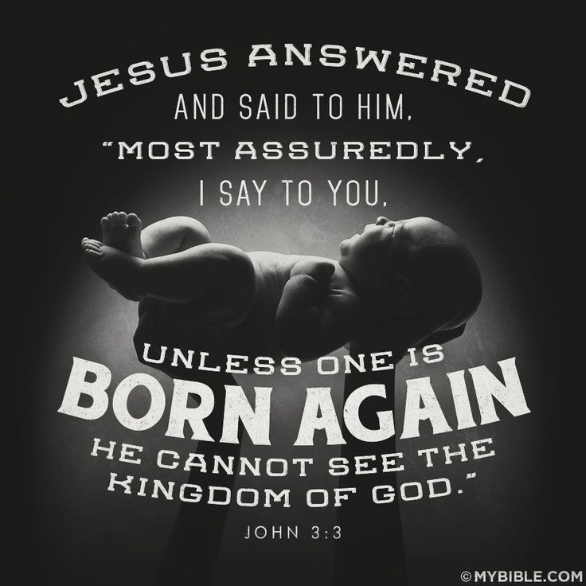

Slide 12
The War
When a person is born again in Jesus Christ, they become a citizen of the Heavenly Kingdom and all things become new.
Therefore, if anyone is in Christ, he is a new creation. The old has passed away; behold, the new has come. 2 Corinthians 5:17

Slide 13
The War
When we enter the Heavenly Kingdom, we enter as a babe.

Slide 14
The War
When we enter the Heavenly Kingdom, we enter as a babe.
Jesus Christ makes us his workmanship, transforming us into his image – moment by moment – day by day – from glory to glory.
Do not be conformed to this world, but be transformed by the renewal of your mind, that by testing you may discern what is the will of God, what is good and acceptable and perfect. Rom. 12:2

Slide 15
The War
In the earthly kingdom, our conflict choices are motivated by our natural desires – what the Bible refers to as the “flesh.”

Slide 16
The War
The Apostle Paul described the works of the flesh in his letter to the Galatians.
The acts of the flesh are obvious: sexual immorality, impurity and debauchery; idolatry and witchcraft; hatred, discord, jealousy, fits of rage, selfish ambition, dissensions, factions and envy; drunkenness, orgies, and the like. I warn you, as I did before, that those who live like this will not inherit the kingdom of God. Galatians 5:19-21

Slide 17
The War
In the Heavenly Kingdom, our choices are motivated by faith that works through love that is given to us as a gift from God through the presence of the Holy Spirit in our lives.

Slide 18
The War
For it is by grace you have been saved, through faith—and this is not from yourselves, it is the gift of God— Ephesians 2:8
I have been crucified with Christ and I no longer live, but Christ lives in me. The life I now live in the body, I live by faith in the Son of God, who loved me and gave himself for me. Gal. 2:20

Slide 19
The War
When we make faith choices in reliance on Jesus Christ, we are no longer dominated by the power of the flesh.

Slide 20
The War
When we make faith choices in reliance on Jesus Christ, we are no longer dominated by the power of the flesh.
As we grow from a babe to a mature Christian, we begin to walk in step with the Holy Spirit and bear “fruit” that looks like Jesus Christ.
But the fruit of the Spirit is love, joy, peace, forbearance, kindness, goodness, faithfulness, gentleness and self-control. Against such things there is no law. Galatians 5:22-23

Slide 21
The War
The war in every Christian’s life is the war for the desires of the heart – who will control the heart’s desires – the flesh or the spirit?

Slide 22
The War
The war in every Christian’s life is the war for the desires of the heart – who will control the heart’s desires – the flesh or the spirit?
Dear friends, I urge you, as foreigners and exiles, to abstain from sinful desires, which wage war against your soul. 1 Peter 2:11

Slide 23
The War
Who we give our attention to will control our desires and our choices.
Those who live according to the flesh have their minds set on what the flesh desires; but those who live in accordance with the Spirit have their minds set on what the Spirit desires. The mind governed by the flesh is death, but the mind governed by the Spirit is life and peace. The mind governed by the flesh is hostile to God; it does not submit to God’s law, nor can it do so. Those who are in the realm of the flesh cannot please God. Rom. 8:5-8

Slide 24
The War
The flesh and the spirit oppose one another. At any given time, we serve one or the other. We cannot serve both at the same time.
So I say, walk by the Spirit, and you will not gratify the desires of the flesh. For the flesh desires what is contrary to the Spirit, and the Spirit what is contrary to the flesh. They are in conflict with each other, so that you are not to do whatever you want. Galatians 5:16-17

Slide 25
The War
When we give our desires to the flesh, we will be focused on the wildfire and pursuing our desired outcome.

Slide 26
The War
When we give our desires to the flesh, we will be focused on the wildfire and pursuing our desired outcome.
But when we give our desires to the Spirit, we will focus on the Peacefire.

Slide 27
The War
When we give our desires to the flesh, we will be focused on the wildfire and pursuing our desired outcome.
But when we give our desires to the Spirit, we will focus on the Peacefire.
Do you see the dramatic difference this can make in how we respond to conflict?

Slide 28
The War
We win the spiritual battles in this war by spending time studying God’s Word, spending time in prayer, receiving counsel from mature Christians, and making faith choices in reliance on Jesus Christ.

Slide 29
The War
The spiritual war is relentless. In any given conflict, we can make spirit led choices in one moment, and a flesh motivated choice in the next.

Slide 30
The War
The spiritual war is relentless. In any given conflict, we can make spirit led choices in one moment, and a flesh motivated choice in the next.
When we see works of the flesh manifest in our choices, our response is not to give up or give in, but to immediately return to the Peacefire, ask the Lord’s forgiveness, thank Him for it, and get back in the fight!

Slide 31
A Curious Question
In your conflict story, what works of the flesh were evident?
What might the Lord do in your conflict story if you began to submit your desires to the Holy Spirit?

Slide 32
Lecture 9
There is a war between the wildfire and the Peacefire – a spiritual war between Satan and God – a war between our natural desires and the desires of the Holy Spirit.
We are all born into the earthly kingdom.
When someone is born again, they enter the heavenly kingdom.
These kingdoms have contrary values and laws.

Slide 33
Lecture 9
These kingdoms battle for control of our heart’s desires.
The “works of the flesh” and the “fruit of the spirit” indicate which kingdom controls the desires of our heart at any given moment.
This war rages moment by moment, day by day. This war continues for long as we live in a mortal body.

