Slide 1
Leadership 22
There’s a Price to Pay

Slide 2
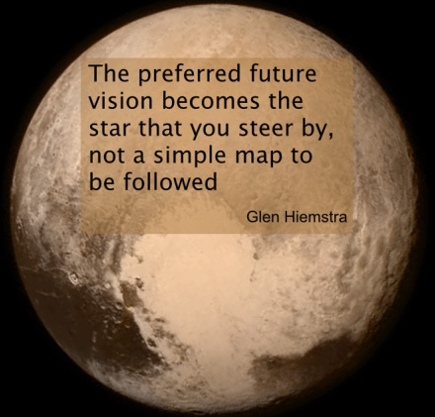

Slide 3
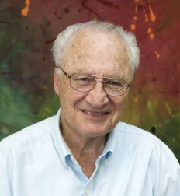
Harold Korver

Slide 4
There’s a price to pay

Slide 5
There’s a price to pay
Going all in.
“People buy into the vision after the leader buys into it.”
John Maxwell

Slide 6
There’s a price to pay
Going all in.
“People buy into the vision after the leader buys into it.”
John Maxwell
Physical, emotional, spiritual, financial.
e.g. of Karen Bennett

Slide 7
There’s a price to pay
Going all in.
Physical, emotional, spiritual, financial.
The Critics will come

Slide 8
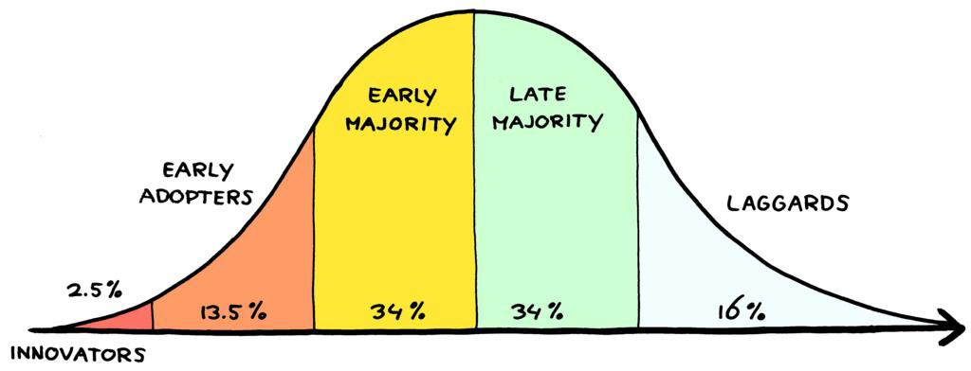

Slide 9
To some the vision is seen as a threat.
Nehemiah’s Response:
He prayed
He remembered the source of the vision
He revised his plan

Slide 10
Prayer
Hear, O our God, how we are despised! Return their reproach on their own heads and give them up for plunder in a land of captivity. Do not forgive their iniquity and let not their sin be blotted out before You, for they have demoralized the builders.
Nehemiah 4:4-5

Slide 11
Prayer, not defending himself!

Slide 12
Remember
The source of the vision.

Slide 13
Remember
The source of the vision.
“When I saw their fear, I rose and spoke to the nobles, the officials and the rest of the people: “Do not be afraid of them; remember the Lord who is great and awesome, and fight for your brothers, your sons, your daughters, your wives and your houses.’”
Nehemiah 4:14

Slide 14
Choosing your pain.

Slide 15
Revise your plan
“But we prayed to our God, and because of them we set up a guard against them day and night.”
Nehemiah 4:9

Slide 16
Be open to change—don’t confuse
your “plans” with the vision.

Slide 17
