Slide 1
Leadership 14
Vision: Introduction
and Definitions

Slide 2
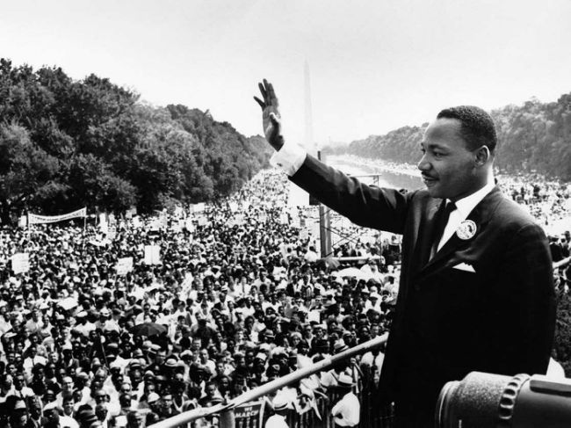

Slide 3
Images
Gathered up hopes of the people
Specific
Clear
Appeal to emotions

Slide 4
What is his vision?

Slide 5
What is his vision?
- Racial Equality

Slide 6
What aspects of culture had to change if his vision was going to become reality?

Slide 7
Mother Theresa
Bill Hybels
Andy Stanley
Henry Ford
Bill Clinton

Slide 8
Mother Theresa
- No one dies alone and unloved
Bill Hybels
- Seekers become followers
Andy Stanley
- Where unbeliever love to attend
Henry Ford
- A car anyone can afford
Coca Cola

Slide 9
“I define an institutional vision as a clear and challenging picture of the future of a ministry as its leadership believes it can and must be.”
Aubrey Malfurs, Vision for Ministry

Slide 10
“I define an institutional vision as a clear and challenging picture of the future of a ministry as its leadership believes it can and must be.”
Aubrey Malfurs, Vision for Ministry
Foresight with insight based on hindsight.
George Barna, The Power of Vision

Slide 11
“Vision for ministry is a clear mental picture of a preferable future imparted by God to his chosen servants and is based upon an accurate understanding of God, self and circumstances.”
George Barna, The Power of Vision

Slide 12
A vision is a clear picture of what the leader sees his or her group being or doing.
John Maxwell, Developing the Leader Within You

Slide 13
Common Elements
- Future-oriented
e.g. of Walt Disney
- A mental picture
- A “Faith” risk
(what “must” be)
- Achievable

Slide 14
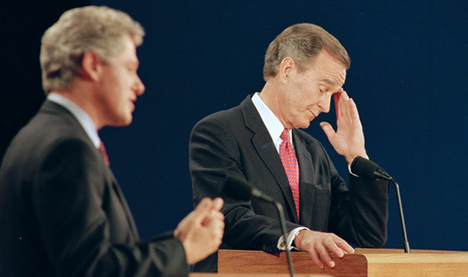

Slide 15
