Slide 1
Christian Leader’s Institute: World History 101 The Beginnings of “Civilization” to 1500 A.D.
Rev. Richard Hamstra, B.A., M.Div, M.A.

Slide 2
Session Two

Slide 3
Mesopotamia
Sumer
Reflections on “religion”
Early Babylonia
Assyrian Empire

Slide 4
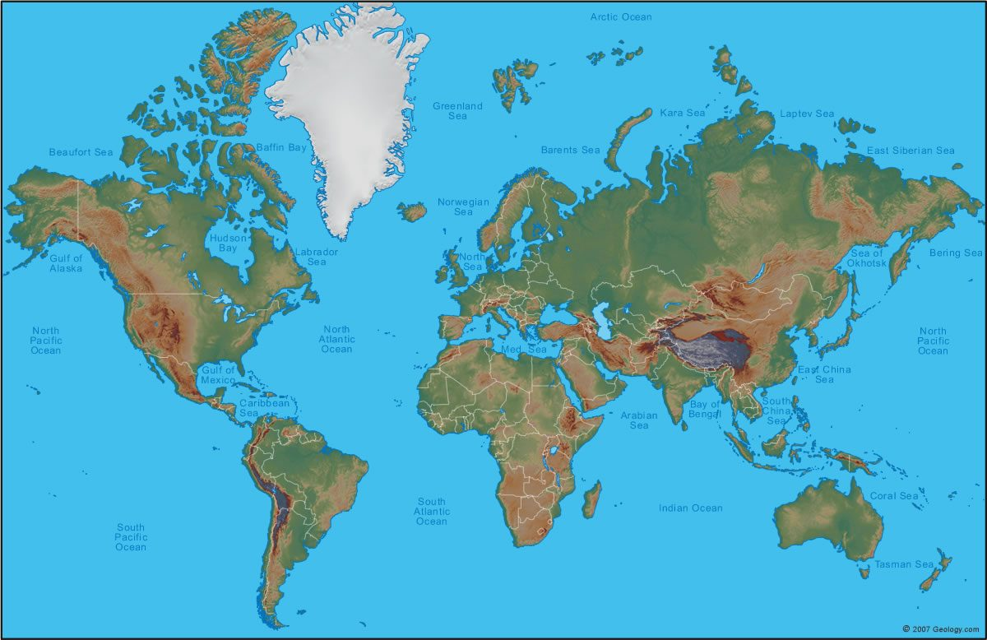

Slide 5
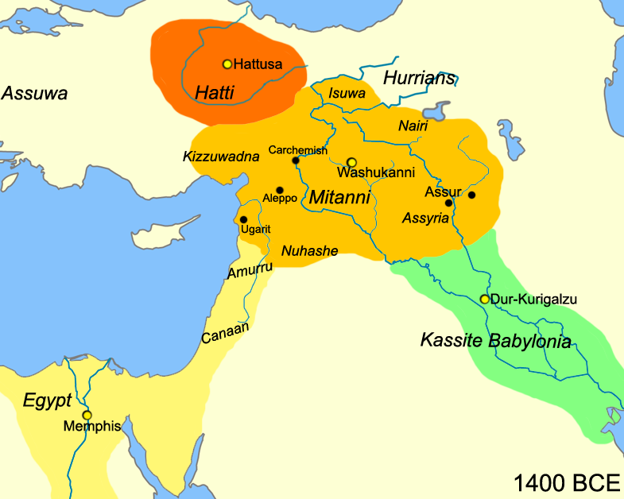
Map of Mesopotamia
Mesopotamia
https://upload.wikimedia.org/wikipedia/commons/0/0c/Near_East_1400_BCE.png

Slide 6
Sumer: The Land Between the Rivers
READING ASSIGNMENT; The History of Ancient Sumeria http://history-world.org/sumeria.htm

Slide 7
Early Sumer
Sumerian city states arise around 3500B.C.-2335 B.C. Agriculturally based, but with increasing centralized power in hands of temple priests and leaders called “lugals”—the leading civic leader—often a warrior.
Over time some city states became dominate over others, with a “king” ruling more than one city.

Slide 8
The Early Sumerian Civilization 3000 B.C.-2300 B.C.
Early Mesopotamia (the land between the rivers) sometimes called the Cradle of Civilization:
Between the Tigris and Euphrates Rivers beginning around 4000 B.C., “city-states” are arise: by 3000 B.C. using canals to irrigate fields: Capital is Uruk (3700 B.C.), others include Eridu, Ur, Lagash, Nippur, and Kish.

Slide 9
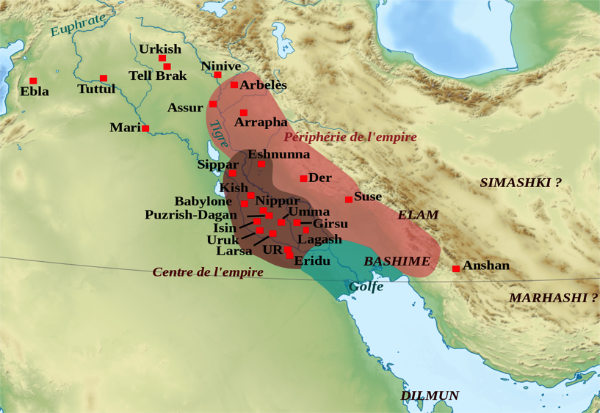
https://upload.wikimedia.org/wikipedia/commons/thumb/7/73/Ur_III.svg/2000px-Ur_III.svg.png

Slide 10
Temples/Religion
In many cultures, the center of life was the city temple.
The Sumerians, chief gods were Anu, the sky god; Enlil the storm god, and Ishtar, the morning and evening star goddess. Each city had its own patron god or goddess as well.
Temples are the local “house” of the god, and used for worship and storage---grain or other wealth.

Slide 11
Reflections on Religion
Every culture includes at least one religion---often the driving force for that culture

Slide 12
Most Ancient Religions develop as a Means to an End
The gods and goddess are ways to identify those forces around us that are beyond human control---we name them as a means of understanding and hopefully influencing them to be on our side—to give us what we want.
That “want” is usually associated with notions of fertility, prosperity, blessing, security, predictability, order over chaos, victory over enemies----for 21st Century Westerners--Success

Slide 19
Religions are often the means to sway these forces to be good to us.
Sacrifices: are means of feeding the gods—also the priests.
Some rituals are meant to entice or entertain the gods—e.g. sexual rituals or burning incense
Temples: provide the gods a local “home”– often a place to interact with the god, sometimes a place of the god’s protection over his/her people.
Priests: experts in knowing which actions will work to sway the god-technicians of religion. Often speaking on the god’s behalf---mediatorial role.
Worship: often means showing humility before the gods, for most gods will not abide human pride—hubris.

Slide 20
Worshippers’ attitudes to the god are not significant as long as the proper rites and rituals are performed.
People may honor the gods, admire the gods, trust the gods, or resent them, distrust them, dread them---not relevant….as long as the god is kept happy and on our side. (Who has god’s ear?)
Religion is generally a culture’s rituals, practices, teachings and symbols used to influence or manipulate the deities to give us what we want– How do we get this god on our side---or at least to give us what we want?

Slide 21
Religion and Civic Organization
Most of the time, a civic leader claimed to have a special relationship with a god (or many), such that the god is blessing him to be a successful administrator, warrior, ruler---often through violence.
Often, such leaders claim to be the incarnation of the god, or a descendant of the gods, or have a special relationship with the god…hence ruled “by divine right”.
Inevitable power struggles between priests and rulers arise…who really can get the god on their side? Failures—e.g. crops, lost battles—call into question the power of either priests or rulers or both to keep the god on their side. Did they practice the religion correctly?

Slide 22
Religion as a means to an End
Self or humanly interest driven….what must I/we do to get the god or gods to favor me/us?
In such religions the focus is on human action dedicated to control the gods, or at least move them to favor us.

Slide 23
Is Christianity such a Religion?
Certainly there are numerous, especially Old Testament texts, that include religious practices that are intended to win God’s favor. The Bible presents us with the interactions of God in various historical contexts---must be understood and respected!
Yet the core of the Christian faith rests on the belief that the God whom the Bible reveals, begins and persists in establishing a gracious relationship with the world.
The Christian religion is “best” understood as our response to God’s gracious, loving actions.

Slide 25
In the Biblical Faith:
The commanded human response to God’s grace is love for God and neighbor. This is the essence of the Christian faith---we love because God in Jesus Christ first loved us.
Focus on the rites, practices, actions, teachings, organization, communities, that follow, proclaim and promote both God’s gift of grace and our response of love for God and for our neighbor.
“Religious” practices are historically contextual; the Love essence of the faith endures and adapts.

Slide 26
Assignment:
In light of such reflections, please read in the Bible:
Micah 6
Jeremiah 7
Acts 17:22-34
I Corinthians 3:16-17; 6:19-20

Slide 27
Notable Sumerian Achievements
1. Writing
2. Ziggurats
3. Mathmatics and civic organization

Slide 28
Cuneiform
Around 4000 B.C. Pictorial representations of objects impressed into soft clay with sharpened reeds, then baked—500,000 “bricks” found…evolved into symbols of sounds for syllables. Not a language, but a way to represent language. Used by various languages for nearly 5000 years.
Indicates diverse society, trade abounds, controlled by priests/scribes.

Slide 29
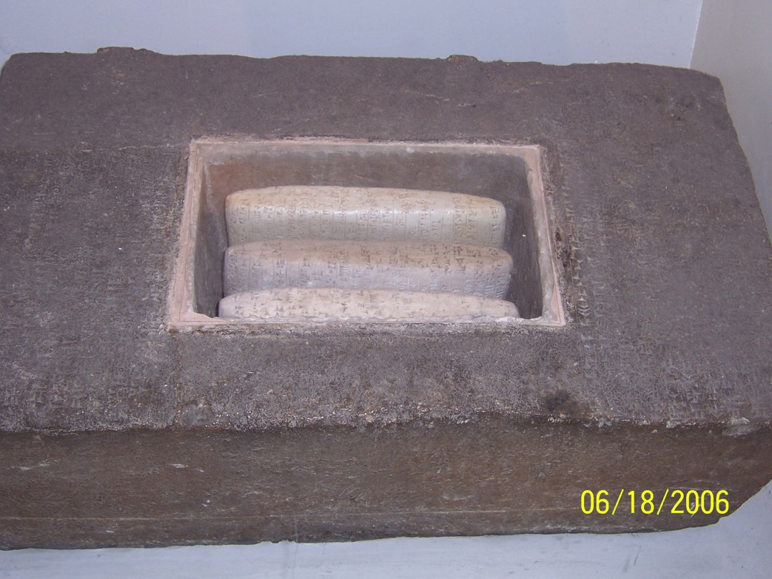

Slide 30
Temple Mounds
Raised platforms
Ziggurats---pyramid shaped towers built to house the local god. (human made mountains). Babylon’s most famous—Tower of Babel

Slide 31
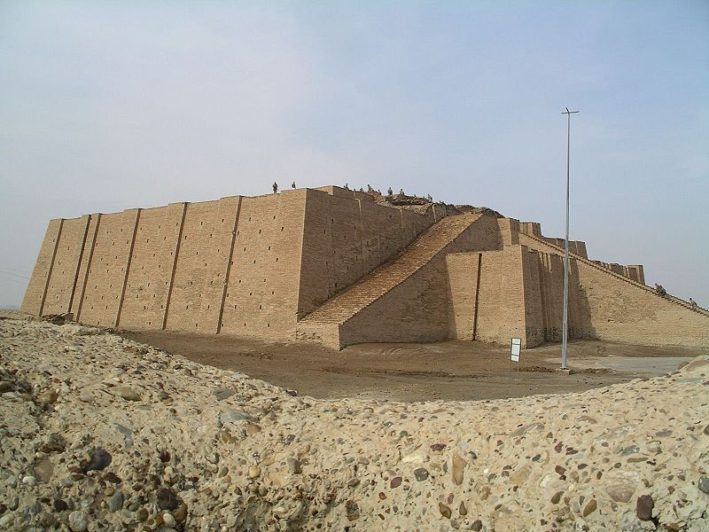
https://encrypted-tbn3.gstatic.com/images?q=tbn:ANd9GcQ-Wr9Ex7K8zdRBbduI1TF9qW1E6sbdG8RTXT_6oVeCMhIBky1qd-NJGw

Slide 32
Math and Organization
Accounting system based on 60…we still use 360 degrees for a circle, 60 seconds for each minute, 60 minutes for each hour.
Systems of business.
Understanding of the movement of the moon, with a calendar based on its movements.

Slide 33
Sumer—Akkadian Empire
Invasion of Semitic speaking people from north of Mesopotamia.
Akad as major city. Akkadian Empire
Sargon I, 2335-2279 B.C., one of the first major “rulers” of Mesopotamia. Ruled the entire land between the rivers as well as great influence both east and west.

Slide 34
READING ASSIGNMENT on Sargon the First http://www.ancient.eu/Sargon_of_Akkad/
Sargon of Akkad: by Joshua J. Mark

Slide 35
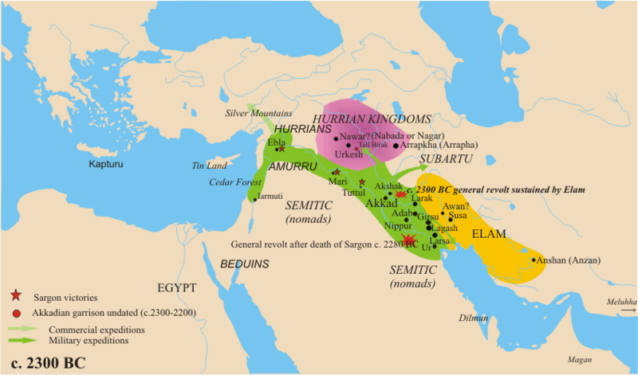
https://upload.wikimedia.org/wikipedia/commons/c/c8/Orientmitja2300aC.png

Slide 36
EARLY Babylon
Ca 1800 B.C.

Slide 37
Early Babylon became an international empire
Early Babylon had political and economic power over most of the Middle East---from Iran to Egypt’s outpost in Palestine.
Main god…Marduk

Slide 38
READING ASSIGNMENT
Article by Joshua J. Mark entitled Babylon.
Http://www.ancient.eu/babylon/
Please read the first two paragraphs: “Definition” and “The Old City and Hammurabi”

Slide 39
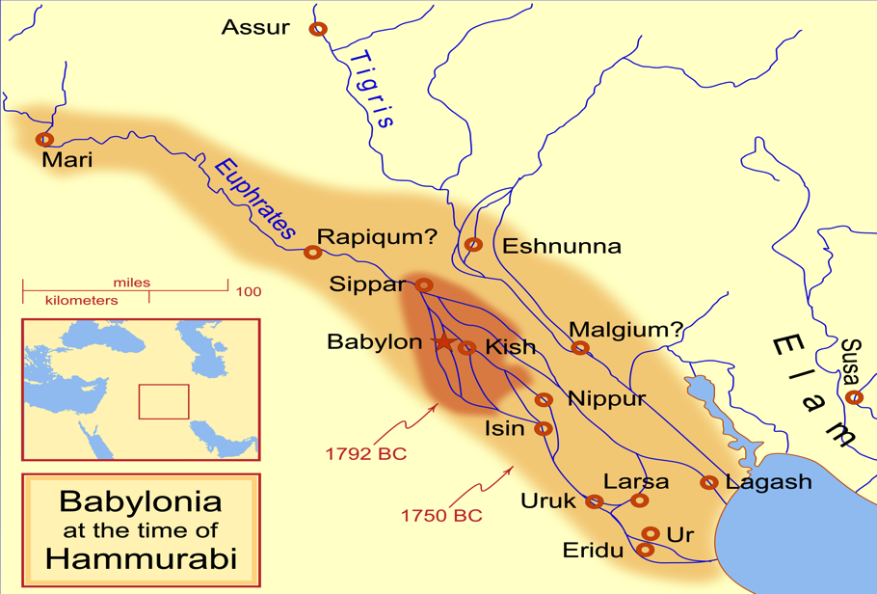
https://upload.wikimedia.org/wikipedia/commons/thumb/1/12/Hammurabi's_Babylonia_1.svg/2000px-Hammurabi's_Babylonia_1.svg.png

Slide 40
Hammurabi
Hammurabi of Babylon defeated Rim-Sin of Larsa (r. about 1823-1763 BC) and became the sole ruler of Sumer and Akkad.

Slide 41
Hammurabi’s Code ca 1754 B.C.
Over 280 laws regulating mostly personal and business concerns…mostly dealing with appropriate fines or punishments.
Engraved on basalt rock in Akkadian cuniform, shaped like a index finger.
Asserts the ruler’s wisdom and authority as given to him by the gods.
Many steles distributed throughout empire.

Slide 42
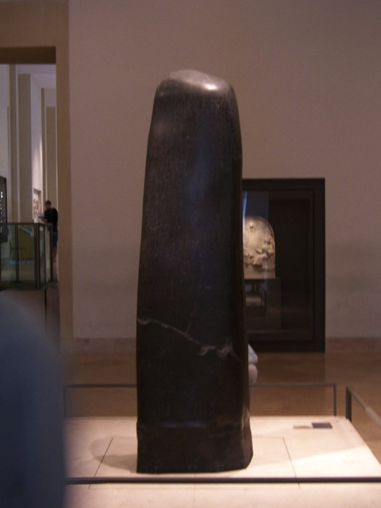

Slide 43
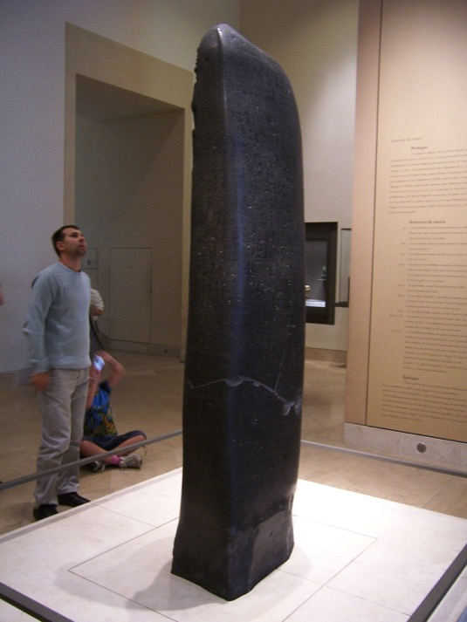

Slide 44
Literary works published around this time
Creation Story: https://en.wikipedia.org/wiki/En%C3%BBma_Eli%C5%A1
Gilgalmish epic…. http://www.ancient.eu/gilgamesh/ Article by Joshua J. Marks
Flood Story: https://en.wikipedia.org/wiki/Gilgamesh_flood_myth

