Slide 1
Christian Leader’s Institute: World History 101 The Beginnings of “Civilization” to 1500 A.D.
Rev. Richard Hamstra

Slide 2
Session 5 Egypt

Slide 3
Egypt
READING ASSIGNMENT: Article by Josuha J. Mark; Ancient Egypt ; http://www.ancient.eu/egypt/
Recommended viewing
https://www.youtube.com/watch?v=KuUMe-43A3E mintues 1-141

Slide 4
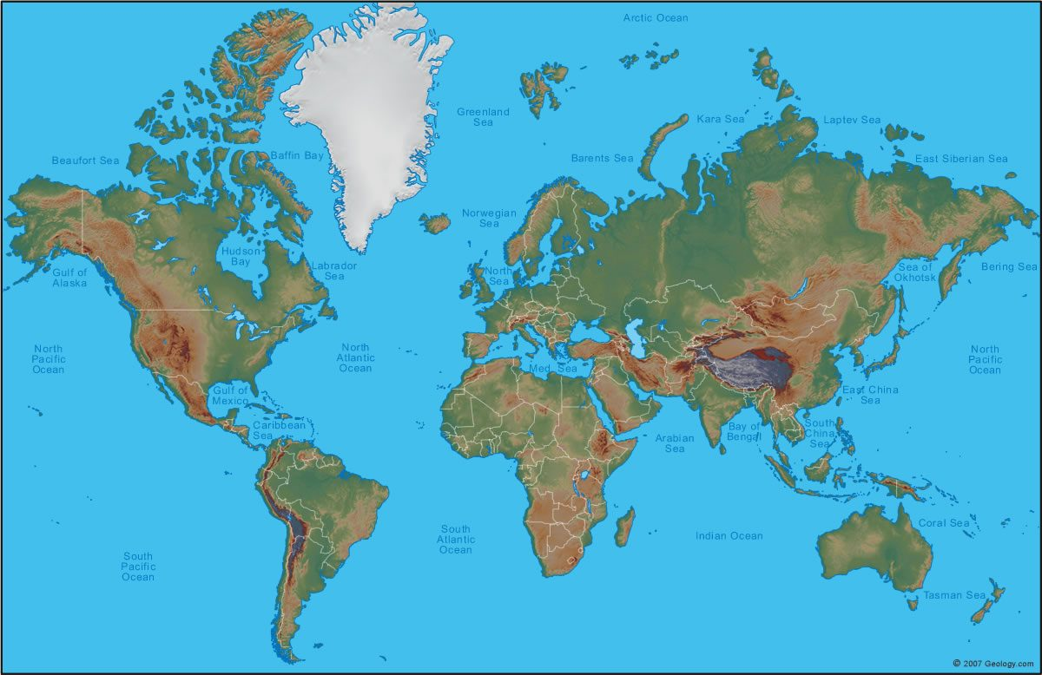

Slide 5
Ancient Egypt: 3150-331 B.C.
Egypt is nearly completely defined by the Nile River and it annual, and predictable, periods of flood and lower water.

Slide 6
From the ancient times there was a Lower and Upper kingdom in Egypt, with the Upper Nile closer to the African mainland (southern)and the Lower Nile (northern) emptying into the Mediterranean sea.

Slide 8
3 Kingdoms or periods
Ancient Egyptian history is divided into three periods called the Old Kingdom, the Middle Kingdom and the New Kingdom.

Slide 9
Old Kingdom-2613-2128 B.C.
Middle Kingdom-2040-1782 B.C.
New Kingdom 1570-1069 B.C.

Slide 10
Following these periods of dominance by other empires, still a formidable culture and nation.
Also, the periods between the Kingdoms were often significant.

Slide 11
Writing
Egyptian writing uses symbols of recognizable figures to represent ideas. This is called hieroglyphics. This form of writing began in use prior to the Old Kingdom, before 3200 B.C.
Way of representing may have influenced, or been influenced by Sumerian Cuneiform

Slide 12
Rosette Stone
Discovered in Egypt by French troops in 1799, a degree written in 194 B.C. in three languages: Greek, Demotic and Ancient Hieroglyphic. Finally translated in 1822, began tool for understanding the hieroglyphic language of ancient Egypt.
Held in British Museum since 1802

Slide 14
Unification of Upper and Lower Egypt
Early Dynastic Egypt begins with King Menes from Lower taking control of both kingdoms uniting Upper and Lower into one Kingdom around 3150 B.C.
Lasted until 2613 B.C.
Capital at Memphis

Slide 17
Old Kingdom 2613-2128 B.C.
Pyramids and Sphinx at Giza were built during first few hundred years of Old Kingdom

Slide 19
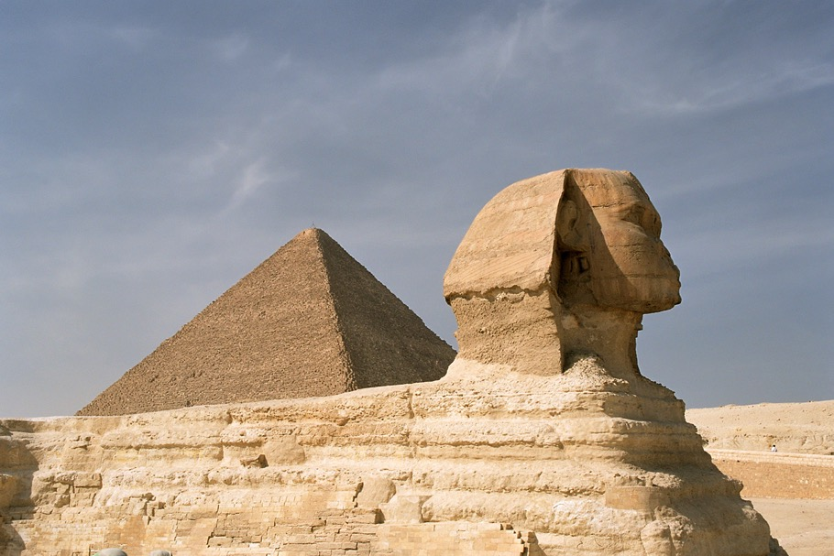
https://upload.wikimedia.org/wikipedia/commons/a/a5/Cairo,_Gizeh,_Sphinx_and_Pyramid_of_Khufu,_Egypt,_Oct_2004.jpg

Slide 20
Middle Kingdom 2040-1782 B.C.
First Kingdom ends with division again between Lower and Upper Egypt, but united by King Mentuhotep II in 2055 B.C. Capital moved to the city of Thebes in Upper Egypt.
Middle Kingdom time of cultural flourishing—”Classical Egypt”.
Biblical person, Joseph? 1900-1700 B.C.?

Slide 26
End of Middle Kingdom related to rise of Hyksos group in Lower (Delta) Egypt.

Slide 27
Hyksos: 1782-1570 B.C.
Ca 1800 B.C., invaders? Refugees? From Syria?
Little is known, related perhaps to migrations near end of Bronze age…gained control of Delta, city of Avaris.
Nubian Kingdom in South, Hyksos in North, overcame Thebes.
Technical advances: horses, wheeled chariot, improved bow, crop rotation, improved bronze
Connection to the Biblical stories of Joseph?

Slide 28
Around 1570, Ahmose I—Thebean, regains control and unites Upper and Lower Egypt—New Kingdom.

Slide 29
New Kingdom 1570-1069 B.C.
Pharaoh—title of the King
Many building projects…Valley of the Kings, Luxor
International expansion—conflicts with Mesopotamia powers under Tuthmosis I-late 1500’s B.C.
Queen Hapshepsut—early 1400’s B.C.---ruled for 20 years

Slide 30
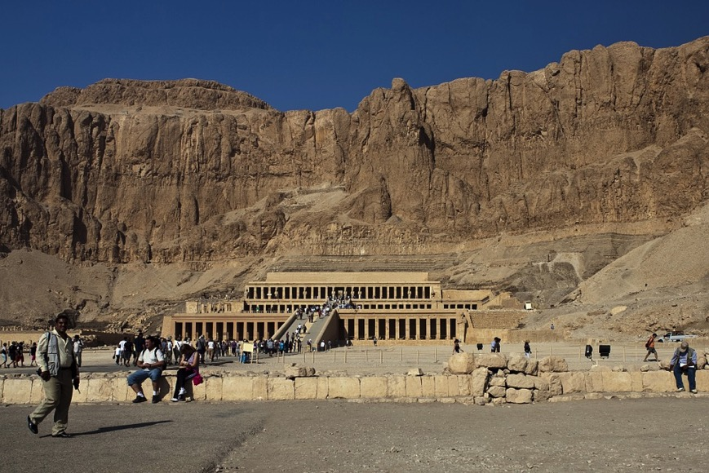
https://pixabay.com/static/uploads/photo/2014/09/11/09/53/valley-of-the-kings-441544_960_720.jpg

Slide 31
Moses
Birth is generally dated around 1530 B.C.
Tuthmosis I
Exodus around 1450 B.C.
Tuthmosis III

Slide 32
New Kingdom cont.
Akhenaten and Nefertiti, 1353-1336 B.C. monothesism –god Aten. Both political reasons—lessen power of the priests—also theological…devoted to Aten. Moved capital to Armana

Slide 33
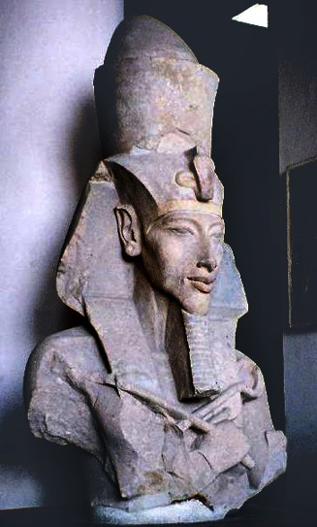
https://upload.wikimedia.org/wikipedia/commons/f/f7/Pharaoh_Akhenaten.jpg

Slide 34
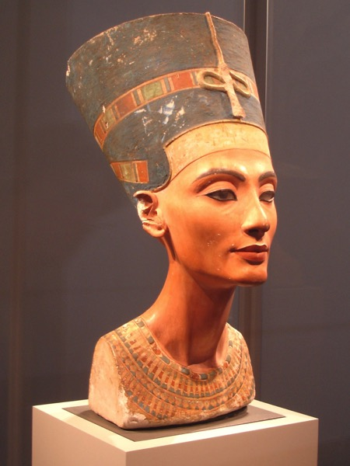
https://upload.wikimedia.org/wikipedia/commons/0/0a/Nefertiti_berlin.jpg

Slide 35
Son-heir-Tutankhamun---restored polythesim, god Amun as the chief god…tomb found in 1922 A.D.

Slide 36
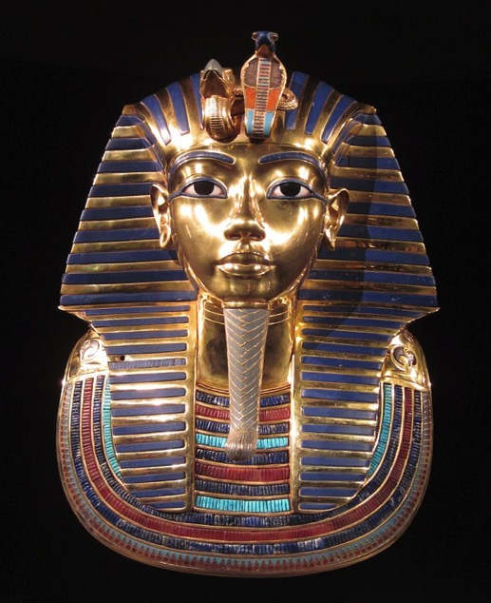
https://pixabay.com/static/uploads/photo/2014/10/30/21/41/tutankhamun-509752_960_720.jpg

Slide 37
Ramses II 1279-1213 B.C.
Warrior—constant conflict with powers in East and North (Hittite Empire in Anatolia)
First “Peace Treaty”….Cut a Treaty, or Cut a Covenant….includes divine retribution if broken….. Curses and Blessings for this Treaty

Slide 38
Curses and Blessings for this Treaty
“As for these words which are on this tablet of silver of the land of Hatti and of the land of Egypt--as for him who shall not keep them, a thousand gods of the land of Hatti, together with a thousand gods of the land of Egypt, shall destroy his house, his land, and his servants.

Slide 39
But, as for him who shall keep these words which are this tablet of silver, whether they are Hatti or whether they are Egyptians, and they are not neglectful of them, a thousand gods of the land of Hatti, together with a thousand gods of the land of Egypt, shall cause that he be well, shall cause that he live, together with his houses and his (land) and his servants.”
Similar pattern in OT covenants/treaties/contracts—Meredith Kline’s work

Slide 40
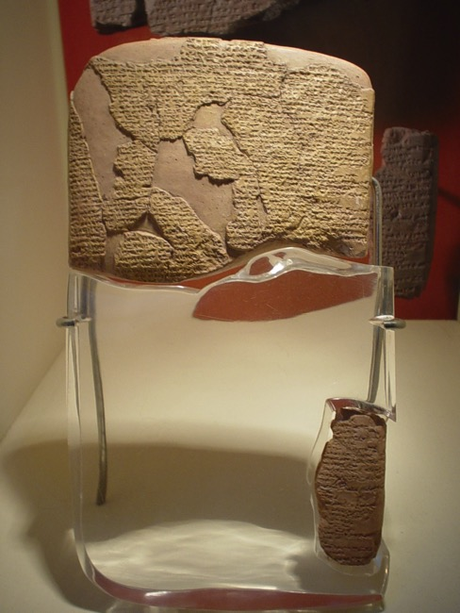
https://upload.wikimedia.org/wikipedia/commons/thumb/9/96/KadeshTreaty.JPG/450px-KadeshTreaty.JPG

Slide 43
Coming of the Sea-People to Egypt 1276-1178 B.C.
READING ASSIGNMENT Joshua J. Mark’s article on The Sea People; http://www.ancient.eu/Sea_Peoples/
Late Bronze age Upheaval
Origins unknown—refugees from early Greek cultures…Mycenaean?---unemployed mercenary troops from Greek city states?---Central Europeans? refugees from fallen Troy?

Slide 44
Not unified group, but effective army and navy force---sometimes travelling with families---
Various allies—Lybia
Technically advanced, used iron weapons, navy power

Slide 45
Relationship with Phoenicians?
Phoenicians: Tyre, Sidon, Byblos, (Lebanon, Syria)….major merchants…
Hiram—Jezebel---chief god--Baal
Carthage in North Africa
Alphabet (vowels)—Phoenician to Greeks

Slide 46
Merneptah Stele
Assigned Reading:
http://realhistoryww.com/world_history/ancient/Misc/Merneptah_Stele/Merneptah_Stele.htm

Slide 47
Merneptah Stele records Merneptah’s victory over the sea peoples and the Lybians mostly in terms of a victory of the Egyptian gods over the invaders gods…ca. 1200 B.C.
Also makes reference to group in Canaan named, Israel as well as a couple of Philistine cities.

Slide 48
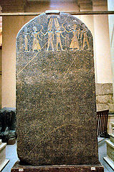
https://upload.wikimedia.org/wikipedia/commons/thumb/c/c4/Merneptah_Israel_Stele_Cairo.JPG/159px-Merneptah_Israel_Stele_Cairo.JPG

Slide 49
Post New Kingdom---
Around 1000 B.C.---some period of return to unified kingdom---but in 7th cent B.C—until 20th Cent A.D..…series of invasions and occupations—Assyrians, Persians, Greeks, Romans, Arab/Muslim--- English, French, English..etc.

Slide 50
Ancient Egyptian Religion
Reading Assignment: Article by Mark Millmore on Egyptians gods and goddesses found at http://discoveringegypt.com/ancient-egyptian-gods-and-goddesses/
Gods and goddesses relate to stages of Nile and desert life
Providing for a well provisioned afterlife, a chief duty to others

Slide 51
Many Egyptian gods and goddesses, influence later Greek/Roman cultures—esp. Isis.
Rulers and family— considered direct descendents of gods, goddesses—ruled by divine right….

Slide 54
End of Session Five

