Slide 1
Leadership 16
Mission and Vision
Continued

Slide 2
Andy Stanley, Visioneering
“Vision weaves four things into the fabric of our daily experience.”

Slide 3
Andy Stanley, Visioneering
“Vision weaves four things into the fabric of our daily experience.”
- Passion (anticipated future)
- Motivation (pulls you forward)
- Direction (selling equipment)
- Purpose (get up in the morning)

Slide 4
Mission and Vision
Mission:
Defines present state or purpose of an organization
Answers three questions of why the organization exists.

Slide 5
Three Questions:
What it does
Who it does it for
How it does what it does

Slide 6
A vision statement:
Defines a future state—what the
organization wants to accomplish over time.
Gives guidance to long-range planning
Functions as a “north star”
Is succinct and inspirational

Slide 7
Characteristics of a good vision statement

Slide 8
Characteristics of a good vision statement
It is clear
e.g. of Nehemiah 2:17

Slide 9
Characteristics of a good vision statement
It is clear
It is challenging
Involves change

Slide 10
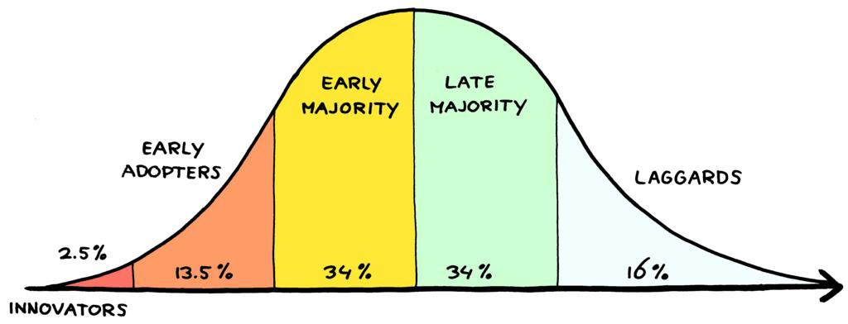

Slide 11
Characteristics of a good vision statement
It is clear
It is challenging
Involves change
It is a mental picture
Moses on Mt. Nebo
King’s speech

Slide 12
Characteristics of a good vision statement
It is clear
It is challenging
Involves change
It is a mental picture
It is future oriented
Long-term
Short-term

Slide 13
Characteristics of a good vision statement
It is clear
It is challenging
Involves change
It is a mental picture
It is future oriented
It is achievable

Slide 14
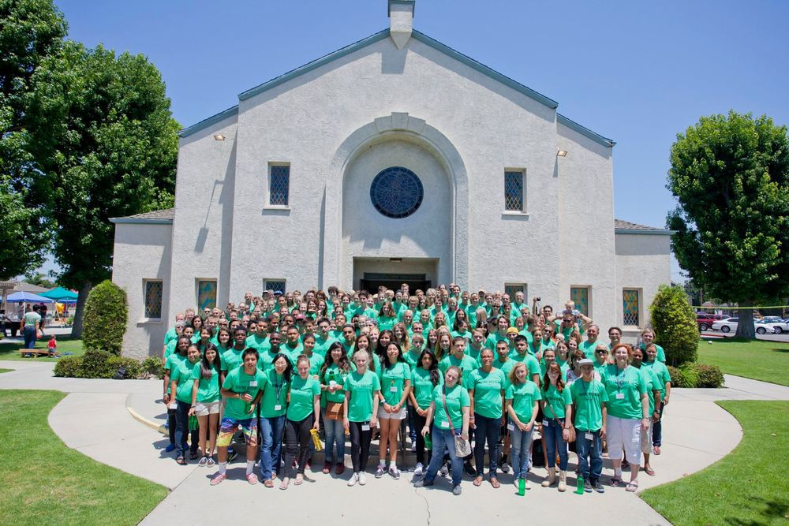

Slide 15
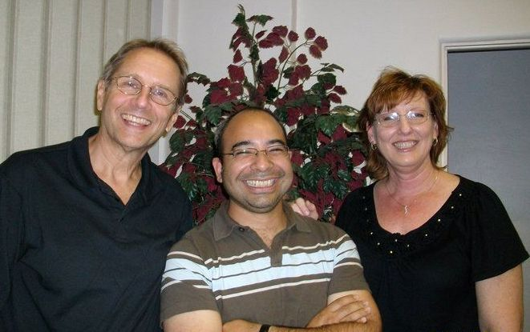

Slide 16
Characteristics of a good vision statement
It is clear
It is challenging
Involves change
It is a mental picture
It is future oriented
It is achievable

Slide 17
Alzheimer's Association:
"Our Vision is a world without Alzheimer‘s Disease."

Slide 18
Microsoft:
"Empower people through great software anytime, anyplace, and on any device."

Slide 19
Christ Church of the Valley (Peoria, AZ):
Impacting 100,000 Phoenix area residents by the year 2020. (9)

Slide 20
The Potter’s House (Dallas, TX): We are the voice and the hand that encourages people to change their lives with hope, comfort and peace. (19)
NewSpring Church (Anderson, SC): To continue growing, impacting lives and using technology and the arts to reach 100,000 people for Jesus Christ. (18)
Perimeter Church (Johns Creek, GA): To make and deploy mature and equipped followers of Christ for the sake of Family, Community and Global transformation. (19)
Coral Ridge Presbyterian Church (Ft Lauderdale, FL): To rescue and replenish a world lost and broken by sin, thereby “making all things new” (Revelation 21:5). (19)

Slide 21
Redeemer Presbyterian New York: To build a great city for all people through a gospel movement that brings personal conversion, community formation, social justice and cultural renewal to New York City and, through it, to the world. (33)

Slide 22
Saddleback: “It is the dream of a place where the hurting, the depressed, the frustrated, and the confused can find love, acceptance, help, hope, forgiveness, guidance, and encouragement.
It is the dream of sharing the Good News of Jesus Christ with the hundreds of thousands of residents in south Orange County.
It is the dream of welcoming 20,000 members into the fellowship of our church family-loving, learning, laughing, and living in harmony together.
It is the dream of developing people to spiritual maturity through Bible studies, small groups, seminars, retreats, and a Bible school for our members.
It is the dream of equipping every believer for a significant ministry by helping them discover the gifts and talents God gave them.
It is the dream of sending out hundreds of career missionaries and church workers all around the world, and empowering every member for a personal life mission in the world. It is the dream of sending our members by the thousands on short-term mission projects to every continent. It is the dream of starting at least one new daughter church every year.
It is the dream of at least fifty acres of land, on which will be built a regional church for south Orange County-with beautiful, yet simple, facilities including a worship center seating thousands, a counseling and prayer center, classrooms for Bible studies and training lay ministers, and a recreation area. All of this will be designed to minister to the local person-spiritually, emotionally physically, and socially-and set in a peaceful, inspiring garden landscape.” (254)

Slide 23
To grow Larger
To grow Deeper
To grow Younger
(to reach the next generation)

