Slide 1
Humanism in Psychology
The approach to psychology that embraces the notions of self-esteem, self-actualization, and free will.

Slide 2
Self Concept
The set of beliefs about who we are

Slide 3
Self Esteem: The positive feelings about the self

Slide 4
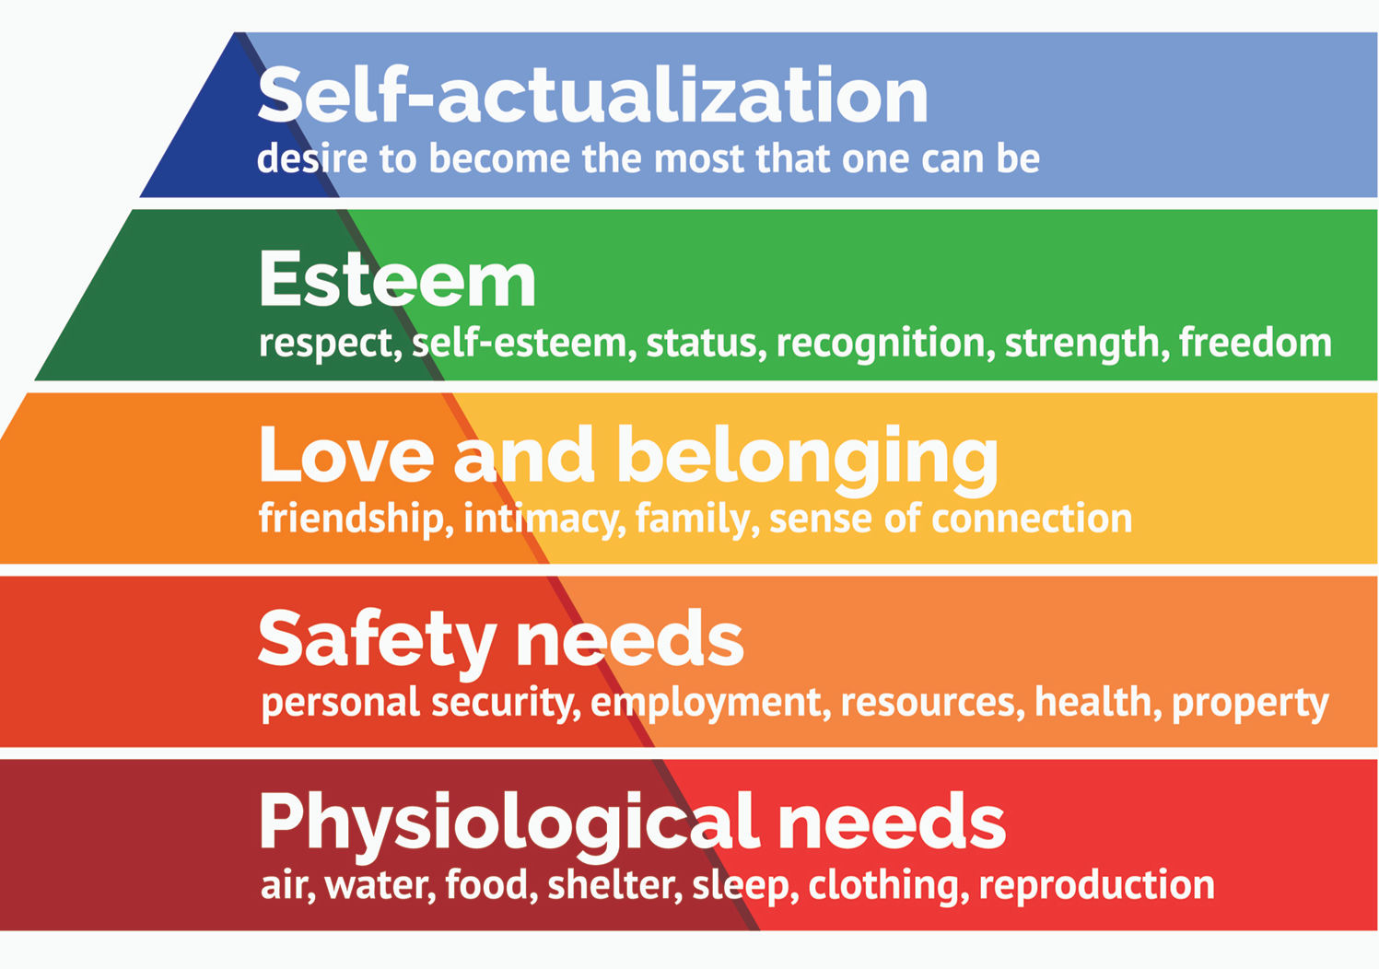
Maslow’s Hierarchy of Needs

Slide 5
Self-Actualization
The motivation to develop our innate potential to the fullest possible extent.

Slide 6
Peak Experiences
Transcendent moments of tranquility accompanied by a strong sense of connection with others

Slide 7
Unconditional Positive Regard
A set of behaviors including being genuine, open to experience, transparent, able to listen to others, and self-disclosing and empathic.

