Slide 1
by
Financial Freedom & Success Institute
Presents
Alex Barrón

Slide 2
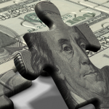
LESSON 7: YOUR PERSONAL BALANCE SHEET & NET WORTH

Slide 3
Read: Why Teach Financial Literacy
“Money without financial intelligence is money soon gone.”
“It’s now how much money you make, it’s how much money you keep.”
“Rich people acquire Assets.”
“The poor and middle class acquire liabilities, but they think they are assets.”
- Robert Kiyosaki

Slide 4
Review of Key Concept: Net Income
Earnings
- Expenses
==============
= Net Income
Net Income is the difference between what you Earn and what you Spend.

Slide 5
What Makes the Difference Between The Rich vs. Middle Class vs. Poor
Poor = Net Income of (-).
They spend more than they earn.
They borrow to buy the things they want.
Middle Class = Net Income of (0).
They live paycheck to paycheck.
They do not borrow, but do not save.
They spend every dollar they earn.
Rich = Net Income of (+).
They save a part of all they earn.
They live under their means.
They are smart and patient and know the key to wealth is savings and investment.

Slide 6
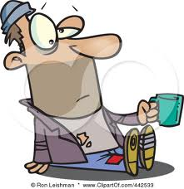
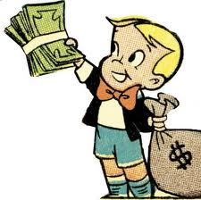
Rich vs. Middle Class vs. Poor
Poor
Earn $100
- Spend $101
₌₌₌₌₌₌₌₌₌₌₌₌₌₌₌₌₌₌₌₌₌₌
₌ Borrow ($1)
Middle Class
Earn $100
- Spend $100
₌₌₌₌₌₌₌₌₌₌₌₌₌₌₌₌₌₌₌₌₌₌
Net Income = $0
Rich
Earn $100
- Save = $10
₌₌₌₌₌₌₌₌₌₌₌₌₌₌₌₌₌₌₌₌₌₌
Spend $90

Slide 7
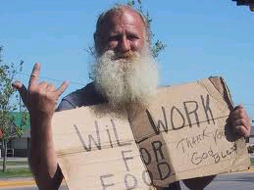
Money is Like a Seed Where Will You Be When You Turn 80?
Poor
Earn $100
- Spend $101
₌₌₌₌₌₌₌₌₌₌₌₌₌₌₌₌₌₌₌₌₌₌
₌ In Debt ($100k’s)
Middle Class
Earn $100
- Spend $100
₌₌₌₌₌₌₌₌₌₌₌₌₌₌₌₌₌₌₌₌₌₌
Net Income = $0
Rich
Earn $10M
- Invest $9M
₌₌₌₌₌₌₌₌₌₌₌₌₌₌₌₌₌₌₌₌₌₌
= Spend $1M

Slide 8
Breakthrough Thought: Do Not Confuse Assets & Liabilities!
Assets: An asset puts money in your pocket
Liabilities: A liability takes money out of your pocket
Net Worth: The difference between Assets and Liabilities
“If you want to be rich, accounting could be the most important subject you should learn.”
– Robert Kiyosaki

Slide 9
What is a Balance Sheet?
Assets
Liabilities
Equity
“If you want to be rich, simply spend your life buying assets. If you want to be poor or middle class, spend your life buying liabilities. Its not knowing the difference that causes most of the financial struggle.”
– Robert Kiyosaki

Slide 10
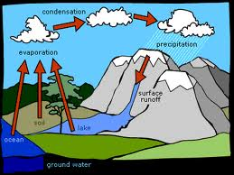
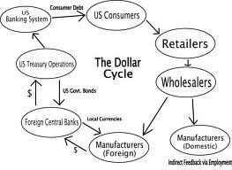
Money Makes the World Go Around
“To get the maximum benefit out of money, what we need to do is to create mental cash flow patterns that will guide your thoughts so that your money will flow in the direction that you want it to go.”
– Alex Barron

Slide 11
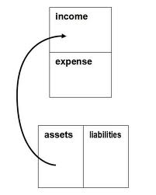
Cash Flow Pattern of an Asset
Why the rich get richer

Slide 12
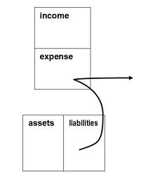
Cash Flow Pattern of a Liability
Why the poor get poorer

Slide 13
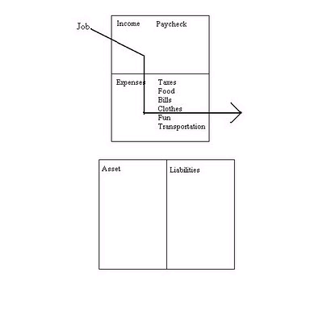
Cash Flow Pattern of the Poor
Money burns in their pocket. Money is spent to survive.

Slide 14
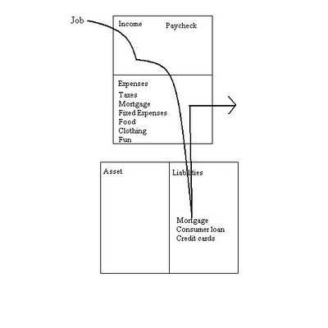
Cash Flow Pattern of Middle Class
Living Paycheck to Paycheck – Caught in the Rat Race. Money is spent to pay off liabilities.

Slide 15
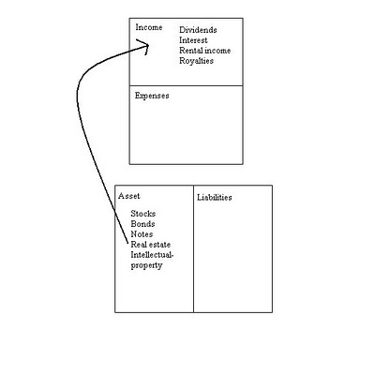
Cash Flow Pattern of the Rich
The rich buy assets. Money works for them.

Slide 16
The Cash Flow Tells the Story!
The cash flow is the story of how a person handles their money, what they do after they get the money in their hand.
More money will not solve your problems. Money only accentuates the cash flow pattern running in your head.
What is missing from education is not how to make money, but how to spend money. – what to do after you make it.
Financial aptitude is what you do with the money once you make it, how to keep people from taking it from you, how long you keep it, and how hard that money works for you.
Most people do not understand cash flow. A person can be highly educated, professionally successful, and financially illiterate!
– Robert Kiyosaki

Slide 17
Don’t Let the Power of Money Work Against You!
The poor and middle class all too often allow the power of money to control them. By simply getting up and working harder, failing to ask themselves if what they do makes sense, they shoot themselves in the foot as they leave to work every morning. By not fully understanding money, the vast majority of people allow the awesome power of money to control them. The power of money is used against them.
– Robert Kiyosaki

Slide 18
TRANSFORMATIONAL THOUGHT: What is the Goal of Financial Freedom?
The goal of financial freedom is to reach the point at which the income you make from your assets is greater than the expenses you require to maintain your lifestyle. So the goal of a financial freedom program is to acquire assets and build a portfolio of assets that will eventually enable you to earn enough to do what you want to do without having to work or worry about how you will make a living.
– Alex Barron

Slide 19
What’s in a Balance Sheet?
ASSETS
Cash, Gold
Stocks, Bonds
Real Estate
PURCHASES
House
Cars
Furniture
LIABILITIES
Mortgage
Car Loan
Credit Card Debt
Student Loans
Other Debt
EQUITY
= Net Worth

Slide 20
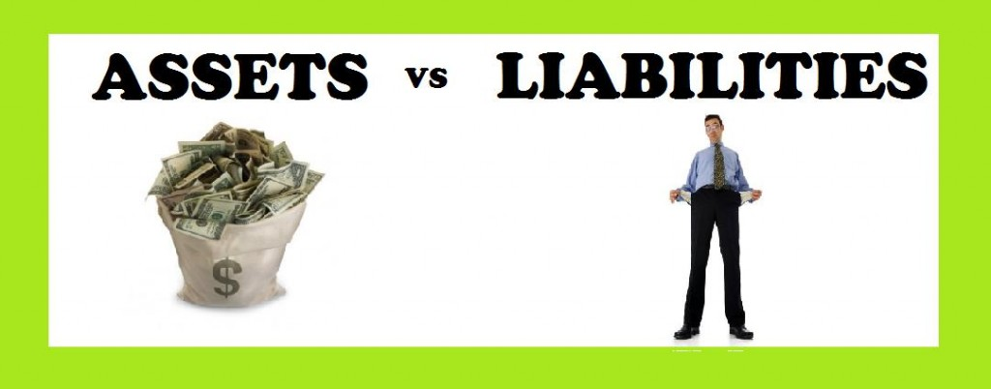
How to Determine Net Worth?
EQUITY = ASSETS + PURCHASES - LIABILITIES
NET WORTH = OWN - OWE
"Your Net Worth consists of what you own minus what you owe.“ – Paul J. Meyer

Slide 21
Balance Sheet for Most People
ASSETS
LIABILITIES
FINANCIAL ASSETS
Job
Checking Account $1,000
PURCHASES
Car $30,000
Home $160,000
============+=============
TOTAL ASSETS $191,000
“GOOD” LIABILITIES
Student Loan $50,000
“BAD” LIABILITIES
Credit Cards $20,000
Car Loan $40,000
Home Mortgage $155,000
===========================
TOTAL LIABILITIES $265,000
NET WORTH = ($74,000)

Slide 22
What’s in Your Intangible Balance Sheet?
Intangible Assets
Education
Work Ethic
Job
Business
Decisions
Opportunities
Reputation
Experience
LIABILITIES
Limiting Beliefs
Negative Attitudes
Fear, Worry, Dishonesty
Procrastination
Indecision
EQUITY
= People Blessed
+Goals Reached
+ Legacy = Destiny

Slide 23
Your Intangible Balance Sheet
“BE” ASSETS
Reliability
Honesty
Faithfulness
Punctuality
Persistence
Commitment
“BE” LIABILITIES
Unreliable
Dishonesty
Unfaithfulness
Always Late
Easily Give Up
Lack of Commitment
EQUITY
= ??

Slide 24
Your Intangible Balance Sheet
“BELIEVE” ASSETS
Money is a Tool
Stewardship Mentality
God’s Will is Prosperity
God Has a Purpose for My Life
“BELIEVE” LIABILITIES
Money is Evil
Ownership Mentality
Poverty is Humility
No idea of God’s Will for your Life
EQUITY
= ??

Slide 25
Your Intangible Balance Sheet
“THINK” ASSETS
Positive Mental Attitude (PMA)
Abundance Mentality
Positive Perspective = How You “See” the World
Recognize Opportunities
“THINK” LIABILITIES
Negative Mental Attitude
Scarcity Mentality
Fear, Worry, Doubt, Insecurity
Greed, Jealousy
Can Only “See” Limitations
EQUITY
= ??

Slide 26
Your Intangible Balance Sheet
“KNOW” ASSETS
Education
Knowledge
Information
Skills
Experience
“KNOW” LIABILITIES
Ignorance
Lack of Education
Lack of Know How
Lack of Desire to Learn
Lack of Experience
EQUITY
= ??

Slide 27
Your Intangible Balance Sheet
“DO” ASSETS
Opportunity
Decision Making
Action!
“DO” LIABILITIES
Procrastination
Indecision
Inaction
Analysis Paralysis
EQUITY
= ??

Slide 28
Your Intangible Balance Sheet
“PEOPLE” ASSETS
Family
Mentors
Clients
Co-Workers
Employees
Suppliers
“PEOPLE” LIABILITIES
“Small Minded” People
Negative People
Negative Influences
EQUITY
= ??

Slide 29
Your Intangible Balance Sheet
“HAVE” ASSETS
Job or Work
Business
Real Estate
Home
Cars
Insurance
“HAVE” LIABILITIES
Loans
Debt
Mortgage
Credit Cards
Leases
Taxes
EQUITY
= ??

Slide 30
Your Intangible Net Worth
“EARN” ASSETS
Name
Reputation
Track Record
Experience
Credit History
INTANGIBLE EQUITY
= People Benefitted
= Riches, Net Worth, Money
= Abundance, Blessings, Prosperity, Success, Freedom, Peace of Mind
= Estate, Inheritance, Legacy, Destiny

Slide 31
“Real” Balance Sheet - Bad
ASSETS
LIABILITIES
“INTANGIBLE” ASSETS
Hard Work Ethic
Honesty
Family
Health
Traditional Education
FINANCIAL ASSETS
Job
Checking Account $1,000
PURCHASES
Car $30,000
Home $200,000
===================================
TOTAL ASSETS $231,000
“INTANGIBLE” LIABILITIES
Victim Mentality, Comfort Zone
Bad Habits, Addictions, Wrong Friends
Fears, Doubts, Insecurity
Bad Attitudes, Character Flaws
“GOOD” LIABILITIES
Student Loans $80,000
“BAD” LIABILITIES
Credit Cards $20,000
Car Loan $40,000
Home Mortgage $195,000
====================================
TOTAL LIABILITIES $335,000
NET WORTH = ($104,000)

Slide 32
“Ideal” Balance Sheet - Good
ASSETS
LIABILITIES
“INTANGIBLE” ASSETS
YOU ARE YOUR BEST INVESTMENT!
Prosperity and Abundance Mindset
Positive Mental Attitude
Dreams, Vision, Purpose, Goals, Destiny, Direction in Life, Sense of Destiny
Work on Your Business
FINANCIAL ASSETS
Checking Account $100,000
Savings Account $100,000
“Your Own Bank” Policy $1,000,000
Your Own Business $1,000,000
Investments $1,000,000
Real Estate Investments $700,000
PURCHASES
Car $100,000
Home $1,000,000
=======================================
TOTAL ASSETS $5,000,000
“INTANGIBLE” LIABILITIES
“GOOD” LIABILITIES
Student Loans $0
Investment Loans $0
“BAD” LIABILITIES
Credit Cards $0
Car Loans $0
Home Mortgage $0
=========================================
TOTAL LIABILITIES $0
NET WORTH = $5,000,000

Slide 33
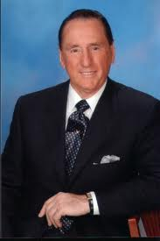
CONCLUSION: How Is Your Balance Sheet? What is Your Net Worth?

Slide 34
Questions? Thoughts?

