Slide 1
Preacher, Preparation,
Presentation
A class on making and preaching sermons
Session 29
Presenting
Your Sermon
Create
Vocal
Variety

Slide 5
Pace
Too Fast

Slide 6
sorrymyemaillookslikethisbutmycomputerfelloutofmyflightbagandmyspacebarbroke

Slide 7
Marian Rich—Voice teacher
Mark a paragraph
Read with breaks
Whisper
Go back and read at a good pace
150 words per minute

Slide 8
Those who talk too fast….

Slide 9
Pace
Too Fast
Too Slow

Slide 10
The human brain can process
words faster than we can speak them.

Slide 11
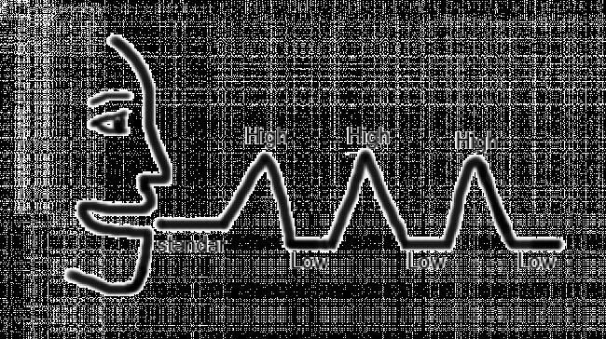
Pace
Pitch

Slide 12
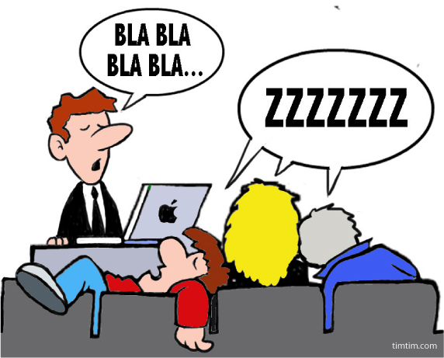
Pace
Pitch
Power (Volume)

Slide 13
Be Heard
- Minimize noise
- Minimize distance
- Reach the back
- Adapt

Slide 14
Be Heard
Be Effective
- Vary volume
- Emphasize key words
- Finish sentences strong
- Finish loud

Slide 15
I can do all things through Him who gives me strength.
-Philippians 4:13

Slide 16
Pace
Pitch
Power (Volume)
Pause

Slide 17
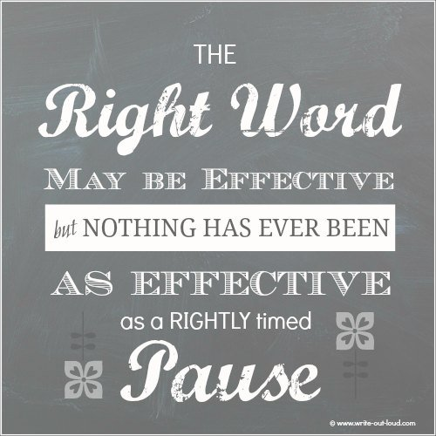

Slide 18
Pause to build suspense
Pause to allow reflection

