Slide 1
Preacher, Preparation,
Presentation
A class on making and preaching sermons
Session 23
Developing
A Sermon
Concluding
Effectively

Slide 2
Conclusion:
- The piece that
ties and applies

Slide 3
Sermon Intensity Graph
Conclusion
Introduction
Main Points

Slide 4
Conclusion Mistakes

Slide 5
Conclusion Mistakes
- Don’t plan it

Slide 6
Conclusion Mistakes
- Don’t plan it
- Don’t close the deal

Slide 7
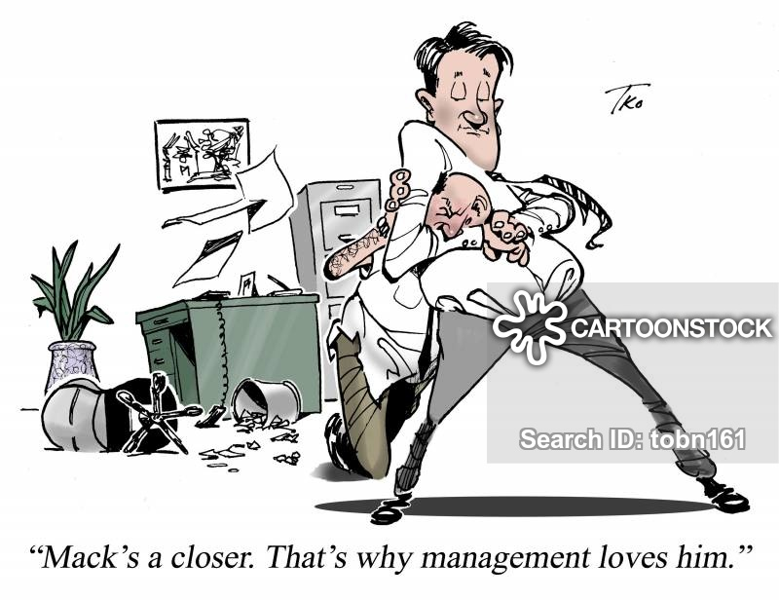

Slide 8
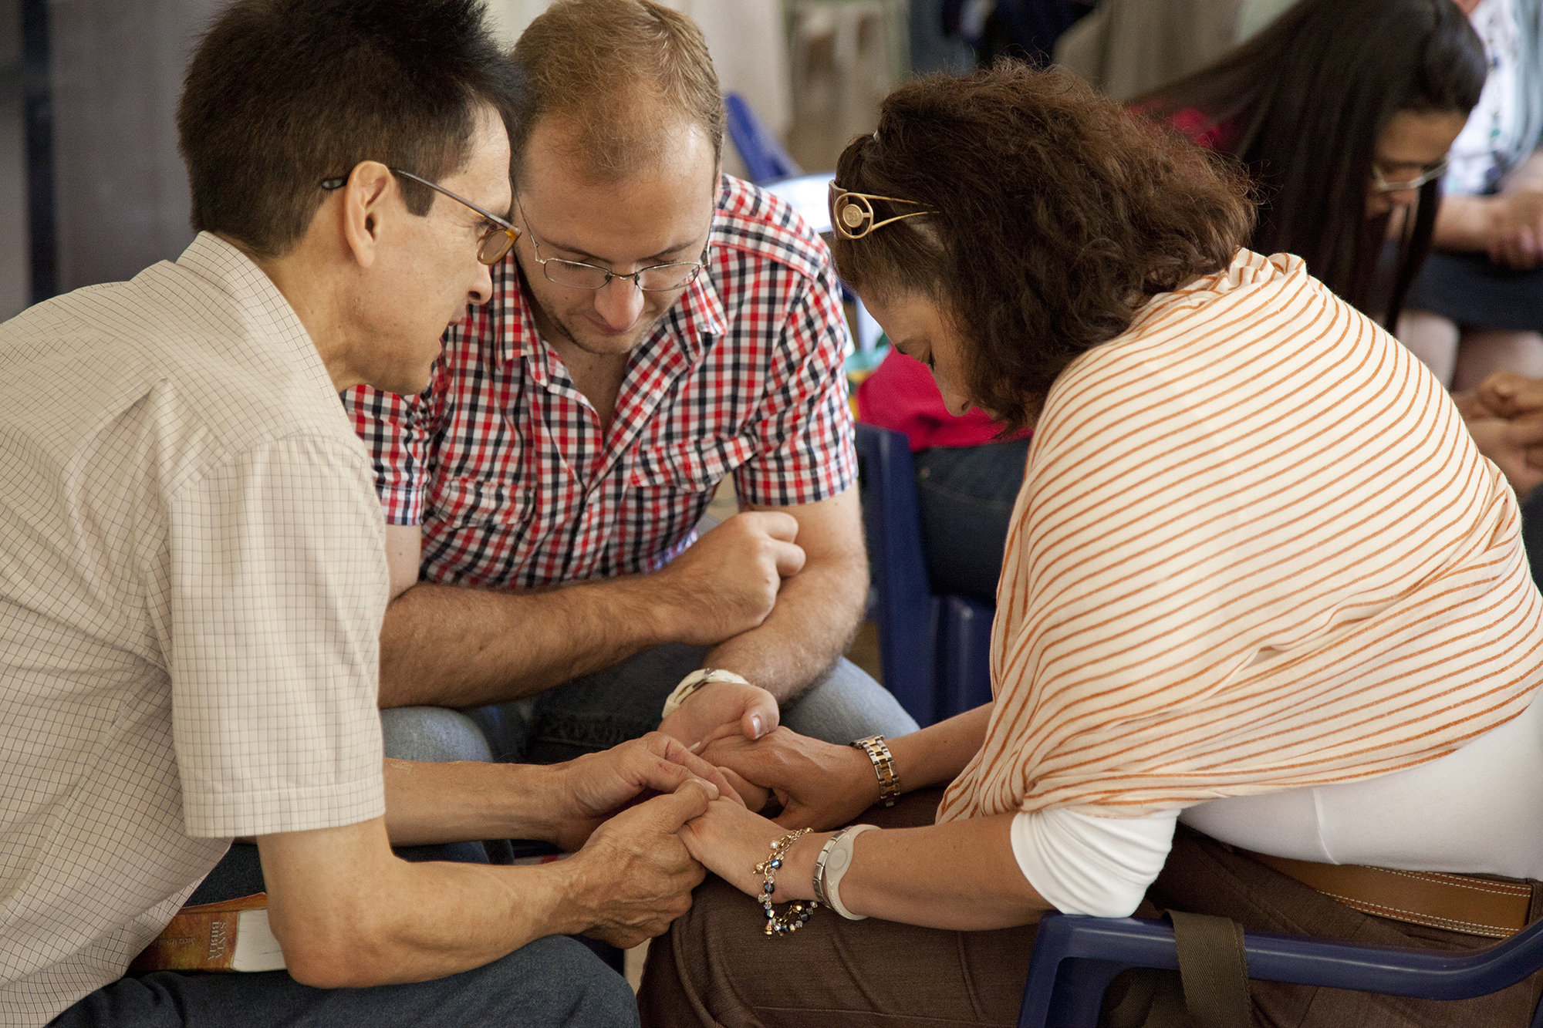

Slide 9
Conclusion Mistakes
- Don’t plan it
- Don’t close the deal
- Searching for a runway

Slide 11
Conclusion Mistakes
- Don’t plan it
- Don’t close the deal
- Searching for a runway
- Taking off again

Slide 12
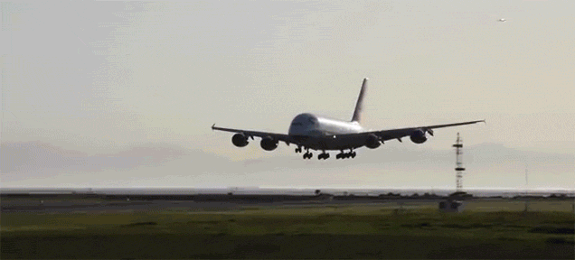

Slide 13
Conclusion Mistakes
- Don’t plan it
- Don’t close the deal
- Searching for a runway
- Taking off again
- The Discouraging Finish

Slide 14
Conclusion Mistakes
- Don’t plan it
- Don’t close the deal
- Searching for a runway
- Taking off again
- The Discouraging Finish
- Summarizing the whole
tell ‘em, tell ‘em, tell ‘em

Slide 15
Conclusion Mistakes
- Don’t plan it
- Don’t close the deal
- Searching for a runway
- Taking off again
- The Discouraging Finish
- Summarizing the whole
- “I’m out of time…”

Slide 16
Andy Stanley

Slide 17
Conclusion Mistakes
- Don’t plan it
- Don’t close the deal
- Searching for a runway
- Taking off again
- The Discouraging Finish
- Summarizing the whole
- “I’m out of time…”
- Left Field conclusion

Slide 19
Conclusion Mistakes
- Don’t plan it
- Don’t close the deal
- Searching for a runway
- Taking off again
- The Discouraging Finish
- Summarizing the whole
- “I’m out of time…”
- Left Field conclusion
- The Machine Gun Finish

Slide 20
