Slide 1
Major Conquests 1000-1500 A.D.
Norman
Turkish
Aztec
Inca
Mongol

Slide 2
Norman Invasion of England; 1066
READING ASSIGNMENT
https://en.wikipedia.org/wiki/Norman_conquest_of_England

Slide 3
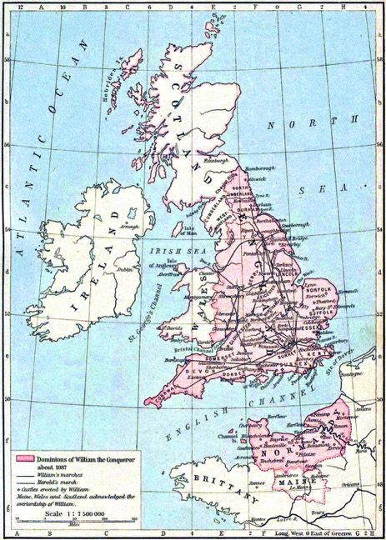
https://upload.wikimedia.org/wikipedia/commons/0/03/Williams_dominions_1087.jpg

Slide 4
William the Conqueror
Descendant of Rollo—Viking; Norsemen
Norman clan…subject to French King
Potential heir to English throne
Invades England Sept. 1066; Battle of Hastings,

Slide 5
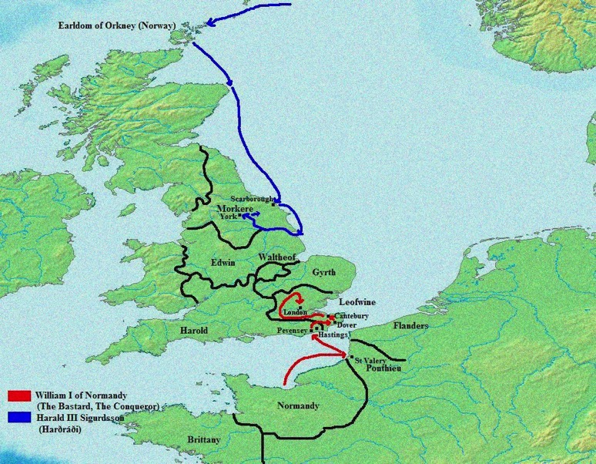
https://upload.wikimedia.org/wikipedia/commons/3/3c/England_1066.png

Slide 6
Transition from Anglo/Saxon to Norman Culture
Land to Norman owners in exchange for military duty and oaths of loyalty (Feudalism)
Doomsday Book-record of land ownership taxes owed…1086
Norman language (French/Norse); Latin officially
Retained basic English law structures (Common Law)
Church less in Nobles’ control; King and Pope

Slide 7
Longer term consequences:
Crusades—loyal to Pope and French King
Friction between French and English—next 800 years—major conflicts in Western Europe
Tied British to Europe…same history…with variations
Strong Papal influence in Britain for next 400 years

Slide 8
Turkish Invasion
READING ASSIGNMENT:
https://en.wikipedia.org/wiki/Byzantine%E2%80%93Seljuq_wars

Slide 9
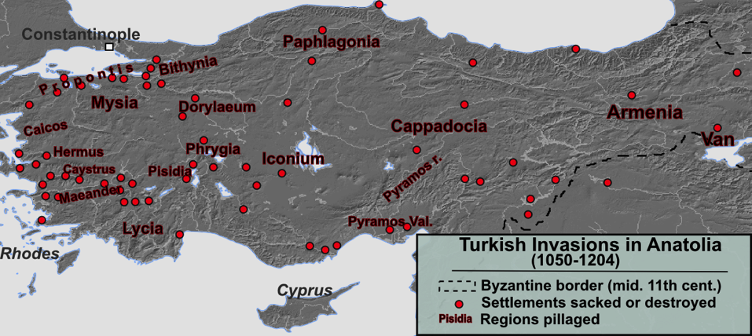
https://upload.wikimedia.org/wikipedia/commons/0/03/11_13th_century_Asia_Minor_Turkish_Invasions.png

Slide 10
Turkish Invasion
North Central Asian warriors enter Middle East around 900 A.D. Become Muslim; Early leader Seljuk (Seljuq)--
Overthrow Persia, establish kingdom by 1063 included all of Mesopotamia and Palestine
Expand north into Asia Minor: Constant conflict with Byzantium; 1071 Battle of Manzikert;

Slide 11
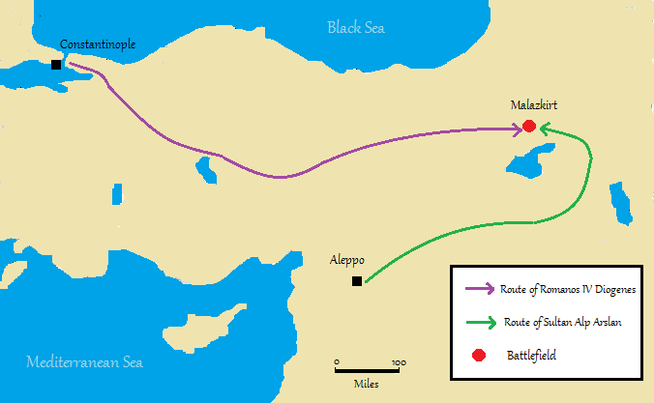
https://upload.wikimedia.org/wikipedia/commons/4/44/Malazkirt_Manzikert_battle_campaign_map_1071.png
https://upload.wikimedia.org/wikipedia/commons/4/44/Malazkirt_Manzikert_battle_campaign_map_1071.png

Slide 12
Early Turkish Importance
Reign lasted until early 1200’s; overcome by Mongols
Although basically religiously tolerant, threat that led Byzantium to ask for Western’s Europe’s help—Crusades ensued
Turned Asia Minor into “Turkey”, with language, Islam, culture

Slide 13
Ottoman Empire
READING ASSIGNMENT: First two sections: Rise of the Ottoman Empire (1299-1452) and Classical Age (1453-1550) found at https://en.wikipedia.org/wiki/History_of_the_Ottoman_Empire

Slide 14
Turkish rule in Asia Minor interrupted by Mongols for 100 years, but after 1300 back in hands of Turks
At first mostly about fighting against Byzantium and raiding into Europe
By 1400, control of most of Asia Minor and Balkans, victories against Venetians/Crusaders at Battles of Kosovo( 1389) and Nicopolis (1396). Following time of decline, return to conquest and expansion into Europe as far as Hungary in 1430s-1450s;

Slide 15
Constantinople to Istanbul
1453, Ottoman finally took control of Constantinople; renamed Istanbul, effective end of Byzantine Empire.
Next 100 years great expansion, especially with navel power in Mediterranean.
Religious tolerance; welcomed especially Jewish refugees from Spain; taxes and soldiers.
16th Cent allied with France, etc. against Holy Roman Empire

Slide 16
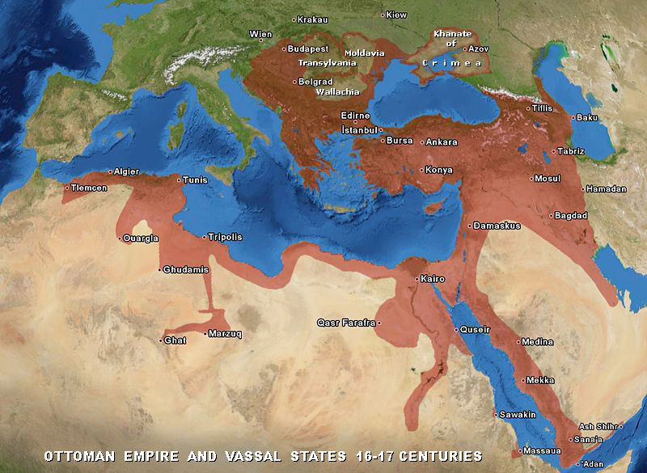
https://upload.wikimedia.org/wikipedia/commons/e/ed/Ottoman_Empire_16-17th_century.jpg

Slide 17
Implications for 1300-1500
Control of trade routes, both silk road and spice routes (land and sea), between India, S.E. Asia, China and Europe; need for European exploration—DeGama, Columbus, Magellan
Spread of Islam into Balkans and eastern Europe
Imperial rival of Holy Roman Empire and Italian City States
Instilled fear into Europe--Reformation

Slide 18
Aztec Empire
Beginning around 1200, northern migratory tribes enter grand basin around today’s Mexico City. Last group, the Mexica, entered around 1250
Next few generations gained control of major city-states in basin: Mexico-Tenochtitlan, Texcoco, and Tlacopan. Tenochtitlan dominates.

Slide 19
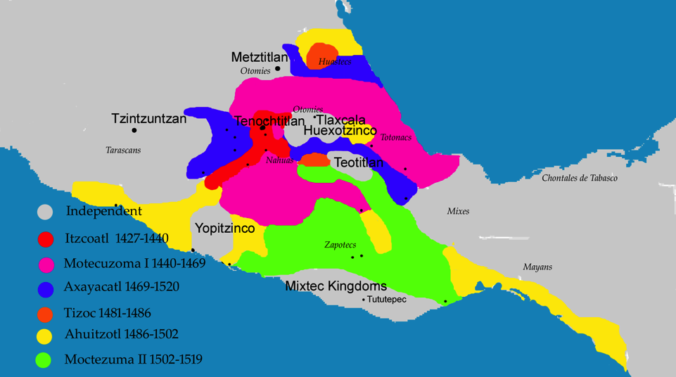
https://upload.wikimedia.org/wikipedia/commons/thumb/0/04/Aztecexpansion.png/450px-Aztecexpansion.png
https://upload.wikimedia.org/wikipedia/commons/thumb/0/04/Aztecexpansion.png/450px-Aztecexpansion.png

Slide 20
Aztec Expansion
By 1450 secured most of Mexcio Basin and control economy and religion.
Warfare constant, with captured people regularly sacrificed to gods of war.
Trade with other cultures central to life—from Southwest North America to Costa Rica—linked Meso America pre-Spanish Conquest in 1519; Mexica as name for land

Slide 21
“The Aztecs left rulers of conquered cities in power so long as they agreed to pay semi-annual tribute to the Alliance, as well as supply military forces when needed for the Aztec war efforts. In return, the imperial authority offered protection and political stability, and facilitated an integrated economic network of diverse lands and peoples who had significant local autonomy.”
https://en.wikipedia.org/wiki/Aztec_Empire

Slide 22
Inca Empire
Reading assignment: Mark Cartwright article in Inca Civilization found at https://www.ancient.eu/Inca_Civilization/

Slide 23
Inca Empire
Around 1438, tribal group speaking the Quechua language expand control over others. Next 120 years, largest empire in Americas; spanning over 3800 miles north to south—lasted until 1530s—Spanish and smallpox overcame
Inca—ruling class—capital in Cusco;
Around 1450 royal estate/religious center in Machu Picchu.

Slide 24
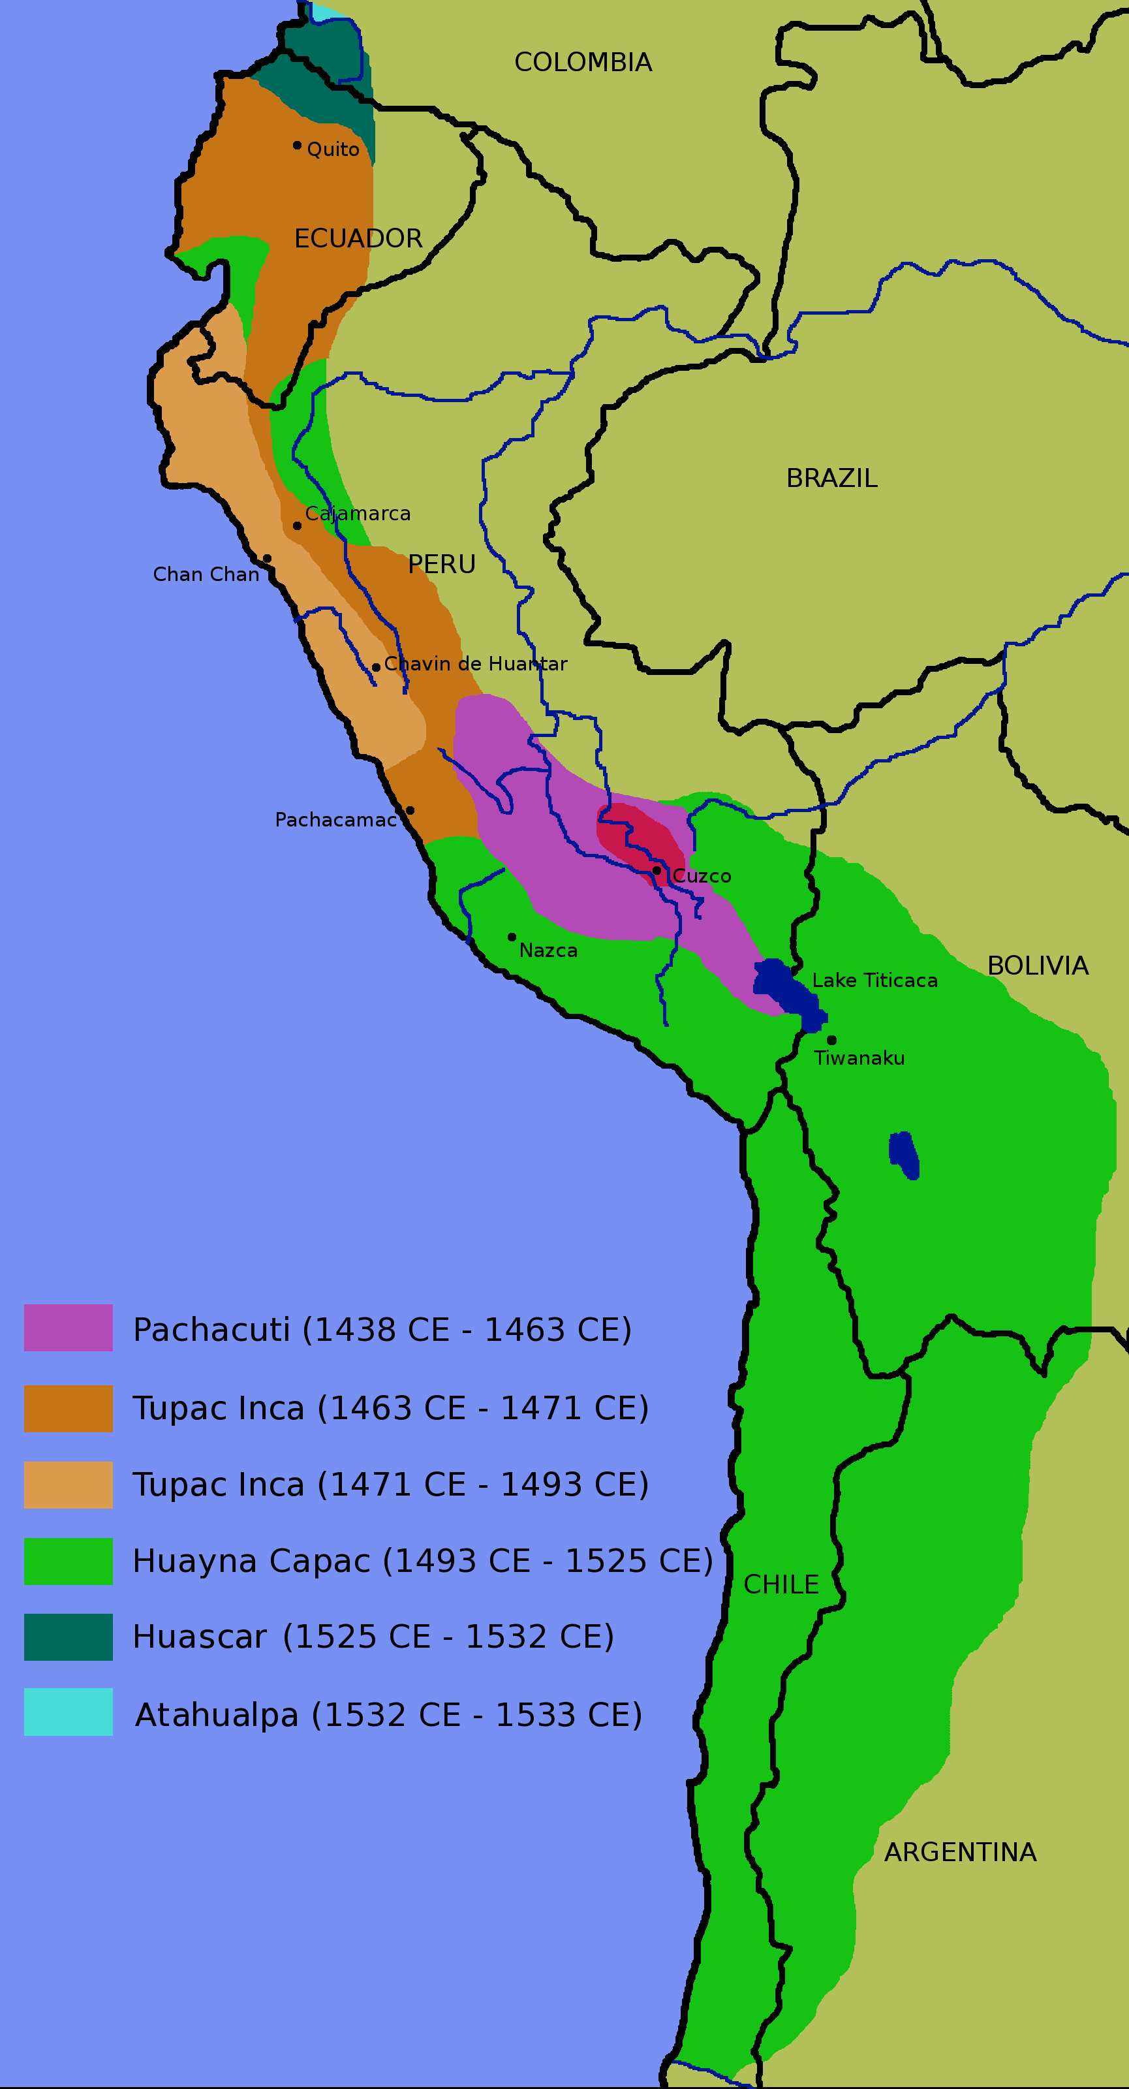
Inca Empire
https://upload.wikimedia.org/wikipedia/commons/3/34/Inca-expansion.png

Slide 25
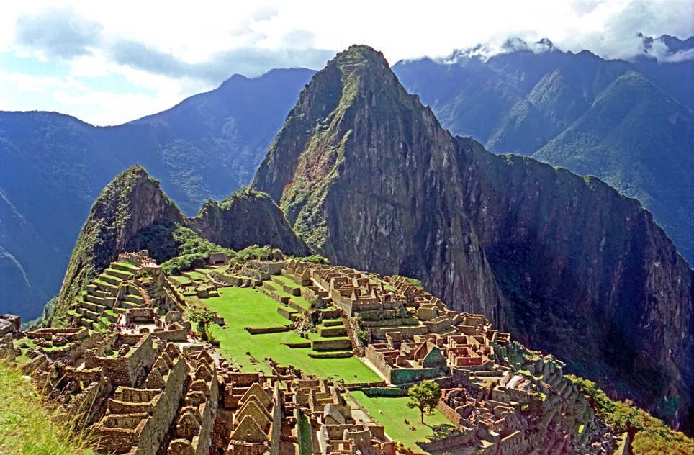
https://c1.staticflickr.com/3/2196/2217911855_72003f2b27_b.jpg

Slide 26
Inca Empire
Consolidation of west coast of South America; Spanish came, one empire to conquer.
Consolidation of wealth in hands of nobility

Slide 27
Mongol Conquest
Reading Assignment: Mongol Invasion and Conquests at
https://en.wikipedia.org/wiki/Mongol_Empire

